Slide 1
Applying to Edinburgh College SCP and Foundation apprenticeships
Cara Davidson –Boroughmuir High School
Notes:
cara

Slide 2
Aim of this session:
Prepare students for applying to SCP courses or Foundation apprenticeships at college
Understand the process
Improving confidence on how to pick a course
How to write a personal statement

Slide 3
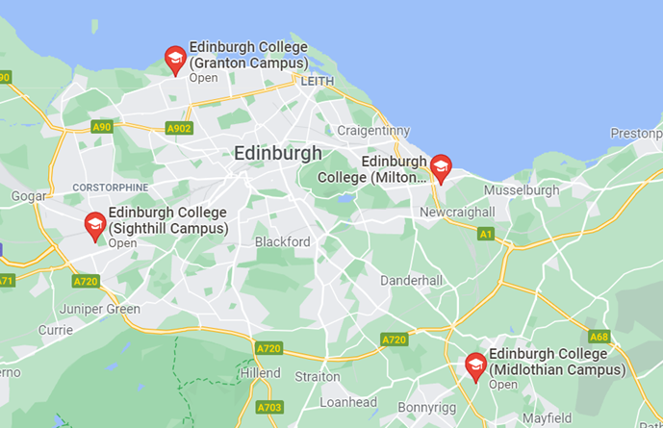
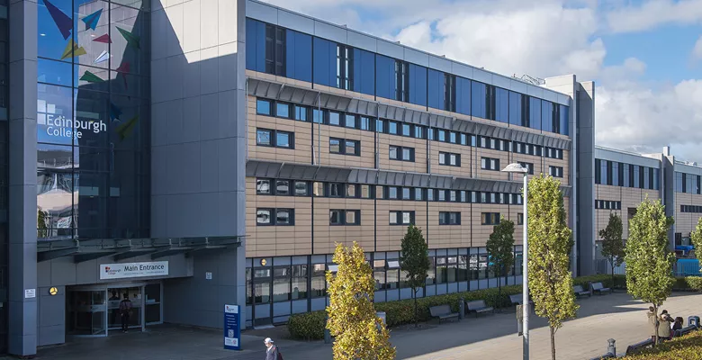
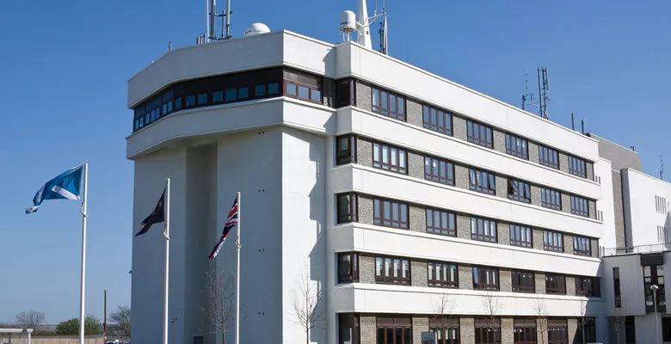
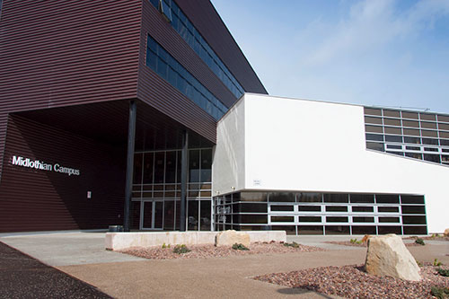
GRANTON CAMPUS
The Apprentice Restaurant,
Art and Design studios
Construction Centre
Dental Nursing facilities
Hair, Barbering, Beauty and Complementary Therapies salons
Performing Arts Studio Scotland (PASS)
Edinburgh College
MILTON RD CAMPUS
Broadcast Media facilities
The Club
CRE:8
Eh15 Restaurant
Hair, Barbering, Beauty and Complementary Therapies salons
Music and Sound Production studios
The Club Gym and Spa
MIDLOTHIAN CAMPUS
Automotive Engineering workshops
Childhood Practice and SVQ Provision
MacTaggart Scott Hydraulics, Pneumatics and PLC Laboratory
Oil Production Platform Simulator
Solar Meadow
Specialist Instrumentation and Control engineering workshops
SIGHTHILL CAMPUS
Broadcast Media and Photography studios
Centre for Sport and Exercise
Community Garden
Science laboratories
The Music Box
Remember you will be travelling from school to the college during lunch –most pupils tend to pick courses at Sighthill or Granton campus

Slide 4
Application Process
Course Selection
Courses open Tuesday the 14th of January. Remember you need to apply to the college for your chosen course (not just put it in your school choice)
Once submitted you will receive an email confirmation
Some courses require a written task or assignment before an offer can be made. Look out for an email with further instructions as this could hold back your application if you miss it
Unconditional – means you have been accepted and have a guaranteed place on your course
Conditional – means you must achieve further qualifications to meet certain criteria before you are accepted on the course, or need to complete a task. The conditions you will need to be will be listed in your conditional offer email
Application
Offer
Unsuccessful – Unfortunately you have not been accepted on to the course
Speak to your Careers adviser if you are unsure what you would like to study or want more info on what SCP or foundation apprenticeship courses there are

Slide 5
Key points
Applications open the 14th of January and applications will be open for around 6 weeks
You can apply for more one than one course but you will eventually have to choose as they all run at the same time
Note that some courses are just open for S6 pupils and foundation apprenticeships are for those going into S5
SCP or foundation apprenticeship courses count as one of your school subjects
You will go to college two afternoons per week –normally on a Tuesday and Thursday
Remember to check your emails and confirm your acceptance of the course.
Normally the Construction SCP course is the most competitive –the college are approaching this differently and allocating places based on locality –more info to come on this
Applications will stay open for 6 weeks –do not leave it to the last minute to apply!
Notes:
Silvia

Slide 6
Schools College Partnership (SCP) offers a wide range of part-time college courses for S4-S6 pupils and provides greater choice in a variety of subjects which may not be available at school e.g. criminology or costume design. SCP courses count as one of your column choices which can be added into your existing timetable. Pupils study their college course on two afternoons per week. Foundation Apprenticeships (FAs) are work-based qualifications for S5 secondary school pupils in industry sectors of key growth. It’s a qualification that takes you out of the classroom and gives you a chance to try out a career while you are still at school. You can choose a Foundation Apprenticeship as one of your subjects in S5 and takes two years to complete, it’s the same level of learning as a Higher (SCQF Level 6) and is accepted by college and all Scottish Universities as Higher equivalent. This is a will put you at an advantage if you plan on applying to do a Graduate Apprenticeship when you leave. More information can be found at https://www.apprenticeships.scot/become-an-apprentice/foundation-apprenticeships/ & https://www.apprenticeships.scot/become-an-apprentice/graduate-apprenticeships
What is a Foundation apprenticeship and what type of courses are offered as part of the school college partnership?
Notes:
Cara

Slide 7
Check qualification level
Not all college courses are ‘Highers’, some are units or NPA’s.
This is important to know, as it can affect your university entry requirements
Foundation Apprenticeship (level 6) is a equivalent to a Higher Grade B but it takes two years to complete. You must be going into S5 to be eligible.
An NPA is not classed as a higher for university but is very helpful for getting a place at college

Slide 8
Foundation Apprenticeships – where can they take me?
Doing a foundation apprenticeship can lead to direct access to a range of full time college courses
It is also useful if you plan to do a modern or graduate apprenticeship after leaving school
It can help with university applications as it counts as a higher and gives you skills and experience you can talk about in your personal statement
Notes:
Cara

Slide 9
How to apply
1. Follow this link to browse the courses on offer
(make sure the date is August 2025 as the college still have some courses with last year’s date on the website!)
Notes:
cara

Slide 10
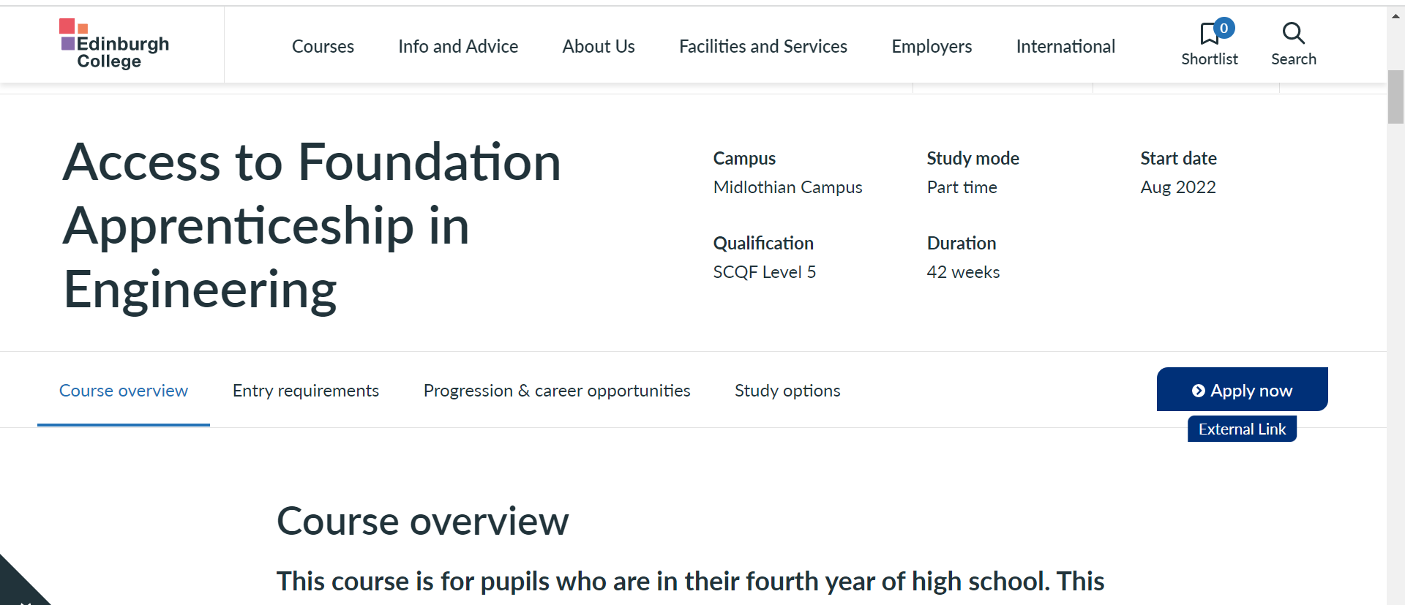
How to apply
Click apply now button
Notes:
cara

Slide 11
Application Step by Step
Click new user
Notes:
ccara

Slide 12
Application Step by Step
Fill in all the registration questions and click register at the bottom of the page
Notes:
cara

Slide 13
Application Step by Step
Click the edit button and this will take you to your application

Slide 14
Application Step by Step
You are now ready to start your application
Fill out all the sections
In the qualifications section it normally just asks you to enter your Scottish candidate number
And they then use this to see any qualifications you have or are studying
See the following slides for advice on the personal statement
When you are ready click submit!

Slide 15
Personal Statement
Why this course?
Anything in particular you are excited to study (check modules)
Career Aspirations
What are your goals
How can this course help you achieve this
Relevant Experience
Do you have any work experience,volunteering part time jobs?
How do your school subjects relate? What skills have they given you?
looking to the future
Where do you hope to go following this course? Don’t worry if you are not sure yet –you can just talk about looking forward to learning in a new environment etc
How will this FA or SCP course be useful to you?
Any key skills and strengths you have that would make you a suitable candidate
What skills do you have that relates to the course

Slide 16
Example Personal Statement
My passion for studying history has developed from my interest in exploring how the past can allow for greater understanding of society in the present. Many of the subjects I studied in school, as well as my current college course within social science have allowed me to look at past historical events and think about how these relate to modern societal issues. I have always had an interest in my own family’s past. My grandad fought in the Second World War and I found it fascinating to learn about his role and what life was like back then. This is what started my enthusiasm for studying World War Two and this interest has stayed with me throughout my life. I am passionate about Scottish history but would also value the chance to study history and explore its relation to politics and culture around the world.
My school studies have also helped prepare me for further study. Studying Higher history, RMPS and modern studies has allowed me to develop skills in essay writing, working within a group and improved my skills in delivering presentations. Additionally, these subjects have given me skills in exploring different societal issues through research and critical analysis.
My work experience through school allowed me to improve upon my general employability skills and has given me an insight into the world of work. I received an excellent report as the teacher felt I had good communication skills and was a good role model.
In my spare time I enjoy continuously learning and have taken part in school trips outside of school, including with my RMPS class to a Buddhist monastery. This gave me insight into the life of a Buddhist monk and how they eat, practice their religion and live daily. I feel that I am an inquisitive person and therefore enjoy finding out about different religions and ways of living.
My previous studies within both school and college have allowed me to explore various social subjects and led me to focus on history. I feel that studying history would allow me to challenge myself in new ways and I would value the opportunity to see where studying history could take me in the future.

Slide 17
Next Steps
You can watch this video from the college
Contact your school careers adviser if you would like your personal statement checked or need further help
Make sure to get your application within 6 weeks of the application open date
Notes:
Caras

Slide 18
FAQS
When will I hear back? Applications stay open for approx 6 weeks , after this you may receive an offer or a task to complete straight away or again it may take a few weeks. Keep an eye on your emails!
General help:
Please e-mail schools@edinburghcollege.ac.uk with your request.
SCP Helpline number :
0131 297 8649
What happens if I do not meet my conditions: If you do not meet your conditions it may be worth calling the helpline as sometimes you can still get a place or may be offered a place on another course
What happens if I change my mind and don’t want to go to college: its ok to change your mind! You can just contact the college using the number or email above and let them know
Notes:
Caras

Slide 19
College Application Support
I will be offering an SCP application support session on Monday the 27th of January periods 5 and 6 in the assembly hall
My email if you require further support is : cara.davidson@sds.co.uk
Notes:
Cara

