Slide 1
To ensure a confident, nurturing and inclusive learning community where all achieve their true potential and embrace life’s challenges.

Slide 2
Our aims this year:
Qualifications
Wellbeing
Leadership

Slide 3
Ms Fraser Headteacher
Mr Hayes Depute Head Teacher S4/5
Cara Davidson Careers
Alan Binnie Edinburgh College
Mr Brandie Viewforth
Ms Grant Hartington
Ms Nisbet Leamington
Mr McIlwaine Montpelier
Ms Scherzer Bruntsfield
Ms Wallace Westhall
Boroughmuir High School
Course Choice Information 2025-6

Slide 4
Our plan for the year: S4 Important dates
Tues 20th August Parent information evening ‘how to help’, plan a routine together
End September Tracking report, families discuss progress, plan next steps
1st-15th Nov Prelims
9th Dec Progress report, students make ‘success plan’, discuss with families
14th January Parent consultations, plan next steps with teachers
23rd January Course choice presentation, deadline soon after, plan for next year
February Students produce revision plan, families help
April: SQA exams start, study leave, immersion days
May leavers event
End June work experience
August: results day

Slide 5
Our plan for the year: S5 Important dates
4th 5th June Induction days: Humanutopia and Leadership
24th June Work experience
Tues 20th August Parent information evening ‘how to help’, plan a routine together
End September Tracking report, families discuss progress, plan next steps
20th / 28th Nov Parent consultations, plan next steps with teachers
10-24th January Prelims
23rd January Course choice presentation, deadline soon after, plan for next year
24th Feb Progress report, students make ‘success plan’, discuss with families
February Students produce revision plan, families help
April: SQA exams start, study leave, immersion days
May leavers event
August: results day

Slide 6
What must I do now?
Speak to guidance teacher (especially if thinking of leaving to get support from us and Skills Development Scotland (SDS)
Research options / Speak to Careers advisers
School course choice done with guidance teacher from 13th January to 21st February
You apply to college by 10th March – students come to workshop on Monday 20th / Monday 27th January

Slide 7
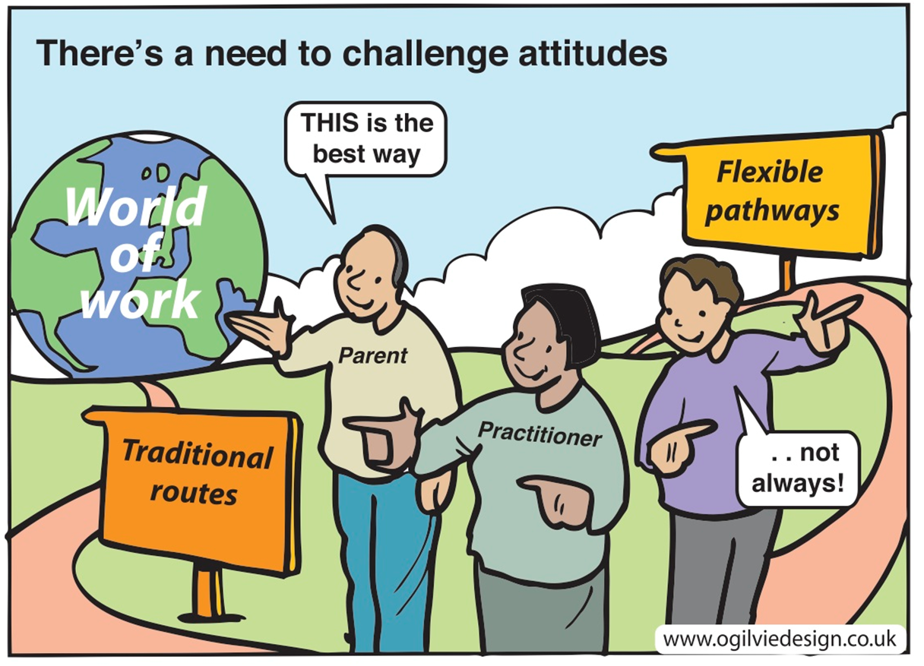
Choose the best for you…

Slide 8
How to navigate the Scottish curriculum
Very flexible in 4 ways:
WHEN x3 chances S4, S5, S6
WHERE school, college, partnerships
CHOICE 30 + subject options
CHALLENGE levels National 3, National 4, National 5, Level 6 Highers, Level 6 NPAs…, Level 7s…
Take sensible steps forward
Do what’s right for you, not for others
Think of goals, but be open to change as you go

Slide 9
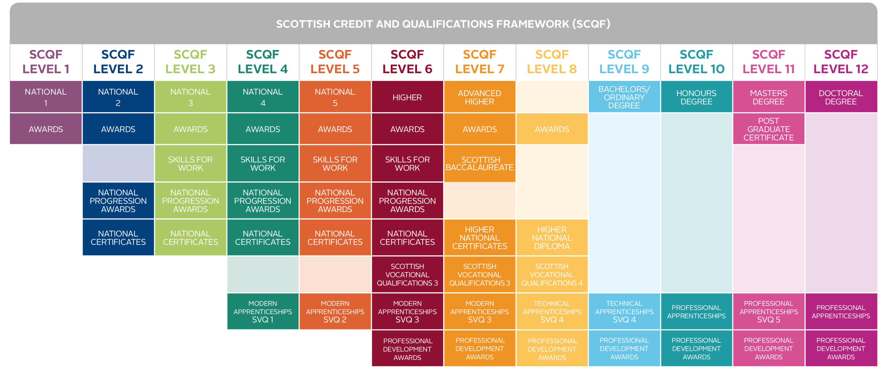
Increasing challenge
Level 3 | Level 4 | Level 5 | Level 6 | Level 7
Standard Grade Foundation/ Access 3 | Standard Grade General/ Intermediate 1 | Ordinary (‘O’) Grade/ Standard Grade Credit/ Intermediate 2 | Higher | Certificate in Sixth Year Studies (CSYS)/ A-Level

Slide 10
One Route (less than half)
Higher/ Advanced Higher
Employment
National 4
National 5
University

Slide 11
Many other routes
Graduate Apprenticeship
Foundation Apprenticeship
Modern Apprenticeship
Employment
Nat 4
NPA SFW
Nat 5
NPA SFW
Higher
NPA SFW FA
University
HND
HNC
1/3 take this route to Edinburgh universities
NC
School College Partnership
Full-time College
Notes:
College offers a number of vocational pathways to prepare young people for the workplace.
Whereas before you would see National 4s, 5s Highers and Advanced Highers what you will also see are new work based learning qualifications which are recognised by industry and have the same equivalence in SCQF points. The main difference is these qualifications are assessment based and have no exams
College also recognised routes to University and if not your fist choice, can be a very good back up if things don’t go to plan.

Slide 12
Different routes (for example Maths)
Finance
Sound Engineering
Computer Science
STEM
Medicine
Economics
Computer Science
Investment Analysis
Engineering
Astronomy
Physics...
AH
Mechanics
AH
Maths
AH
Statistics
Law
Business
Architecture
Project Management
(Medicine)
Higher
Maths
HIGHER
Applications of Maths
NAT 5
Maths
NAT 5
Applications of Maths
NAT 4
Maths
NAT 4
Applications of Maths

Slide 13
What are the options?
Leave school: job (if 16 by September)
Leave school: apprenticeship, college
Part school, part college (School-College-Partnership)
School in S5, leave in S6
School in S5 and S6
Notes:
There are special courses at college and JET (Jobs Education and training) offere extended supported work placements for pupils who realy feel school is not for them but aren’t old enough to leave by May 2016

Slide 14
What are the options? Apprenticeships
Opportunities Board (theguarantee.org)
Notes:
Tax apprentice- need Highers
Customer Service specialist – need N5s

Slide 15
What are the options? College
Full Time
Or
School / College Partnership
Period 5 & 6 on Tuesday + Thursday at college, Period 1 Monday in school
Check where course is taking place – can you get there? Bus tokens provided
Good way of getting experience of college before leaving school
Highers/Nat 5/Foundation Apprenticeships
Must apply for College courses in February- August is too late – CHECK ENTRY REQUIREMENTS!!
Must apply online at www.edinburghcollege.ac.uk/Schools/ by 12th March
make back up choice for school
Notes:
Courses in High Demand
Courses in high demand will have an application window of 23rd January to 12th March, these are :
Skills for Work Engineering Nat 5
Intro to Motor Industry: Paint & Body
Intro to Motor Industry: Light Vehicle
NPA 6 Criminology (Legal)
VTCT Level 1/2 Extended Certificate in Hair and Beauty Skills
NPA Professional Cookery
Not open for application on the web site
NPA 4 construction will recruit with a restricted link via schools or The Local Authority as appropriate. The LA will be in touch with more details on this after the February break.
NPA5 Construction is a progression pathway for previous NPA 4 students and will not open for applications.

Slide 16
What are the options? Might University be for me?
Some young people want to go to university, or to keep their options open to go later.
College route
1/3 of all Edinburgh universities students come from Edinburgh college
School route
Take Highers and Advanced Highers at school
Notes:
Tax apprentice- need Highers
Customer Service specialist – need N5s

Slide 17
Pupils should do some research to help with future planning/goals
Useful websites to help are…
For Career options: www.myworldofwork.co.uk
College: For School Pupils | Edinburgh College
Apprenticeships:
https://www.apprenticeships.scot/
Opportunities Board (theguarantee.org)
University
https://digital.ucas.com/search
www.UCAS.com
www.discoveruni.org.uk
Notes:
Universities and Colleges Admissions Service in the UK
MWOW – created by SDS. Make a plan – 2 year plan if going to uni. Need to do research. Some people will know what they want to do but others will not – getting an idea of jobs that are available and what skills employers are looking for is a key area to ensuring success. The websites here can all help with research and planning.
It is important that young people have a plan for S5. Some young people will have known what they’ve wanted to be since they were 5 others will still be wondering. Important that you know what you need to have in terms of grades, types of qualifications and work experience to achieve your goal. Helps focus the mind for S5 or S5/6. Guidance teachers have shown you the my world of work website. Variety of toolls to use if you are unsure of what to do.
Information on jobs, how to get into the role, what it is about, average salary, what qualifications employers may be looking for.
Put in your skills and find out what jobs suit. Put in a job you fancy and find out more about it.strengths test.
Uk course finder – university courses, also European courses
UCAS – has a course finder where you can search by course or by institution to find out what you need to get into different unis
Play to your strengths
Be familiar about entry requirements
www.myworldofwork.co.uk
‘My strengths’
Info on subject choice
Info on jobs/College/University
Parent Zone
Every pupil: Plan A and Plan B
Pathways to the professions -

Slide 18
Edinburgh College SCP and Post School Options Edinburgh Schools and Young People

Slide 19
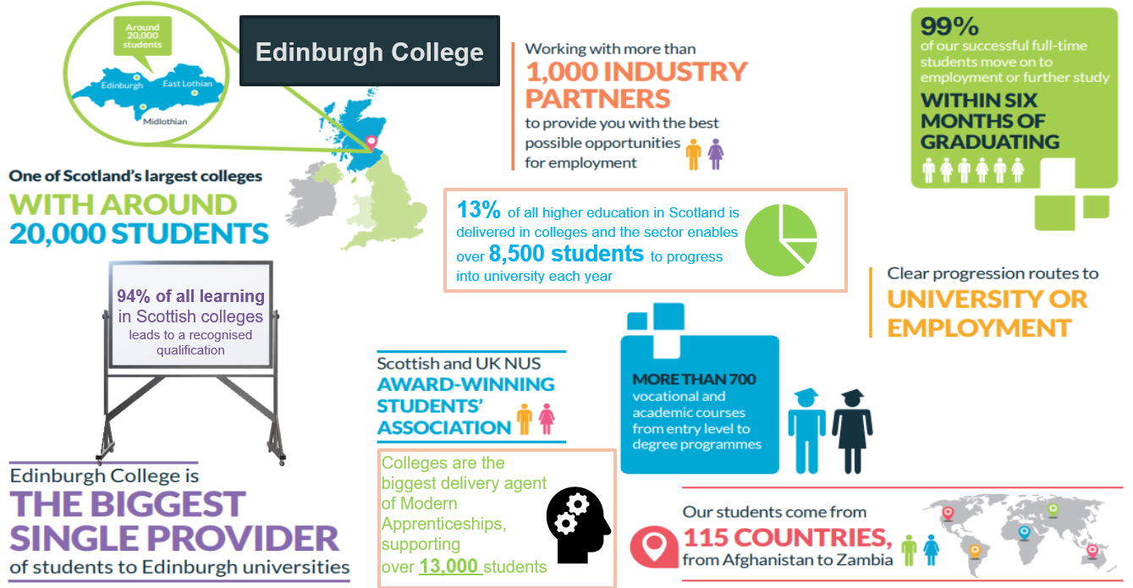

Slide 20
School College Partnership
Enables S4-S6 students to gain a qualification at college whilst still at school
Students attend college on a part-time basis, usually two afternoons a week
Over 60 courses from 16 curriculum areas
Course level ranges from SCQF level 1/2 to SCQF level 7 (Advanced Higher)

Slide 21
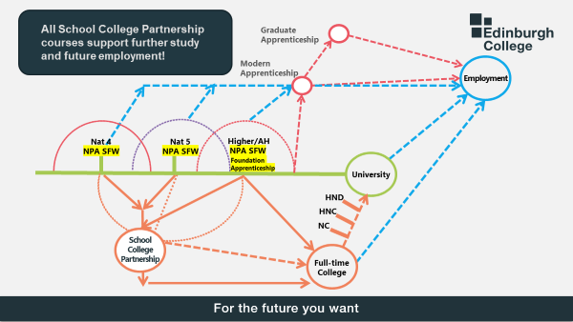
Graduate
Apprenticeship
Modern
Apprenticeship
NPA
SFW
Foundation Apprenticeship
Employment
NPA
SFW
NPA
SFW
National 4
Higher/Advanced Higher
National 5
University
HND
HNC
NC
College

Slide 22
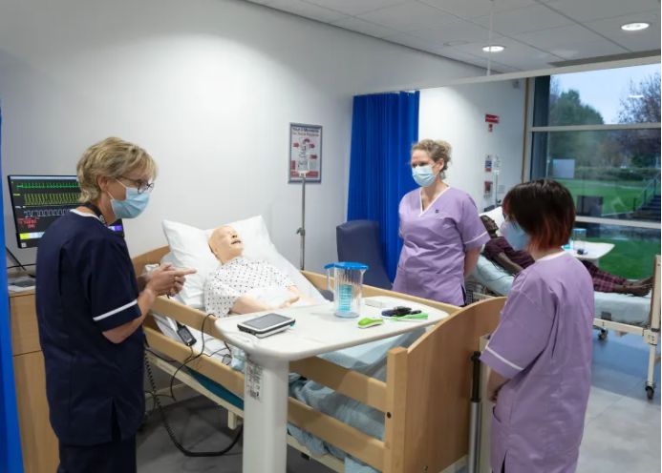
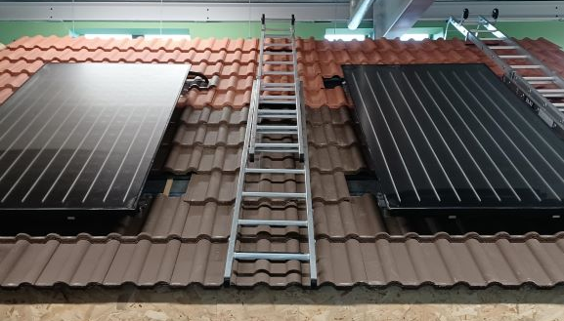
Post-school Curriculum Areas
Creative Industries
Broadcast Media & Film | Music & Sound Production | Art & Design | Computing | Performing Arts Studio Scotland (PASS)
Construction, Engineering, Built Environment & Science
Construction Trades | Electrical & Mechanical Engineering | Civil Engineering | Automotive | Renewables | Building Services | Plumbing | Electrical| Fire & Security
Health Professions & Social Care
Health Care | Social Care | Dental | Pharmacy | Childcare | Sport & Fitness | Integrated Curriculum Studies
Tourism Hospitality & Business
Enterprise & Commerce | Professional Cookery | Hospitality
Retail & Events | ESOL | Tourism & Modern Languages

Slide 23
Associate Student Degrees
Formal agreement between College & University
Students dual enrolled at both institutions
Complete HNC (year 1 at College)
Complete HND (year 2 at College)
Guaranteed University Progression to year 3 of degree course

Slide 24
Bachelor (Hons) Degrees at Edinburgh College
Accredited two-year Bachelor degrees with honours.
In areas such as: Sport and Fitness, Music, and Photography.
Entry requirements: Completion of an HND course or sufficient industry level experience.

Slide 25
For any Edinburgh College course-related info please visit edinburghcollege.ac.uk or email courseinfo@edinburghcollege.ac.uk

Slide 26
Cara Davidson (SDS): Available Support and Tips
Tips for Course choice
For College or University look up the entry requirements to the course you are interested in and check for essential subjects – eg: law requires Higher English; Nursing Higher English and 1 science
Think about other subjects that could be useful – these are not essential but may be helpful.
Apprenticeships and employment require basic Maths and English and depending on the type of apprenticeship they may ask for relevant subjects (work experience will also be really important) – have a look at Apprenticeship.scot to help research.
There is the option of SCP (School college partnership courses) and foundation apprenticeships –these offer options in unique areas such as costume, mechanics
Understand what the different qualifications mean - A foundation apprenticeship takes 2 years and counts as a Higher Grade B , An NPA is not counted as a higher for most universities
Notes:
Introduce Pathways Activity detailed in facilitators notes
This activity will highlight the various pathways beyond S4

Slide 27
Cara Davidson (SDS): Available Support and Tips
What help is available?
Pupils can book an appointment through emailing me or letting their guidance teacher know they would like an appointment. My email is: Cara.davidson@sds.co.uk
I will also be offering a SCP (college) application support session
On Monday the 27th of January periods 5 and 6 in the assembly hall.
Please note SCP applications have a 6 week application window and your young person should apply within this –it is important not to leave it until the last minute!
If they would like to attend this support session they can email me or speak with their guidance teacher so their name is added to my list
Notes:
Introduce Pathways Activity detailed in facilitators notes
This activity will highlight the various pathways beyond S4

Slide 28
Earn while you learn
Achieve industry qualifications
Range of levels from Higher level to under-graduate level
Entry requirements typically National 5/Higher attainment
Approx. 90 different frameworks available: IT, Care, Engineering, Paralegal, Sports, Hospitality, Creative Digital Media, Nursing, Jewellery, Project Management
Huge range of employers involved
Vacancies and more information at www.apprenticeships.scot

Slide 29
Graduate apprenticeships offer the chance to get a degree
Employed status, earn as you learn
Many Scottish universities involved
Growing list of frameworks, including: Data Security, Engineering, IT Management for Business, Software Development, Construction, Civil Engineering, etc
4 years
Vacancies and more information at www.apprenticeships.scot/graduate

Slide 30
What are the options? School
Full Time School OR School / College Partnership
You are choosing to join and lead our community:
Modelling our values: respect, equality…
Wearing school dress
Leadership: qualification, participating or leading wider activities
You are aiming for high standards:
Full set of qualifications (usually 5 in S5) + Leadership
Punctuality / Attendance
Deadlines / Homework
Notes:
Tax apprentice- need Highers
Customer Service specialist – need N5s

Slide 31
e.g. Higher English
Exam (70% of grade):
Paper 1 RUAE (30 marks)
Paper 2 Critical Reading - 1 Scottish textual
analysis (20 marks) + critical essay (20 marks)
Folio of Writing (30% of grade):
editing Discursive / persuasive piece
drafting first personal-reflective, or creative, piece
Spoken Language – continued assessment of four elements of Spoken Language Course Award, through solo and group talk. Must be passed by end of March to gain a course award
Notes:
Example of a higher course and demands. Number of units varies, MS has 3 plus a written assignment that’s worth 30 mars and an exam paper worth 70?
Spoken Language – Presentation: continued assessment of four elements of Spoken Language Course Award, through solo and group talk, asking and responding appropriately to questions. Must be passed by end of March to gain a course award.
Maths 2 exam papers non calculator and calculator worth 60 and 70 marks – no assignments but 3 units to complete.

Slide 32
Structure of the Senior School
28 period week
5 subjects (5 hours per week)
Column E / College – Tuesday / Thurs pm
Registration / Friday assembly for wellbeing
+ 3 periods:
Personal Social Education (PSE)
Leadership qualification
Study period (optional PE)
Notes:
Need more about activities??
8 subjects (x3 periods/wk)
5 subjects (x5 periods/wk)
Progression-avoid ‘crashing’
Play to strengths
Coursing levels – use these to guide you
Remember 2 years becomes a Workload- 2 term dash
Column E allows for SCP and neighbourhood if pupils cant get courses

Slide 33
What to consider when choosing subjects…
8 subjects → 5 subjects
(x3 periods/wk) (x5 periods/wk)
Play to strengths
Workload
Entry requirements give best chance to achieve
Take small steps to Highers (get N5 As & Bs first)
Progression - avoid ‘crashing’
https://www.sqa.org.uk/sqa/91419.html
Notes:
Progressions stats show that
Eg English – N5 Cs – around 70% don’t make it to a Higher pass, but Bs around 70% do. Advice is to re-take N5 if really want a Higher the following year.

Slide 34
Course choice booklet on Teams and website

Slide 35
Boroughmuir High School: S4,5,6 Curriculum & Courses 2025-26
S4 Curriculum National 3,4,5
S5 or S6
S6 only
Administration and IT
Art & Design
Biology
Business Management
Chemistry
Computing Science
Design & Manufacture
Drama
Economics
Engineering Science
English
French
Geography
German
Graphic Communication
Health & Food Technology
History
Mandarin
Maths - National 4 or 5
- Applications of Maths N4
Media Studies
Modern Studies
Music
Music Technology
Physical Education
Physics
Practical Cookery
Practical Woodwork
RMPS
Science
Spanish
College Courses
Level 5 or 6
Schools College Partnership (SCP)
Foundation Apprenticeships
Schools College Partnership (SCP)
Foundation Apprenticeship
National 5 or
Level 5 NPA
Apps of Maths
Maths
Art & Design
Business
Computing
Computer Games Development NPA
English
HFT
Hospitality NPA
Practical Cookery
Woodworking
Media Studies
Photography NPA
Physical Education
Sports Leadership NPA
S5 Core Curriculum Leadership
PSE and Assembly
PE / Study
S6 Advanced Higher (AH) Level 7
Art & Design
Biology
Business Management
Chemistry
Computing Science
Design & Manufacture
Drama
Engineering Science
English
French
Geography
German
Health and Food Technology
History
Mandarin
Mathematics, Mechanics or
Statistics
Modern Studies
Music
Physical Education
Physics
RMPS
Science Baccalaureate
Spanish
Higher (H)
or NPA, FA Level 6
Art & Design
Biology
Business Skills FA
Chemistry
Computing Science
Data Science NPA
Digital Media NPA
Design & Manuf
Drama
Economics
English
Engineering Science
Film and Media NPA
French
Geography
German
Graphic Comm.
HFT
History
Human Biology
Journalism NPA
Mandarin
Mathematics
Apps of Maths
Media Studies
Modern Studies
Music
PE
Philosophy
Photography
Physics
RMPS
Young STEM Leader
Spanish
Sports Leadership
S4 Core Curriculum
PE
PSE
Wider Achievement Awards in
Health & Wellbeing
Religion, Belief & Values
S6 Core Curriculum
PSE
Assembly
Study

Slide 36
What to consider when choosing subjects…
Choose 5 subjects
and 2 reserve subjects (labelled R and S)
Choose subjects in preference order
Other reminders for S4 to S5 pupils:
Do NOT select a Study 1 or Study 2 (this is for the S5 to S6 pupils)
Do NOT select Advanced Highers (Level 7 courses)
Level 6 is Higher or Level 6 NPA
Level 5 is N5 or Level 5 NPA
Notes:
Progressions stats show that
Eg English – N5 Cs – around 70% don’t make it to a Higher pass, but Bs around 70% do. Advice is to re-take N5 if really want a Higher the following year.

Slide 37
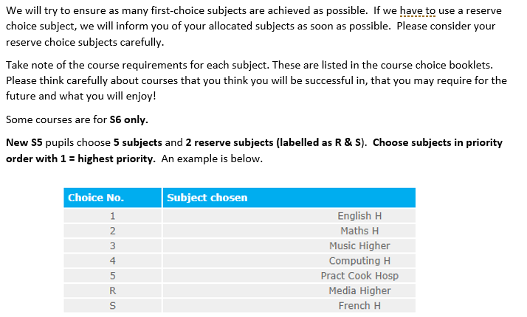
Into S5

Slide 38
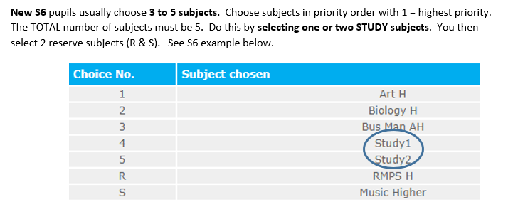
Into
S6

Slide 39
What must I do now?
Speak to guidance teacher (especially if thinking of leaving to get support from us and Skills Development Scotland (SDS)
Research options
Speak to Careers advisers
School course choice done with guidance teacher from 13th January to 21st February
You apply to college by 10th March – students come to workshop on Monday 20th / Monday 27th January

Slide 40
What must I do now?
Questions
Guidance teachers upstairs
Study skills session in atrium

