Slide 1
Applying to Edinburgh College
Notes:
cara

Slide 2
Aim of this session:
Prepare students for applying to college
Understand the process
Improving confidence on how to pick a course
How to do a personal statement
Notes:
Silvia

Slide 3
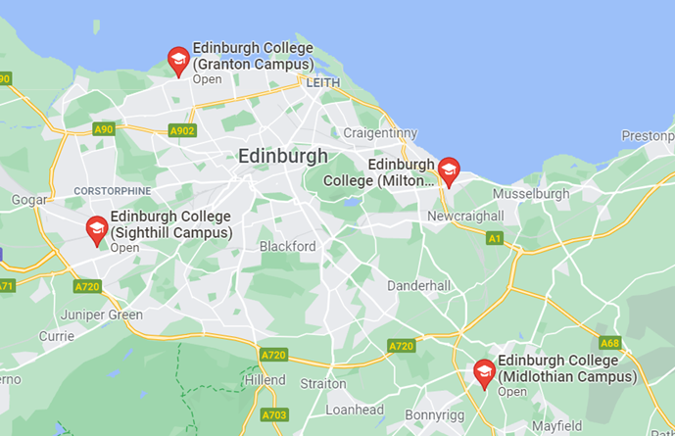
GRANTON CAMPUS
The Apprentice Restaurant,
Art and Design studios
Construction Centre
Dental Nursing facilities
Hair, Barbering, Beauty and Complementary Therapies salons
Performing Arts Studio Scotland (PASS)
Edinburgh College
MILTON RD CAMPUS
Broadcast Media facilities
The Club
CRE:8
Eh15 Restaurant
Hair, Barbering, Beauty and Complementary Therapies salons
Music and Sound Production studios
The Club Gym and Spa
MIDLOTHIAN CAMPUS
Automotive Engineering workshops
Childhood Practice and SVQ Provision
MacTaggart Scott Hydraulics, Pneumatics and PLC Laboratory
Oil Production Platform Simulator
Solar Meadow
Specialist Instrumentation and Control engineering workshops
SIGHTHILL CAMPUS
Broadcast Media and Photography studios
Centre for Sport and Exercise
Community Garden
Science laboratories
The Music Box
Notes:
The different campuses include Sighthill , Milton road , granton and midlothian –think about travel time from school
Full time opening date for applications is 1st of february
Some courses may close quicker and others will stay open throughout summer –advised to apply ASAP
Key facts of the college =- silvi a

Slide 4
Application Process
Course Selection
Applications open on the 14th of January (please be aware that there can be delays and certain courses can take a few days to be uploaded)
Speak to your Careers adviser if you are unsure what you would like to study
Once submitted you will receive an email confirmation
Some courses require interview, audition or assessment before an offer can be made. Look out for an email with further instructions
Unconditional – means you have been accepted and have a guaranteed place on your course
Conditional – means you must achieve further qualifications to meet certain criteria before you are accepted on the course. The conditions you will need to be will be listed in your conditional offer email
Application
Offer
Unsuccessful – Unfortunately you have not been accepted on to the course
Notes:
Silvia

Slide 5
Key points
Tuesday the 14th of January - Application Opening Dates
You can only apply for one course
Not set closing dates, first come first serve for applications
Remember to check your emails and CONFIRM your acceptance of the course.
Normally the Construction, business and Health Care courses fill up the quickest!
Use your personal email and not your school one
Notes:
Silvia

Slide 6
Understanding the different course levels
You may see levels that are not on the above sheet but usually on the college website it says below the course title what the SCQF level is
If you are studying at a particular level, make sure you are applying for the next level above I.e.. currently studying at level 4, you would be looking at level 5 courses
Notes:
Cara

Slide 7
Where your course can take you : Progression maps
Edinburgh College > Info & Advice > Progression Routes
https://www.edinburghcollege.ac.uk/media/ky1lgzwi/ec-progression-maps-booklet.pdf
As you can see from the progressions booklet ,college can lead to lots of opportunities
Did you know that if you do a HNC/D at college you can sometimes get into 2nd or 3rd year of university (depending on the course)
Notes:
Cara

Slide 8
How to apply : Step by step application support
First search for the course you wish to apply for
Then this is the button you will click to start your application
Notes:
cara

Slide 9
Application Step by Step
Click new user
Notes:
ccara

Slide 10
Application Step by Step
Fill in all the registration questions and click register at the bottom of the page
Notes:
cara

Slide 11
Application Step by Step
Click the edit button and this will take you to your application

Slide 12
Application Step by Step
You are now ready to start your application
Fill out all the sections
In the qualifications section add your SCN number (this is your school email number)
For method of payment if the course is HNC or above tick: I will apply to SAAS funding ,
If the course is below HNC tick I will apply for a College Fee Waiver
Check the following slides for support on writing a personal statement
When you are ready click submit!

Slide 13
Personal Statement
Why this course?
Anything in particular you are excited to study (check modules)
Are you studying any relevant subjects?
What skills and experience have these subjects given you?
Relevant Experience
Do you have any work experience,volunteering part time jobs?
What do you like to do in your spare time? (hobbies, interests etc)
Career aspirations
Where do you hope to go following this course?
Employment? Further studies? Don’t worry if you aren't sure you can keep it more generic and talk about challenging yourself and learning new skills
Any key skills and strengths you have that would make you a suitable candidate
What skills do you have that relates to the course
School subjects
Notes:
Silvia - don’t use abbreviations

Slide 14
Example Personal Statement
My passion for studying history has developed from my interest in exploring how the past can allow for greater understanding of society in the present. Many of the subjects I studied in school, as well as my current college course within social science have allowed me to look at past historical events and think about how these relate to modern societal issues. I have always had an interest in my own family’s past. My grandad fought in the Second World War and I found it fascinating to learn about his role and what life was like back then. This is what started my enthusiasm for studying World War Two and this interest has stayed with me throughout my life. I am passionate about Scottish history but would also value the chance to study history and explore its relation to politics and culture around the world.
My school studies have also helped prepare me for academic study. Studying Higher history, RMPS and modern studies has allowed me to develop skills in essay writing, working within a group and improved my skills in delivering presentations. Additionally, these subjects have given me skills in exploring different societal issues through research and critical analysis.
My work experience through school allowed me to improve upon my general employability skills and has given me an insight into the world of work. I received an excellent report as the teacher felt I had good communication skills and was a good role model.
In my spare time I enjoy continuously learning and have taken part in school trips outside of school, including with my RMPS class to a Buddhist monastery. This gave me insight into the life of a Buddhist monk and how they eat, practice their religion and live daily. I feel that I am an inquisitive person and therefore enjoy finding out about different religions and ways of living.
My previous studies within both school and college have allowed me to explore various social subjects and led me to focus on history. I feel that studying history would allow me to challenge myself in new ways and I would value the opportunity to see where studying history could take me in the future.

Slide 15
FAQS
What happens if I am unsuccessful? : If you are unsuccessful the college normally offer you a place on another course , the college have a clearing number that you can call to apply for a place on another course once you have your exam results -this number is not released until July
Who do I contact with questions about my application: see details below
What happens if I do not meet my conditions: If you do not meet your conditions the college normally offer you a place on another course potentially at a lower level , the college have a clearing number that you can call to apply for a place on another course once you have your exam results
What happens if I change my mind and don’t want to go to college: its ok to change your mind! You can just contact the college using the numbers above and let them know
Learning Support : learning.support@edinburghcollege.ac.uk
Course Information (For help with choosing a course and making an application.):0131 297 8300 or courseinfo@edinburghcollege.ac.uk
Course Application Enquiries (For enquiries about your course application) : 0131 297 8500 or cams@edinburghcollege.ac.uk
Student Funding Enquiries (EMA, Bursary, Childcare) :studentfunding@edinburghcollege.ac.uk
Notes:
Caras

Slide 16
Next Steps
Check out the college’s Help with applying page Here
You can watch this video from the college :
Contact your school careers adviser if you would like your personal statement checked or need further help
Attend an open day: check Edinburgh college website for dates
Attend the help session run by the careers advisers on Monday the 20th periods 3 and 4 in the assembly hall –please email cara at Cara.davidson@sds.co.uk to confirm attendance
Notes:
Caras

Slide 17
Important information
Please note that even though the careers adviser is running help sessions it is your responsibility to get your application in on time
Many courses fill up quickly and the college work on a first come basis so when there has been too many applications they will close course applications
Certain courses such as construction related, healthcare and business are very popular
Have a go at writing the personal statement or making a start on it before attending the help session (look at slides 13 and 14)
Please note careers adviser is here to help if you are stuck on what course to apply for , my email is cara.davidson@sds.co.uk
If you have applied to university and are likely to get a conditional it can be a good idea to put in a back up college application (HNC level study is equivalent to 1st year of university and can get you into 2nd year of university depending on course subject and university)

Slide 18
Full time college help session
Monday the 20th of January
Periods 3 and 4 (10:50am- 12:50)
Held in the assembly hall
Careers advisers will be there to help you pick the right course , check personal statement and help you step by step with applying

