Slide 1
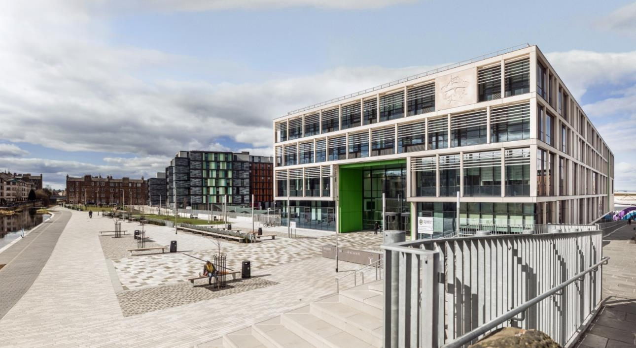
Boroughmuir High School
Parents’ Information Evening
Mr Hayes
Depute Head Teacher S4/5

Slide 2
How do I help my child?
Aims for the year
How teenagers need our help
Our plan for the year
How you can help
Support from school
And any questions…

Slide 3
1. Our school aims
Our Vision
To ensure a confident,
nurturing and
inclusive learning community
where all achieve their true potential & embrace life’s challenges.

Slide 4
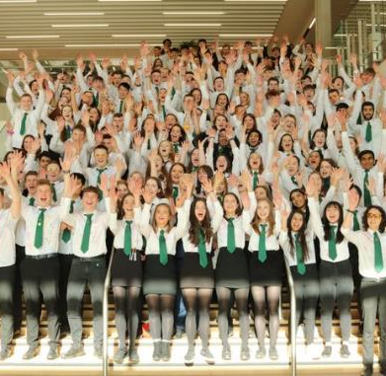
Our aims this year:
Qualifications
Wellbeing
Leading

Slide 5
2. Why teenagers need our help:
‘Teenagers are not yet adults’
Age at which brain stops maturing?
Discuss shared aims
Little and often, discussions about progress
Chunking: small steps
Balance is important:
qualifications, wellbeing, other interests and challenges (leadership)
Notes:
Teenagers tend to be more focussed than adults on social cues, peers, risk taking and less good at prioritising and organisation. This is also a great time for inspiration and creativity and forming new ways of thinking.

Slide 6
Qualifications: Where are we going?
Level 3 National 3 No exam, in class 'unit assessments'
Level 4 National 4 No exam, in class 'units', assignment
Graded as Pass or Fail
Level 5 National 5: Coursework assignments + final exam.
Graded A,B,C, D or No Award
Level 6 NPAs: no exam, pass/ fail
Highers: graded A-D
Apprenticeships
Level 7 NPAs, Advanced Highers, HNCs, Scottish Baccalaureat
Level 8-10 Modern Apprenticeships, University Degrees... etc

Slide 7
How are we getting there?
3 years of senior phase to get started, college and universities to take you further
Small steps! Different steps for each student. Succeed at one level before moving to the next.
S4: Mainly in school, National 4s and 5s, other awards
S5: National 4s and 5s in school and at college (Schools College Partnership)
Highers and NPAs in school and at college
Full time college, apprenticeships, JET work experience
S6: As above including Advanced Highers, Baccalaureat etc..

Slide 8
Example: Maths

Slide 9
Boroughmuir High School: S4-6 Curriculum & Courses example (changes each year)
S4 Curriculum National 3,4,5
S5 or S6
S6
Administration and IT
Art & Design
Biology
Business Management
Chemistry
Computing Science
Design & Manufacture
Drama
Economics
Engineering Science
English
French
Geography
German
Graphic Communication
Health & Food Technology
History
Mandarin
Maths – National 4/5
Applications of Maths – National 4
Media Studies
Modern Studies
Music
Physical Education
Physics
Practical Cookery
Practical Woodwork
RMPS
Science
Spanish
Note - only 1 Maths course is chosen
College Courses
Schools College Partnership (SCP)
Courses - Various
Foundation Apprenticeship
College Courses
Schools College Partnership (SCP)
Foundation Apprenticeship
SCQF L5 NPA
Computing Science
Digital Media
Media Studies
Photography
Practical Science
Sports Leadership
S6 Advanced Higher (AH)
S6 Core Curriculum
PSE – Assembly – Study
Art & Design
Biology
Business Management
Chemistry
Computing Science
Database Design & Programming (Oracle)
Design & Manufacture
Drama
Engineering Science
English
French
Geography
German
Health and Food Technology
History
Mandarin
Mathematics
Mathematics of Mechanics
Mathematics - Statistics
Modern Studies
Music
Physical Education
Physics
Scottish Baccalaureate Interdisciplinary Projects
Spanish
N5
Maths - Nat5
Applications of Maths
Practical Cookery – Hospitality
Practical Woodwork
N5 or Higher
Art & Design
Business
Management
English
Media Studies
Modern Studies
Physical Education
S5 H to S6 AH
Higher (H)
Biology
Chemistry
Computing Science
Data Science(NPA)
Digital Media
Design & Manufacture
Drama
Economics
Engineering Science
French
Geography
German
Graphic Communication
Health & Food Technology
History
Human Biology
Mandarin
Mathematics
Media Studies
Music
Philosophy
Physics
RMPS
Spanish
College Courses
S4 Core Curriculum
PE
PSE
Wider Achievement Awards in
Health & Wellbeing
Religion, Belief & Values
S5 Core Curriculum
Career Management Skills PSE
PE and Study
* Pupils attend neighbouring schools

Slide 10
Typical S4 Timetable | 1 | 2 | 3 | 4 | 5 | 6
Mon | English | History | Physics | Music | Maths | French
Tue | PE | PE | Maths | Graphic Com. | Chemistry | History
Wed | Chemistry | French | Physics | English | Music | Graphic Com.
Thurs | French | Music | PSE | Health & Wellbeing | English | Chemistry
Fri | Graphic Com. | History | Maths | Physics

Slide 11
3. Our plan for the year: S5 Important dates
4th 5th June Induction days: Humanutopia and Leadership
24th June Work experience
Tues 20th August Parent information evening ‘how to help’, plan a routine together
End September Tracking report, families discuss progress, plan next steps
20th / 28th Nov Parent consultations, plan next steps with teachers
10-24th January Prelims
23rd January Course choice presentation, deadline soon after, plan for next year
24th Feb Progress report, students make ‘success plan’, discuss with families
February Students produce revision plan, families help
April: SQA exams start, study leave, immersion days
May leavers event
August: results day

Slide 12
4. How you can help
Organisation: “talk me through your plan”
Weekly planner / diary on ipad (Teams/ Outlook / Assignments)
Termly reports
Planning next steps
Planning revision

Slide 13
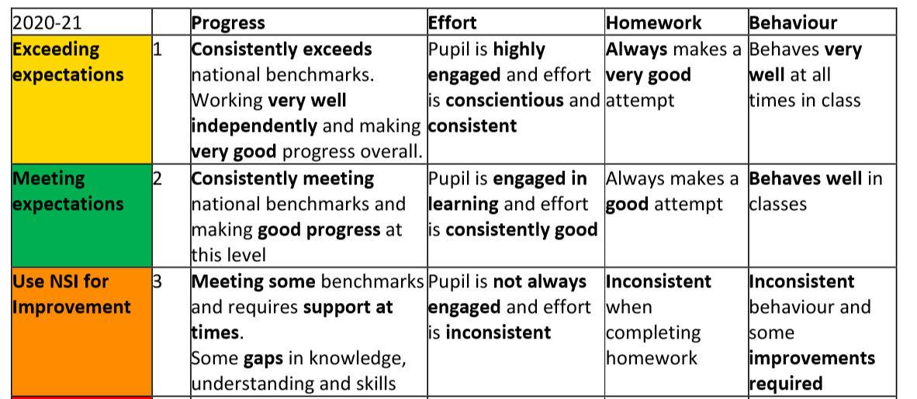
How to help your child with reports: 3s
‘Talk me through your report’ ‘What’s the plan to fix this?’
Notes:
All pupils are expected to work towards achieving a qualification in each of their 5 subjects. The Working Level can be National 2, 3, 4 or 5. The final Working Level is based on their progress in. All pupils must remain in their subjects throughout the year and target a qualification.
The prelims in are used by many subjects to help determine the final working levels e.g. Higher, N5 or N4. Generally a prelim grade A-D at N5 will ensure entry to the final May N5 exams. However for most courses there will be further assessment opportunities. Some Curricular Leaders may start to contact you to discuss your child’s working levels following the prelims.

Slide 14
4. How you can help
Wellbeing
Make a routine… regular routines, including sleep. Agree routines now.
Friends… should be part of any routines.
Outdoors / exercise…
Chunking… break tasks into small bits. Make a list. Do one bit first.
Social media / devices…Hard to multi-task. So devices should be part of the routine.
Get help

Slide 15
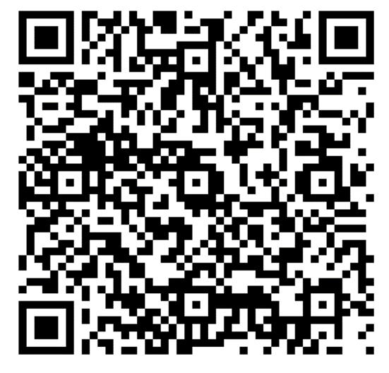
Wellbeing: Humanutopia
Humanutopia day – building relationships between students
S5 ‘Heroes’
‘I just want to say’… QR alert
Notes:
Humanutopia key points – ‘common language’ for all staff and students
‘bin filling’ everyone has things that fill their bin – it can be small comments, or it can be something more. You don’t know when someone’s bin is full.
Supporting = ‘being a friend’, taking time for others, listening, meeting. Speak to someone you don’t know.

Slide 16
Humanutopia: how we help wellbeing
Use a common language:
1. Don’t fill the bin:
Everyone has a ‘bin’ that gets filled. So be kind to others; you don’t know how full their ‘bin’ is.
2. Talk to someone you don’t know well
Talking is important to build trust and allow us to help each other. So get to know others around you now; you don’t know yet how you can help each other in future.

Slide 17
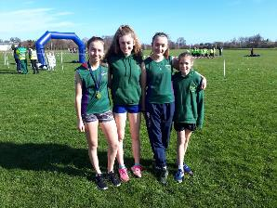
Wellbeing: Sports and Clubs
35+ clubs and teams
246 males taking part
254 females taking part
6 paid coaches
36 volunteers:

Slide 18
5. Help from school
Ask your class teacher: they are the expert!
Use the study support sessions, revision materials, websites…
Use your ‘success plan’ showing next steps, you MUST then fix them.
Use prelims / tests as practice- then fix mistakes
Revision planner: given out in February for students to complete.
Ask your pupil support teacher, or Mr Hayes.
Notes:
Practise exams under full exam conditions (exams are held mostly in the Games Hall with independent invigilators)
Support decisions about appropriate level of final SQA course levels at Nat 3/4/5
Provide important evidence for SQA Estimate Grades and for exceptional circumstances should a pupil not sit the final assessment
Evidence for recommended next levels of study in S5
A very valuable opportunity for pupils to gain feedback on areas of strength and areas for development in the lead up to final SQA exams and assessments

Slide 19
Updated SLT and Guidance systems
HT / DHT | Year Group responsibilities | Other key areas of responsibility
Kate Fraser | Head Teacher | Whole School Strategic Lead.
Juliet Presly | DHT P7/S1 | Learning, Teaching & Assessment, Pupil Equity Funding, primary school liaison
Clive Hembury | DHT S2/S3 | Curriculum, Tracking & Monitoring, School Timetable
Damian Hayes | DHT S4/S5 | Raising Attainment & Achievement, SQA coordinator
Claire Paterson | DHT S6/post S6 | Head of Pastoral Support Team, Equalities coordinator, post school liaison
Clare Braisby | Acting DHT(S6)
Bruce Munro | Business manager

Slide 20
Support for Pupils
6 HOUSES each with 2 Register classes e.g 4H1 and 4H2
Hartington: Ms F Grant (Pupil Support Leader)
Leamington: Ms C Nisbet (PSL)
Montpelier: Mr P McIlwaine (PSL)
Viewforth: Mr C Brandie (PSL)
Westhall: Mrs L Wallace (PSL)
Bruntsfield: Ms K Scherzer (PSL)
Notes:
So with all the internal assessments and coursework required its important that we are supporting our pupils.
As I’m sure you’re aware our first line of support in the school are our Support for pupils teachers. They are your first point of contact if you have any concerns regarding your child’s well being or their learning.

Slide 21
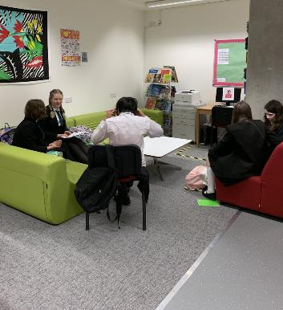
Support for Learning (SfL)
Mrs Hall, Support for Learning Leader
and the team of specialist Support for Learning Teachers, Pupil Support Officer and Pupil Support Assistants (PSAs).
Notes:
Provide support in classes and in 1:1 settings, to ensure that the effects of learning difficulties or disabilities are minimised
Offer specialised teaching to develop necessary language and learning skills
Promote understanding of additional support needs
Develop effective teaching and learning approaches for pupils with additional support needs
Identify and implement assessment strategies and ensure that the results are reported to parents
Involve parents in the planning of their son’s/daughter’s progression throughout secondary school
Support pupils in our Hub

Slide 22
Pathway 1 – Majority of needs of pupils met in classroom by teacher.
Pathway 2 – Involvement of Support for Learning Staff
Pathway 3- Involvement of outside agencies/SFL staff/Wellbeing Hub/Enhanced Support Provision
S5 – Mr Arricibita
Targeted support with revision/study skills and coursework for identified young people
ICT Training – iPad Accessibility features
Homework Club – Wednesday 3.40pm in the Library
SFL Support for Assessments
Attendance at Young Person Planning Meetings
Update information that is shared with staff re additional support needs
Assessing young people for literacy difficulties/dyslexia
Collaborative work with Pupil Support Leaders and outside agencies to support young people's needs
Liaise with class teachers and pupils about appropriate Assessment Arrangements for exams

Slide 23
Assessment Arrangements (AA)
Some pupils with an additional support need have Assessment Arrangements for assessments to help them demonstrate attainment
may be different for each subject / student
‘normal working’
Showing that it makes a difference
Organised by October
Our Educational Psychologist reviews any AA and the evidence used in support of the arrangement
Please contact Mrs Sarah Hall at sarah.hall@boroughmuir.edin.sch.uk if you have any questions

Slide 24
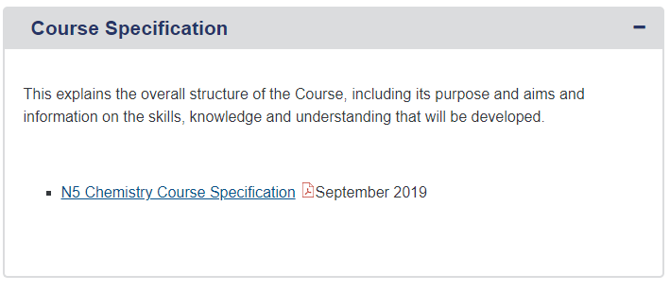
SQA Website – Subject Pages
Lists the essential knowledge and skills required for each course
Past Papers and answers are available … a must for revision!

Slide 26
Nationals in a Nutshell
What skills will my child develop?
What will my child experience during the Course?
Assessment

Slide 27
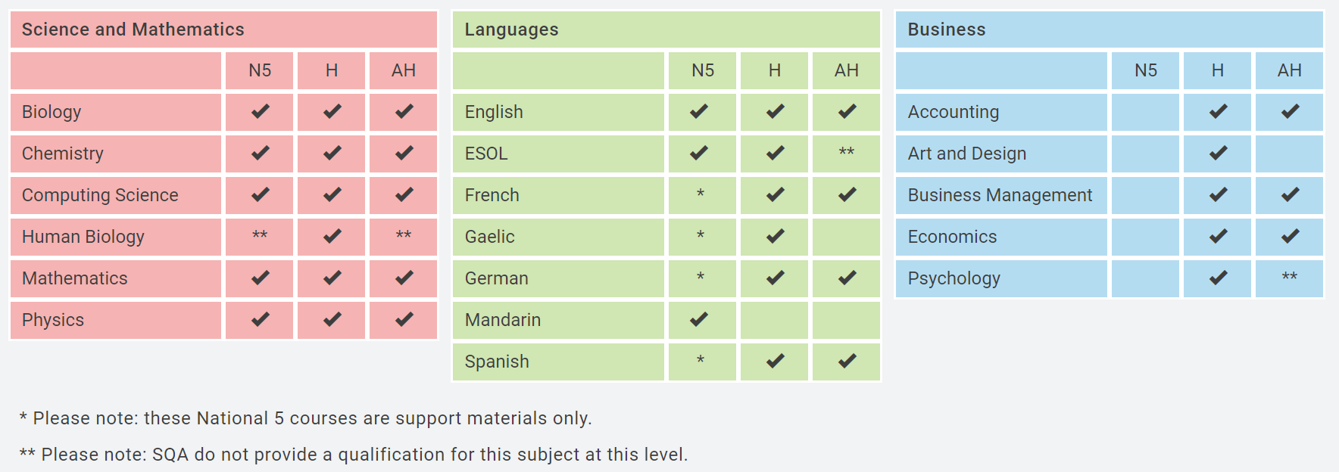
Homework and Home Study
Heriot Watt University SCHOLAR courses have been running for over 20 years and offer 37 high quality online courses for Scottish schools aligned to the SQA curriculum at National 5, Higher and Advanced Higher level.
Each pupil is provided with their own username (their SCN number) and a password.

Slide 28
Homework and Home Study

Slide 29
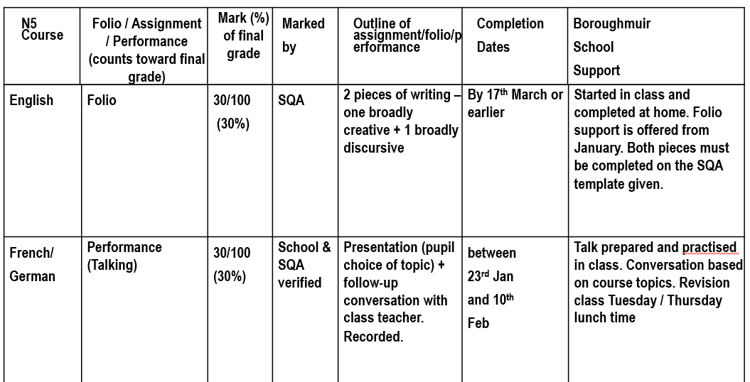

Slide 30
6. Leading
Helping students to take responsibility for:
leading their own learning and future lives
leading others
Notes:
?: leavers event
8th August: results day

Slide 31
S5 Leadership Level 5
Qualification at Level 5 = N5
1. Research leadership
2. Evaluate your own strengths and weaknesses
3. Lead a project, evaluate it
Monday P5 or Tuesday P1 and registration
Notes:
?: leavers event
8th August: results day

Slide 32
What leadership project might you choose?
Sports leaders (Mr Collard)
Humanutopia / P7s / S1s (Ms Presly)
Beans Baristas (Ms Kelly, Mr Cochran / Mr O’Hagan)
Colony in Space (Ms Garland)
Pupil Voice (Ms Vines)
Inter-generational project (Ms Howden/ Ms Dighton / Ms Dunlop)
Football coaching (Mr Hayes / Mr Graham)
House club competitions (Ms Asif)
Active schools clubs (Mr Segal)
Ambassadors: Digital, Food, Eco… (see class teachers)
Christmas Show… (Mr Graham)
Your own choice, in or out of school…
Notes:
?: leavers event
8th August: results day

Slide 33
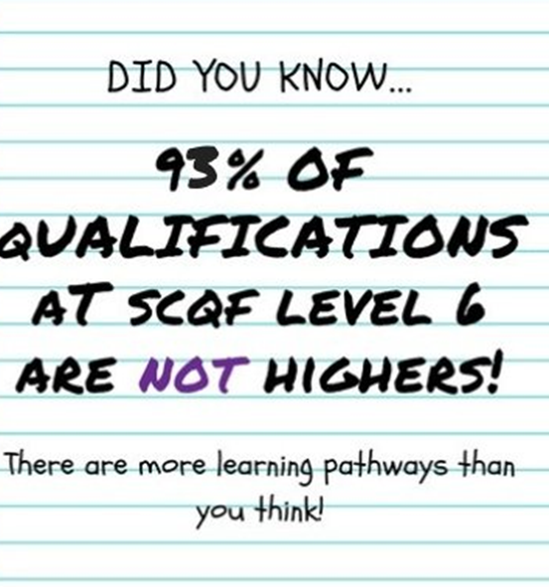
Leading themselves: Post School Planning & Careers

Slide 34
Careers Advice - Our Careers Advisors are Cara Davidson and Lesley Robertson Cara.Davidson@sds.co.uk appointments can be made by request through the Pupil Support Leaders or by email.
The Careers part of the website contains additional information including information as to how our subjects departments are developing skills for the young workforce.
My World of Work is a key source of careers information

Slide 35
6 week course for parents and carers of teens
Ideas to help with:
- increasing independence
- developing confidence, security and resilience
- promoting emotional wellbeing

Slide 36
Useful Parent/Carer Resources
Research/Support
Opportunities
My Kids Career www.mykidscareer.com/
My World of Work www.myworldofwork.co.uk/parents
DYW – E resources www.dyw.scot/edyw.html
Digital World www.digitalworld.net/
Articulation Routes
www.pathways.ac.uk
Apprenticeship.Scot
www.apprenticeships.scot/
The Guarantee
www.theguarantee.org/
SDS Edinburgh Facebook
www.facebook.com/SDSEdinburgh/

Slide 37
8. Questions
Or email / phone the school office

