Slide 1
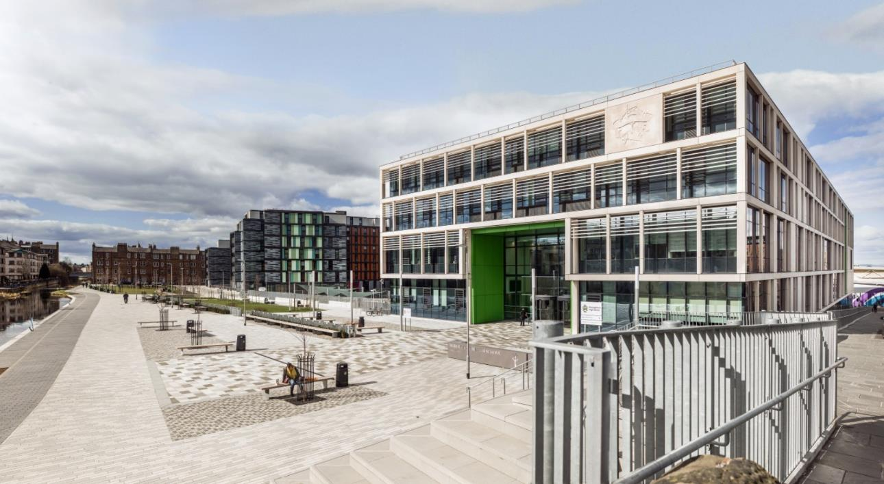

Boroughmuir High School
Parents’ Information Evening
Mr Hayes
Depute Head Teacher S4/5

Slide 2
How do I help my child?
Aims for the year
How teenagers need our help
Our plan for the year
How you can help
Support from school
And any questions…

Slide 3

1. Our school aims
Our Vision
To ensure a confident,
nurturing and
inclusive learning community
where all achieve their true potential & embrace life’s challenges.

Slide 4

Our aims this year:
Qualifications
Wellbeing
Leading

Slide 5

2. Why teenagers need our help:
‘Teenagers are not yet adults’
Age at which brain stops maturing?
Discuss shared aims
Little and often, discussions about progress
Chunking: small steps
Balance is important:
qualifications, wellbeing, other interests and challenges (leadership)
Notes:
Teenagers tend to be more focussed than adults on social cues, peers, risk taking and less good at prioritising and organisation. This is also a great time for inspiration and creativity and forming new ways of thinking.

Slide 6

Qualifications: Where are we going?
Level 3 National 3 No exam, in class 'unit assessments'
Level 4 National 4 No exam, in class 'units', assignment
Graded as Pass or Fail
Level 5 National 5: Coursework assignments + final exam.
Graded A,B,C, D or No Award
Level 6 NPAs: no exam, pass/ fail
Highers: graded A-D
Apprenticeships
Level 7 NPAs, Advanced Highers, HNCs, Scottish Baccalaureat
Level 8-10 Modern Apprenticeships, University Degrees... etc

Slide 7
How are we getting there?
3 years of senior phase to get started, college and universities to take you further
Small steps! Different steps for each student. Succeed at one level before moving to the next.
S4: Mainly in school, National 4s and 5s, other awards
S5: National 4s and 5s in school and at college (Schools College Partnership)
Highers and NPAs in school and at college
Full time college, apprenticeships, JET work experience
S6: As above including Advanced Highers, Baccalaureat etc..

Slide 8
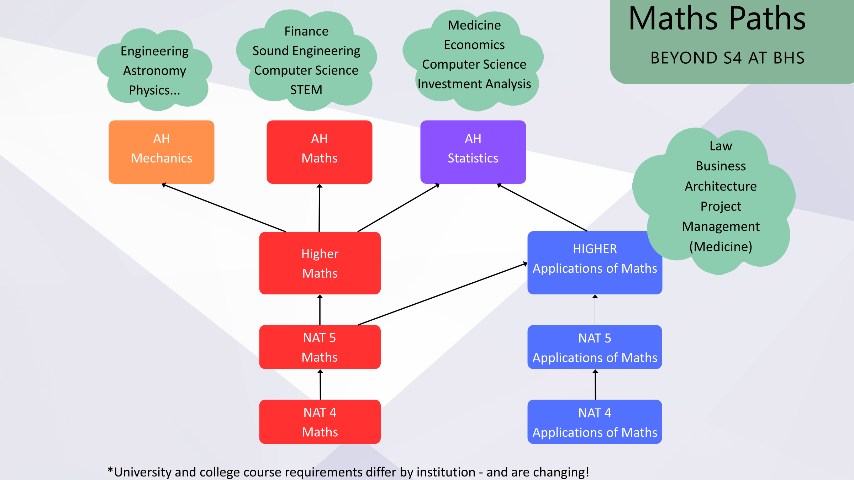
Example: Maths

Slide 9
Boroughmuir High School: S4-6 Curriculum & Courses example (changes each year)
S4 Curriculum National 3,4,5
S5 or S6
S6
Administration and IT
Art & Design
Biology
Business Management
Chemistry
Computing Science
Design & Manufacture
Drama
Economics
Engineering Science
English
French
Geography
German
Graphic Communication
Health & Food Technology
History
Mandarin
Maths – National 4/5
Applications of Maths – National 4
Media Studies
Modern Studies
Music
Physical Education
Physics
Practical Cookery
Practical Woodwork
RMPS
Science
Spanish
Note - only 1 Maths course is chosen
College Courses
Schools College Partnership (SCP)
Courses - Various
Foundation Apprenticeship
College Courses
Schools College Partnership (SCP)
Foundation Apprenticeship
SCQF L5 NPA
Computing Science
Digital Media
Media Studies
Photography
Practical Science
Sports Leadership
S6 Advanced Higher (AH)
S6 Core Curriculum
PSE – Assembly – Study
Art & Design
Biology
Business Management
Chemistry
Computing Science
Database Design & Programming (Oracle)
Design & Manufacture
Drama
Engineering Science
English
French
Geography
German
Health and Food Technology
History
Mandarin
Mathematics
Mathematics of Mechanics
Mathematics - Statistics
Modern Studies
Music
Physical Education
Physics
Scottish Baccalaureate Interdisciplinary Projects
Spanish
N5
Maths - Nat5
Applications of Maths
Practical Cookery – Hospitality
Practical Woodwork
N5 or Higher
Art & Design
Business
Management
English
Media Studies
Modern Studies
Physical Education
S5 H to S6 AH
Higher (H)
Biology
Chemistry
Computing Science
Data Science(NPA)
Digital Media
Design & Manufacture
Drama
Economics
Engineering Science
French
Geography
German
Graphic Communication
Health & Food Technology
History
Human Biology
Mandarin
Mathematics
Media Studies
Music
Philosophy
Physics
RMPS
Spanish
College Courses
S4 Core Curriculum
PE
PSE
Wider Achievement Awards in
Health & Wellbeing
Religion, Belief & Values
S5 Core Curriculum
Career Management Skills PSE
PE and Study
* Pupils attend neighbouring schools

Slide 10
Typical S4 Timetable | 1 | 2 | 3 | 4 | 5 | 6
Mon | English | History | Physics | Music | Maths | French
Tue | PE | PE | Maths | Graphic Com. | Chemistry | History
Wed | Chemistry | French | Physics | English | Music | Graphic Com.
Thurs | French | Music | PSE | Health & Wellbeing | English | Chemistry
Fri | Graphic Com. | History | Maths | Physics

Slide 11
3. Our plan for the year:
S4 Important dates
  Tues 20th August Parent information evening ‘how to help’, plan a routine together
  End September Tracking report, families discuss progress, plan next steps
  1st-15th Nov Prelims
  9th Dec Progress report, students make ‘success plan’, discuss with families
  14th January Parent consultations, plan next steps with teachers
  23rd January Course choice presentation, deadline soon after, plan for next year
  February Students produce revision plan, families help
  April: SQA exams start, study leave, immersion days
  May leavers event
  End June work experience
  August: results day

Slide 12
4. How you can help
  Organisation: “talk me through your plan”
  Weekly planner / diary on ipad (Teams/ Outlook / Assignments)
  Termly reports
  Planning next steps
  Planning revision

Slide 13
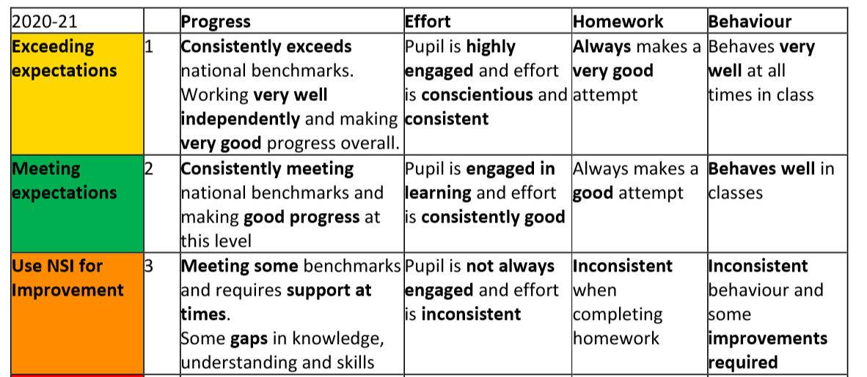
How to help your child with reports: 3s
‘Talk me through your report’ ‘What’s the plan to fix this?’
Notes:
All pupils are expected to work towards achieving a qualification in each of their 5 subjects. The Working Level can be National 2, 3, 4 or 5. The final Working Level is based on their progress in. All pupils must remain in their subjects throughout the year and target a qualification.
The prelims in are used by many subjects to help determine the final working levels e.g. Higher, N5 or N4. Generally a prelim grade A-D at N5 will ensure entry to the final May N5 exams. However for most courses there will be further assessment opportunities. Some Curricular Leaders may start to contact you to discuss your child’s working levels following the prelims.

Slide 14
4. How you can help
  Wellbeing
  Make a routine… regular routines, including sleep. Agree routines now.
  Friends… should be part of any routines.
  Outdoors / exercise…
  Chunking… break tasks into small bits. Make a list. Do one bit first.
  Social media / devices…Hard to multi-task. So devices should be part of the routine.
  Get help

Slide 15



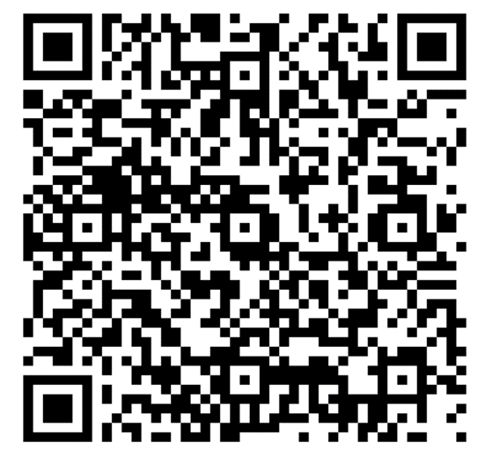
Wellbeing: Humanutopia
Humanutopia day – building relationships between students
S5 ‘Heroes’
‘I just want to say’… QR alert
Notes:
Humanutopia key points – ‘common language’ for all staff and students
‘bin filling’ everyone has things that fill their bin – it can be small comments, or it can be something more. You don’t know when someone’s bin is full.
Supporting = ‘being a friend’, taking time for others, listening, meeting. Speak to someone you don’t know.

Slide 16
Humanutopia: how we help wellbeing
Use a common language:
1. Don’t fill the bin:
Everyone has a ‘bin’ that gets filled. So be kind to others; you don’t know how full their ‘bin’ is.
2. Talk to someone you don’t know well
Talking is important to build trust and allow us to help each other. So get to know others around you now; you don’t know yet how you can help each other in future.

Slide 17

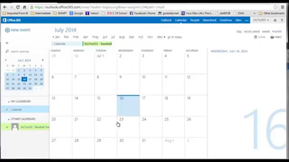

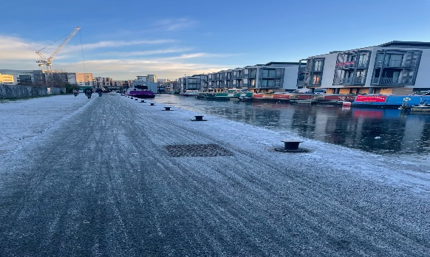
Wellbeing classes in 4
Rotation 1 Digital Diary and Bloom Bloom | RBV award | What is resilience? Exam stress Decisions future Social pressures Managing studies Friendships Juggling time
Rotation 1 50% of RBV Award Lead RMPS All staff deliver 12 weeks |  | Values/ morals / world and local issues Explore and develop a resource
Rotation 2 50% of Well-being Award All staff deliver 12 weeks until exam leave |  | The power of relationships YMM The amazing brain YMM Wellbeing during exams YMM- reflect on what is going well Eat, Sleep, Exercise, relax. Investigate a MH issue

Slide 18

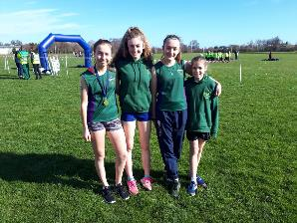

Wellbeing: Sports and Clubs
35+ clubs and teams
246 males taking part
254 females taking part
6 paid coaches
36 volunteers:

Slide 19
5. Help from school
  Ask your class teacher: they are the expert!
  Use the study support sessions, revision materials, websites…
  Use your ‘success plan’ showing next steps, you MUST then fix them.
  Use prelims / tests as practice- then fix mistakes
  Revision planner: given out in February for students to complete.
  Ask your pupil support teacher, or Mr Hayes.
Notes:
Practise exams under full exam conditions (exams are held mostly in the Games Hall with independent invigilators)
Support decisions about appropriate level of final SQA course levels at Nat 3/4/5
Provide important evidence for SQA Estimate Grades and for exceptional circumstances should a pupil not sit the final assessment
Evidence for recommended next levels of study in S5
A very valuable opportunity for pupils to gain feedback on areas of strength and areas for development in the lead up to final SQA exams and assessments

Slide 20
Updated SLT and Guidance systems
HT / DHT | Year Group responsibilities | Other key areas of responsibility
Kate Fraser | Head Teacher | Whole School Strategic Lead.
Juliet Presly | DHT P7/S1 | Learning, Teaching & Assessment, Pupil Equity Funding, primary school liaison
Clive Hembury | DHT S2/S3 | Curriculum, Tracking & Monitoring, School Timetable
Damian Hayes | DHT S4/S5 | Raising Attainment & Achievement, SQA coordinator
Claire Paterson | DHT S6/post S6 | Head of Pastoral Support Team, Equalities coordinator, post school liaison
Clare Braisby | Acting DHT(S6)
Bruce Munro | Business manager

Slide 21
Support for Pupils
6 HOUSES each with 2 Register classes e.g 4H1 and 4H2
Hartington: Ms F Grant (Pupil Support Leader)
Leamington: Ms C Nisbet (PSL)
Montpelier: Mr P McIlwaine (PSL)
Viewforth: Mr C Brandie (PSL)
Westhall: Mrs L Wallace (PSL)
Bruntsfield: Ms K Scherzer (PSL)
Notes:
So with all the internal assessments and coursework required its important that we are supporting our pupils.
As I’m sure you’re aware our first line of support in the school are our Support for pupils teachers. They are your first point of contact if you have any concerns regarding your child’s well being or their learning.

Slide 22

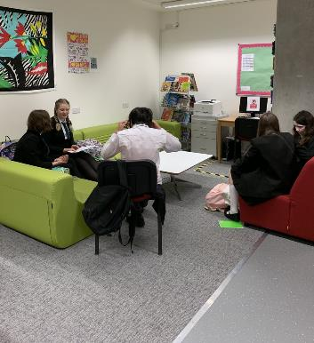
Support for Learning (SfL)
Mrs Hall, Support for Learning Leader
and the team of specialist Support for Learning Teachers, Pupil Support Officer and Pupil Support Assistants (PSAs).
Notes:
Provide support in classes and in 1:1 settings, to ensure that the effects of learning difficulties or disabilities are minimised
Offer specialised teaching to develop necessary language and learning skills
Promote understanding of additional support needs
Develop effective teaching and learning approaches for pupils with additional support needs
Identify and implement assessment strategies and ensure that the results are reported to parents
Involve parents in the planning of their son’s/daughter’s progression throughout secondary school
Support pupils in our Hub

Slide 23

Pathway 1 – Majority of needs of pupils met in classroom by teacher.
Pathway 2 – Involvement of Support for Learning Staff
Pathway 3- Involvement of outside agencies/SFL staff/Wellbeing Hub/Enhanced Support Provision
S4 – Mrs Hall
Where appropriate PSA support in class
Targeted support with revision/study skills and homework for identified young people
ICT Training – iPad Accessibility features
Homework Club – Wednesday 3.40pm in the Library
SFL Support for Assessments
Attendance at Young Person Planning Meetings
Update information that is shared with staff re additional support needs
Assessing young people for literacy difficulties/dyslexia
Collaborative work with Pupil Support Leaders and outside agencies to support young people's needs
Liaise with class teachers and pupils about appropriate Assessment Arrangements for exams

Slide 24
Pathway 1 – Majority of needs of pupils met in classroom by teacher.
Pathway 2 – Involvement of Support for Learning Staff
Pathway 3- Involvement of outside agencies/SFL staff/Wellbeing Hub/Enhanced Support Provision
S5 – Mr Arricibita
Targeted support with revision/study skills and coursework for identified young people
ICT Training – iPad Accessibility features
Homework Club – Wednesday 3.40pm in the Library
SFL Support for Assessments
Attendance at Young Person Planning Meetings
Update information that is shared with staff re additional support needs
Assessing young people for literacy difficulties/dyslexia
Collaborative work with Pupil Support Leaders and outside agencies to support young people's needs
Liaise with class teachers and pupils about appropriate Assessment Arrangements for exams

Slide 25

Assessment Arrangements (AA)
Some pupils with an additional support need have Assessment Arrangements for assessments to help them demonstrate attainment
  may be different for each subject / student
  ‘normal working’
  Showing that it makes a difference
  Organised by October
Our Educational Psychologist reviews any AA and the evidence used in support of the arrangement
Please contact Mrs Sarah Hall at sarah.hall@boroughmuir.edin.sch.uk if you have any questions

Slide 26
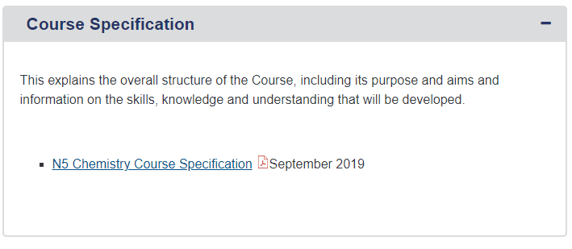
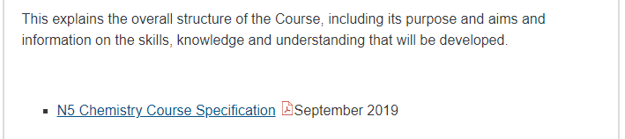
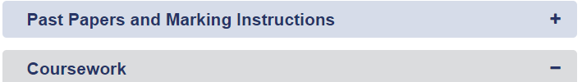
SQA Website – Subject Pages
Lists the essential knowledge and skills required for each course
Past Papers and answers are available … a must for revision!

Slide 27


Slide 28


Nationals in a Nutshell
What skills will my child develop?
What will my child experience during the Course?
Assessment

Slide 29


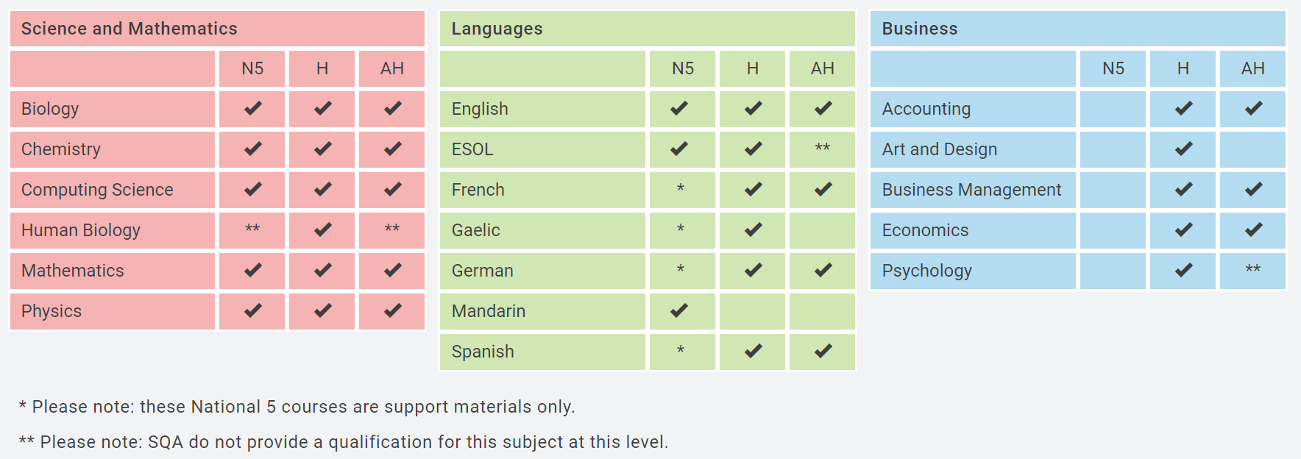
Homework and Home Study
Heriot Watt University SCHOLAR courses have been running for over 20 years and offer 37 high quality online courses for Scottish schools aligned to the SQA curriculum at National 5, Higher and Advanced Higher level.
Each pupil is provided with their own username (their SCN number) and a password.

Slide 30



Homework and Home Study

Slide 31


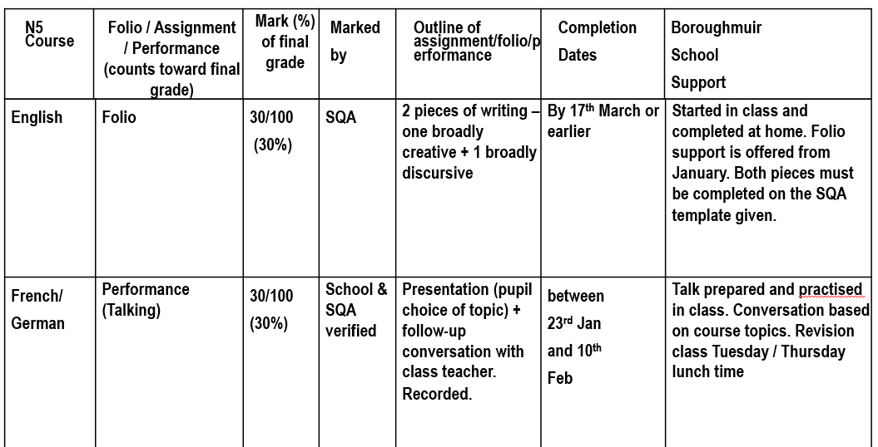



Slide 32
6. Leading
  Helping students to take responsibility for:
  leading their own learning and future lives
  leading others
Notes:
?: leavers event
8th August: results day

Slide 33
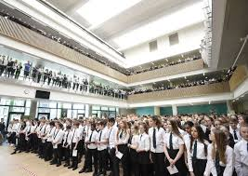
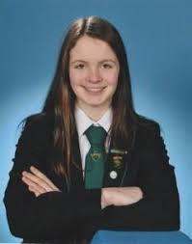

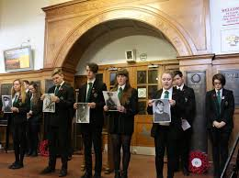
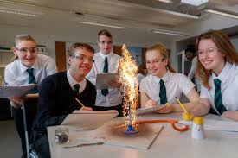
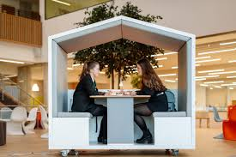
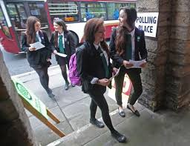
Leading others:

Slide 34
Leading themselves: S4 Work Experience
In June
Weekly PSE lessons to prepare.
2 ways to get a placement:
Self Found Placements Deadline for applications February (tbc)
School contacts – see Mr McIlwaine

Slide 35
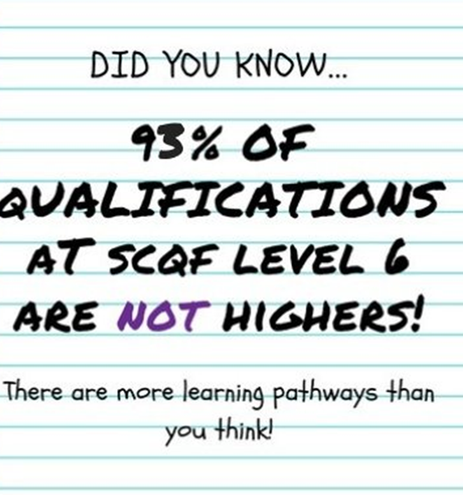
Leading themselves: Post School Planning & Careers

Slide 36










Networks
S4 WORK
EXPERIENCE
Notes:
I have mostly discussed how we work to develop self, strengths and horizons but what about networks. In addition to a variety of subject based activities. There are future options where school works with others to help develop your young person’s awareness. As well as teaching staff, support staff and myself;. There are websites such as My World of Work, Digital World, Apprenticeship.scot
In Class visits and external visits as part of Developing Scotland's’ Young Workforce
Speakers at parent council events
Foundation Apprenticeships available via the college programme in S5 and S6 where your young person gets the chance to gain industry qualifications and work experience
JET Programme available in S4 – which is a work placement programme.
Career Ready a mentoring programme that allows people to be mentored by people in business and gain some significant work experience in the summer
Finally in S4 pupils are encourage complete a relevant work experience as this can help with statements and interviews for future opportunities
A guide to our services is available for you.

Slide 37

JET+
School winter leavers can apply for JET+
focused on gaining practical experience from a full-time work placement.
A Work Placement Coordinator will support the placement
meet with employers, training providers, colleges and SDS staff
gain a Certificate of Work Readiness.
JET+ has 100% success rate in progressing young people into a positive destination.
Progression routes include employment, college, modern apprenticeships and training.

Slide 38



Careers Advice - Our Careers Advisors are Cara Davidson and Lesley Robertson Cara.Davidson@sds.co.uk appointments can be made by request through the Pupil Support Leaders or by email.
The Careers part of the website contains additional information including information as to how our subjects departments are developing skills for the young workforce.
My World of Work is a key source of careers information

Slide 39
SDS Service Offer
Year Group | Offer
S1 | Group session within PSE
S2 | Group session within PSE PLUS 1-2-1 decision making
S3 | Group session within PSE
S4 | Group session within PSE. Compulsory 1-2-1 for leavers, 1-2-1 requests through guidance. Drop-in sessions
Notes:
So how have I been working with your young person;
S1 PSE lesson –we undertook a range of activities where we talked about skills and qualities, stereotyping, prioritises and having a end goal when making decisions
In S2 we had a 1-2-1 sessions on decision making We introduced them to career management skills and showed them tools to help like my world of work (more on this later)
S2 PSE lesson – in S2 we looked at subject choice and further introduced them to Career Management Skills
S3 PSE lesson – we talked about how they view themselves and their strengths (Self and Strengths), we looked at how people represent themselves to the world and we talked about routes and pathways
S4 PSE lesson – we will be discussing horizons and how to plan for the future. If they stay on this will be continued with the S5 Career Management Skills rota
If your child is leaving at the end of S4 or even thinking about it please inform their guidance teacher as they will have compulsory 1-2-1 sessions with me to help plan their future
In S5 they take part in a career management skills rota that helps them with their future plans run by a variety of teaching and support staff
In S6 there are a variety of programmes based on ucas, college and employment
Your child can also request a 1-2-1 to help plan their future or come to a drop in session to ask questions about entry requirements etc

Slide 40

6 week course for parents and carers of teens
Ideas to help with:
- increasing independence
- developing confidence, security and resilience
- promoting emotional wellbeing

Slide 41


Useful Parent/Carer Resources
Research/Support
Opportunities
My Kids Career www.mykidscareer.com/
My World of Work www.myworldofwork.co.uk/parents
DYW – E resources www.dyw.scot/edyw.html
Digital World
www.digitalworld.net/
Articulation Routes
www.pathways.ac.uk
Apprenticeship.Scot
www.apprenticeships.scot/
The Guarantee
www.theguarantee.org/
SDS Edinburgh Facebook
www.facebook.com/SDSEdinburgh/

Slide 42

8. Questions
Or email / phone the school office

