Slide 1

School renewal plan 2021-22
Learning, Teaching and Assessment; Equalities; Health, Well-being and Resilience; Equity and Inclusion

Slide 2
Renewal and reconnection
Our top priority

Slide 3
Addressing disruption to learning
During disruption
On return to school
renewal
relationships
Learning and assessment
Tracking and reporting
Skills and resilience
Notes:
Cause for Concern system used throughout remote learning periods to discuss and intervene to support pupils whose engagement was noticeably lacking.
Interventions during remote learning included resource packs being delivered to doors, 1:1 or small group support online from subject, SfL and PSL staff, phone calls and home communication, and help prioritising workload, weekly House email to touch base
Teams tools such as Insight show when and for how long a pupil has logged on to the Team and been engaged with the lessons, as well as collating grades and feedback from marked assignments, and this is still accessible to pupil and teacher. Teachers were adept at helping pupils prioritise workload and assignments.
On return to school, we have supported pupils by:
Clarifying assessment expectations – SQA has stripped away various elements of assessment and / or course content Modifications to assessment summary table- SQA and C.Ls have adapted course content accordingly
Provision of pre and post-school day support – Maths breakfast club, homework club, study support across a variety of subjects
In-class support by S6 pupils in S1-2 classes
Setting up of peer tutoring in the Senior Phase and staff-pupil mentoring targeting pupils tracked at 4s for Progress
Careful monitoring of year group tracking, with collegiate discussion across faculties, SfL and PSL, PEF Coordinator and SLT to plan interventions

Slide 4
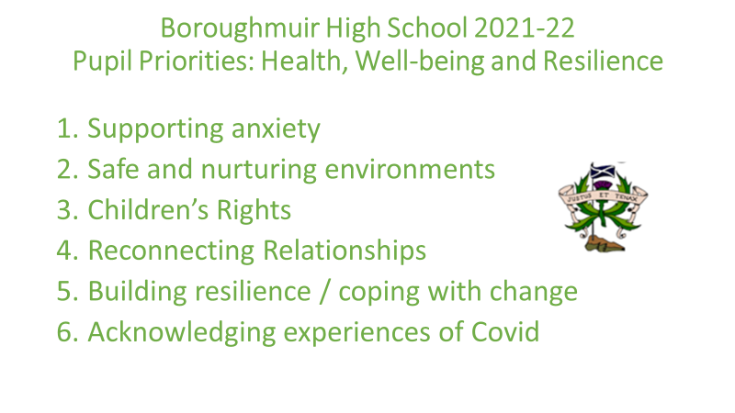
Start of the session: pupil voice
CEC has six areas when looking at health and well-being and Covid-related renewal. We asked pupils and staff what were their top priorities from these six:
Boroughmuir High School 2021-22
Staff Priorities: Health, Well-being and Resilience
1. Safe and nurturing environments
2. Resilience and coping with change
3. Supporting anxiety
4. Reconnecting relationships
5. Children’s Rights
6. Acknowledging experiences of Covid

Slide 5
We asked Faculties ‘what are you already doing that supports pupils’ health, wellbeing and recovery?’
making things as normal as possible, practical etc. Staff are accommodating with deadlines and pupils’ individual needs. Science club is restarting. Using the systems already in place to support wellbeing and attainment (CfCs)
Supported study, one-to-one sessions for pupils, access to resources on Teams pages, encourage people to enter a learning dialogue, debate club (seniors & juniors), pupil council, try to create a safe, welcoming and positive environment for all learners, climate change society, involvement in sports clubs (rugby)
Helping students plan out their time in advance - use of calendars etc. Regular reminders for those who need it. Building relationships with our pupils, empathetic responses. Application of support principles. Available resources online. Use of drop-ins

Slide 6
Various clubs at lunchtime and after school. Open door policy. Supported study sessions. Update Teams regularly so pupils can keep up to date. Excellent communication skills with pupils allowing positive relationships. Group work regularly built into the curriculum. Restorative and pre-emptive conversations with pupils. Discuss any issues with support staff and pupil support. Create resources and lessons that are engaging, fun, inclusive and relevant. Inform ourselves on pupils needs and accommodate them.
• Talking to them little chats (general chit chat) • Have fun, laugh and joke - positive relationships • Digital Literacy skills • Consistency of routines • Running some clubs – see them in a different light • Give more choice (chances in class to provide the content and then choose to answer questions, or make notes etc, etc)
Stable classroom routines, knowing pupils as learners, monitoring progress closely. Supporting same work through Teams. Differentiated courses from S1.
Discussions around presentation levels pre and post prelims help to ease nerves around these decisions. Regular discussions with all pupils about how to manage workload, revision etc. Elements of courses which deal with HWB issues (healthy lifestyles, diet, smoking, alcohol, study skills, managing stress around revision). Liaising with guidance and SfL about how to support pupils.

Slide 7
Support Registration in the Hub / Hub open at break and lunch for identified pupils (staffed by PSA and teaching staff) / check ins with pupils / homework club for S1/2 / regular communication home / liaising with guidance as part of wider ASL team / liaising with outside agencies / Hub staffed during class time to support pupils with anxiety / PSA supporting pupils to attend classes / PSA working with pupils in class
Physical Activity, Lots of personalisation and choice/pupil voice, good knowledge of pupils from support directory, Staff in the depart involved in lunch/break duty and after school sessions, Spare kit, Meet and Greet, Awareness of individual backgrounds, Approachable, Fun learning environment,

Slide 8
Support for Learning
Support for Learning Department
Targeted Interventions
Work with Guidance and at multi-agency level to discuss the needs of young people (PEF, Young Carers, Care Experienced and those with social work involvement) to plan and monitor the implementation of strategies and interventions.
SRA Reading Groups to support pupils with weak literacy skills.
Individualised interventions to accelerate improvement in literacy and numeracy skills.
Support to use ICT effectively – accessing Teams, IVONA.
Support to re-engage learners through small group and one-to-one instruction.
Plan and deliver SQA courses to meet the needs of pupils (Scottish Studies Award).
Support for ASN pupils sitting exams in 2022
Delivering sessions on study skills, exam techniques and effective reading strategies.
Resources to support revision.
Discussion about assessment arrangements with all pupils with an ASN.
In-class Support
In-class support (S1 and S2 Maths, S2 and S3 English, N5 Applications of Maths).
Support with Classwork and Homework
Work cooperatively in classes and in consultation with subject teachers to help make the curriculum accessible for all pupils.
Run the school Homework Club and drop-in lunchtime support group for pupils with additional support needs.
Wellbeing and Nurture
Run the Break and Lunch Hub Club to support vulnerable pupils.
Deliver nurture provision to support vulnerable pupils in S1 and S2.

Slide 9
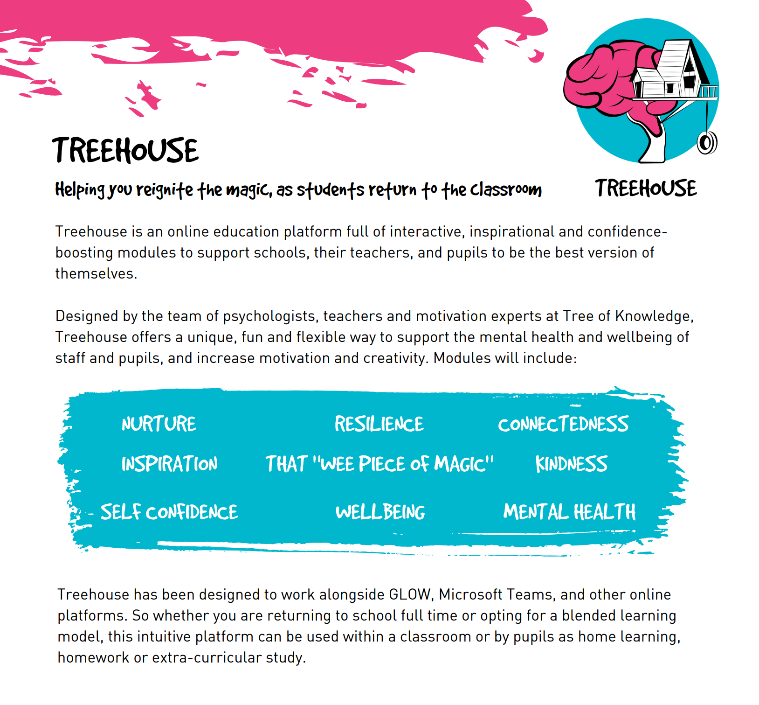
Further support
Tree of Knowledge presentations for all S4-6 pupil addressing positive mental attitudes for exam success (all presented a few weeks before prelims)
S3 Health and Wellbeing rota using Treehouse wellbeing modules, with personalisation and choice for pupils to work through what matters most to them
Dealing with Exam anxiety workshops for S3-4 pupils
Nurture Group established for S2 pupils, which will be rolled out to S1s also
Continued promotion of online resources and live webinars provided by E-Sgoil, Scholar and My World of Work
Continued and embedded use of Teams and OneNote to provide course outlines, schedules, resources and revision materials
Issuing of knowledge organisers and study calendars

Slide 10

Study support
Many teachers volunteering and providing lunch or after school time for free study support
22 subjects on offer, from N5 to AH level, across a range of days and times (posted on year Group Teams pages)
Every Faculty reiterates that all pupils are welcome to make additional appointments by asking their teachers
Regular reminders and links to E-sgoil and Scholar resources shared via year group and class Teams pages
S6 in-class volunteers in S1-2 classes
Post-January prelims, peer tutoring available also

Slide 11
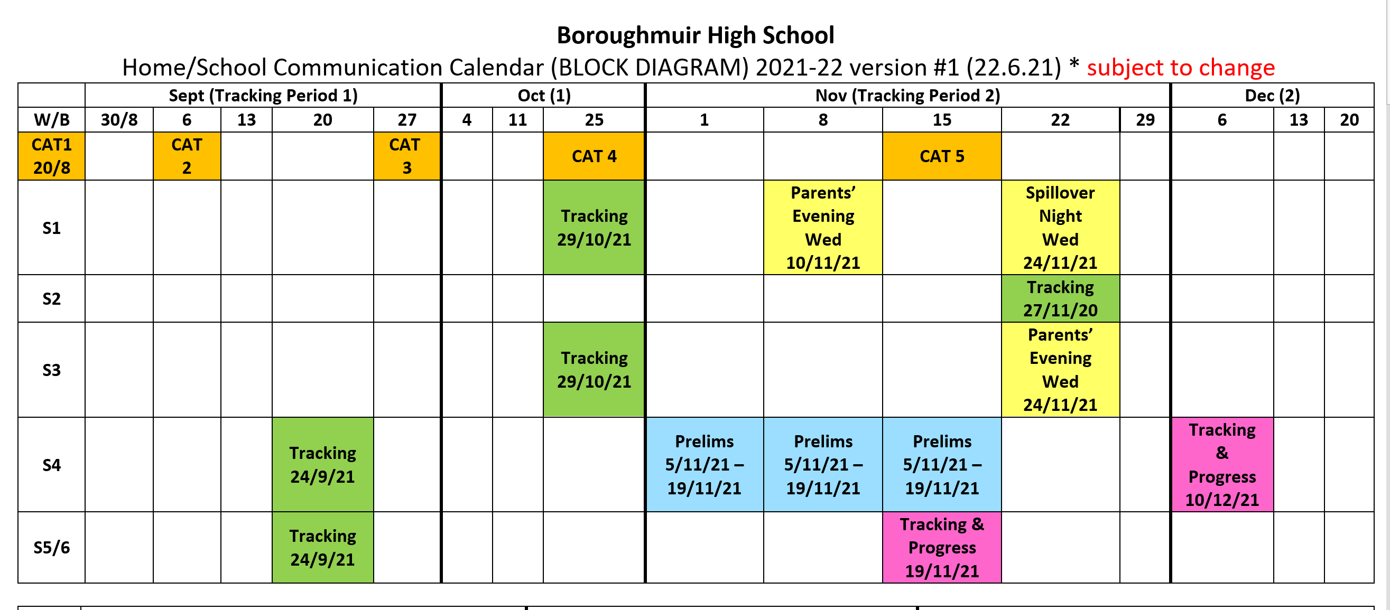
Home – school communications
January - June 2021, tracking and reporting calendar amended slightly; parents’ nights ongoing
Current S2 have had 3 tracking reports and 1 parents’ Night in S1
Current calendar of tracking, reporting and Parents’ Nights is working well so far.

Slide 12

Our four pillars of renewal
Learning, teaching & assessment
equalities
health, Well-being and Resilience
EQUITY AND INCLUSION

Slide 13

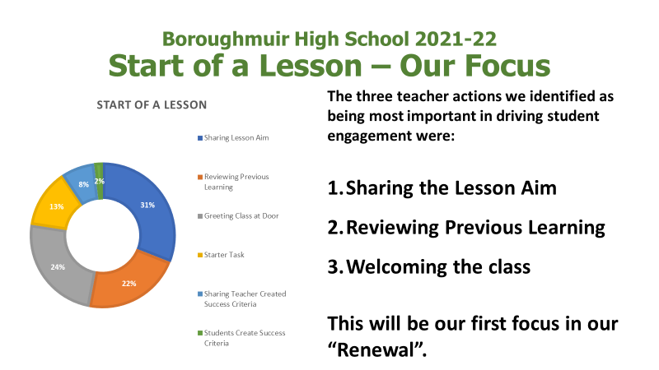
Learning, Teaching and Assessment
Positive relationships support safety and nurture, help pupils deal with anxiety, and lead to better learning and teaching.
Our LTA focus post-HMIE had been building a shared understanding of what good learning and teaching looks like, with focus and exemplification on beginnings, middles and ends of lessons (Boroughmuir Engages Sways – insert link)
Returning in August was the chance to focus on brilliant beginnings, not only for learning and teaching, but for safety and re-establishing positive relationships pupil snapshot data here

Slide 14
Leadership of Learning Partnerships
November 2021
How good is learning, teaching and assessment in your faculty?
How do you know?
Measuring impact. What does your faculty attainment data for 20-21 show about the strengths and areas for development for your learning and teaching?
What do you plan to do this year to improve the quality of learning, teaching and assessment for every pupil across your faculty?
How will you know this has been successful?
Worked effectively at City level to share practice and support each other
Support collaboration and facilitate stronger/better links across faculties
Supports CLs to share with all SLT and highlight and share strengths and successes
Aligned to ethos and Boroughmuir Engages vision
Follows on from inspection feedback to improve consistency of pupils experience as a L&T focus
Notes:
Also SLT walk-throughs, pupil snapshots
Conclusions & Next Steps
Teachers make a big impact
Pupils feel welcome in class
Learning Intentions are well embedded
Success criteria room to improve and fully embed

Slide 15
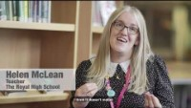
Teams is for life, not just for lockdown!
Digital and Empowered Learning
Continue to use House style for all class Teams; familiar, logical and helpful
Each class has a Team set up and in regular use: teachers are posting resources and guidance on these pages, as well as using the ‘Assignments’ function to set key work.
Please remind your young people that they should be regularly checking their class Teams pages as they are now a fundamental part of class.
CEC ‘Empowered Learning’ is the name for the roll-out of
1:1 devices to staff and pupils, commencing January 2022.

Slide 16
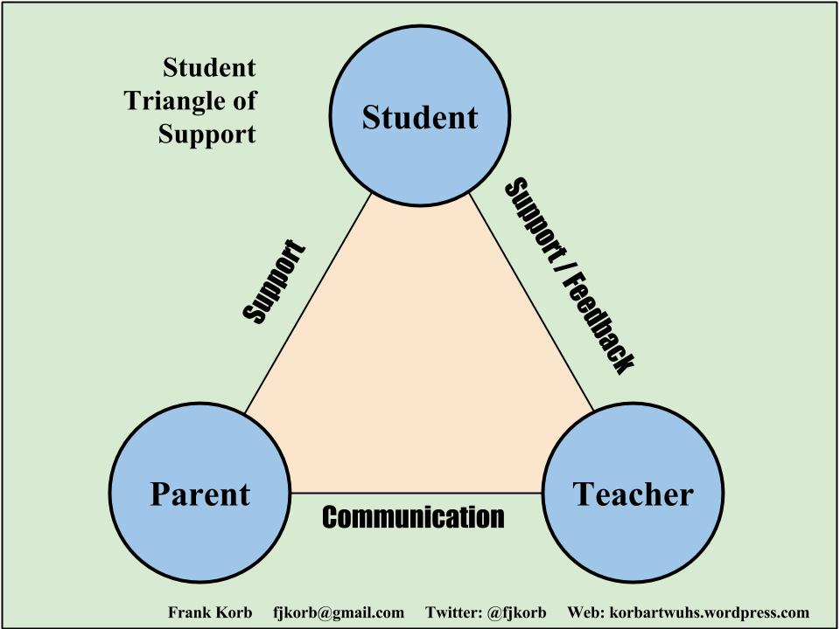


Slide 17

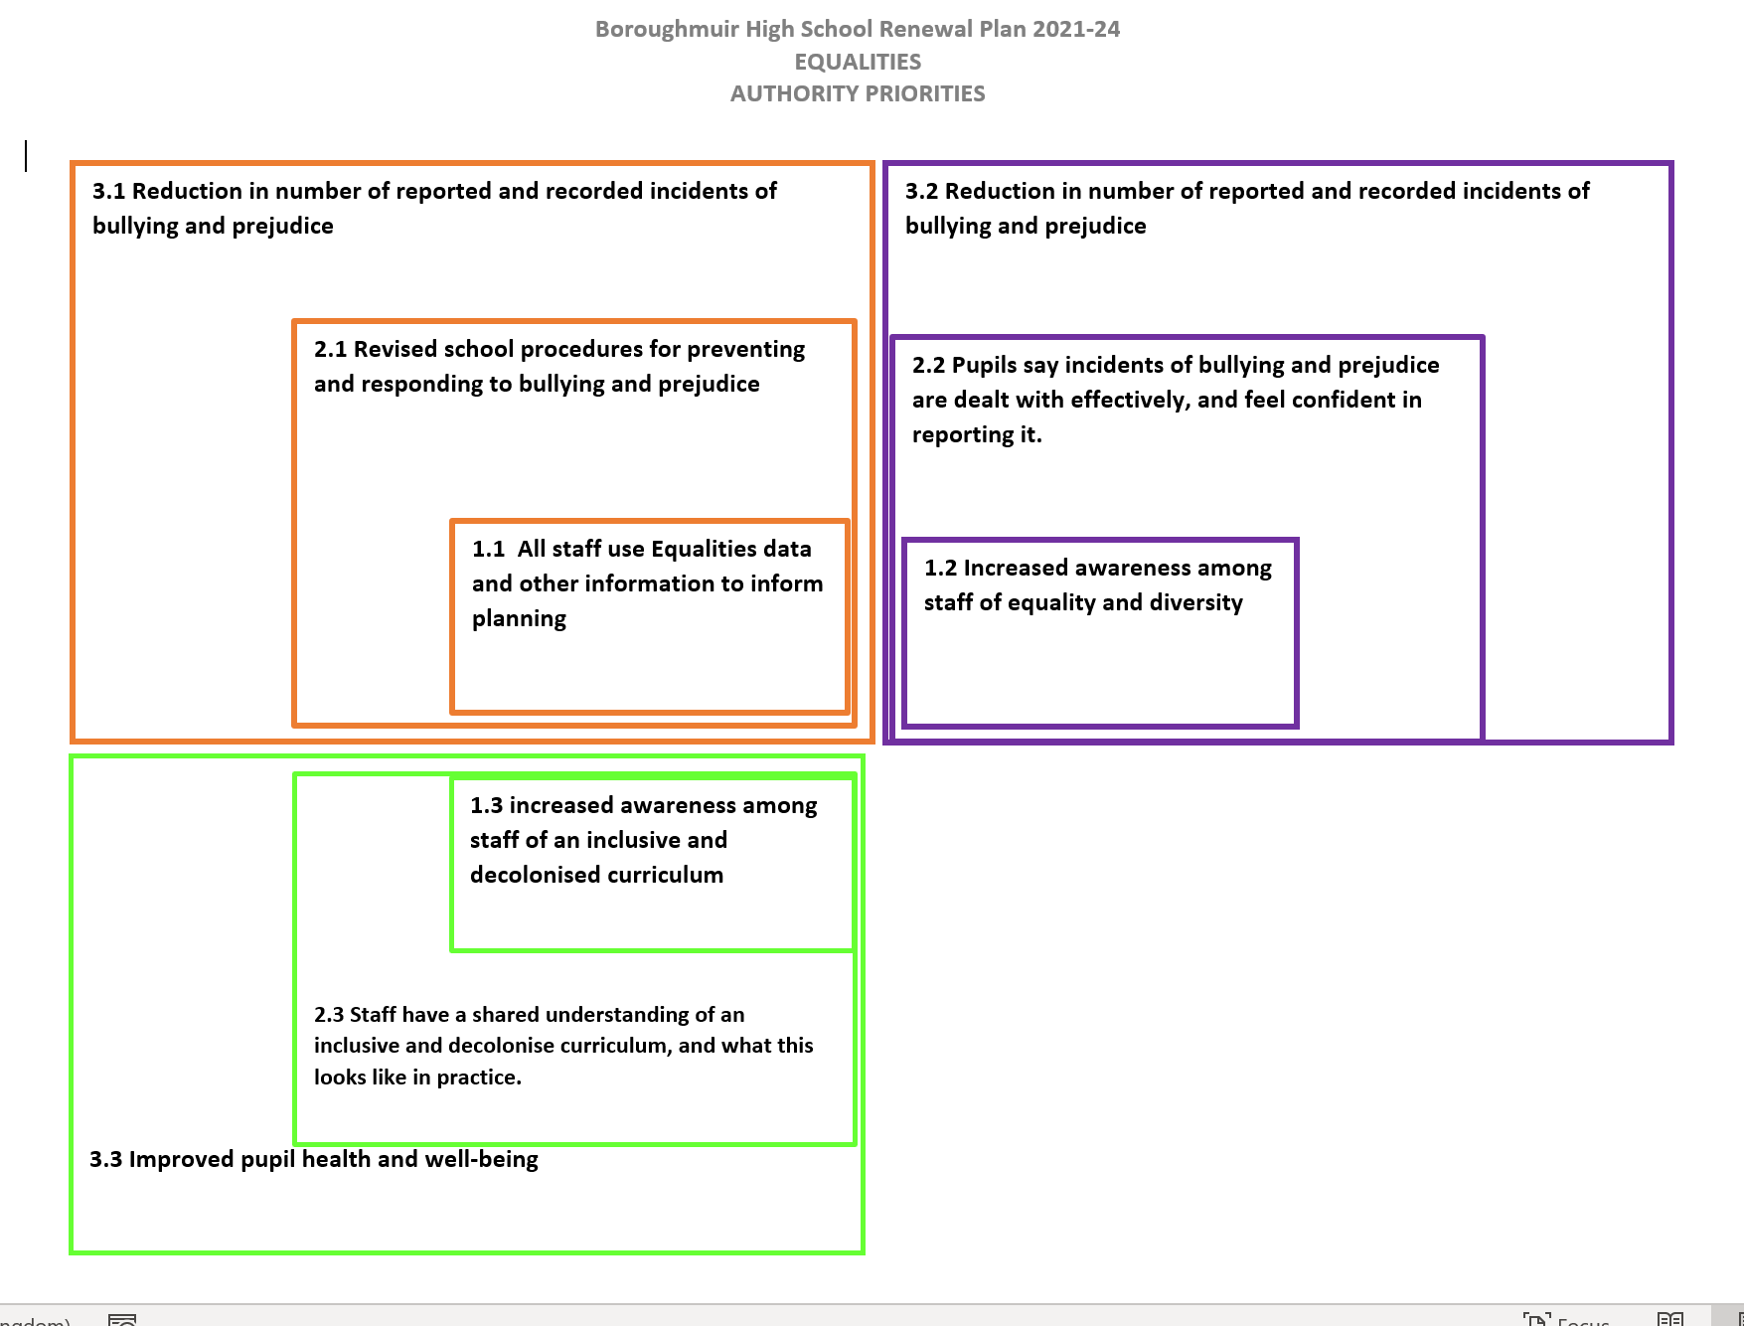
EQUALITIES
Staff training on diversity, from IYS and St. Andrews University
Equalities staff working group, and pupil group
Anti-Bullying Week; new ways to report issues
Free and Equal Conference
EEI Report and monitoring of key groups through tracking and attainment data

Slide 18
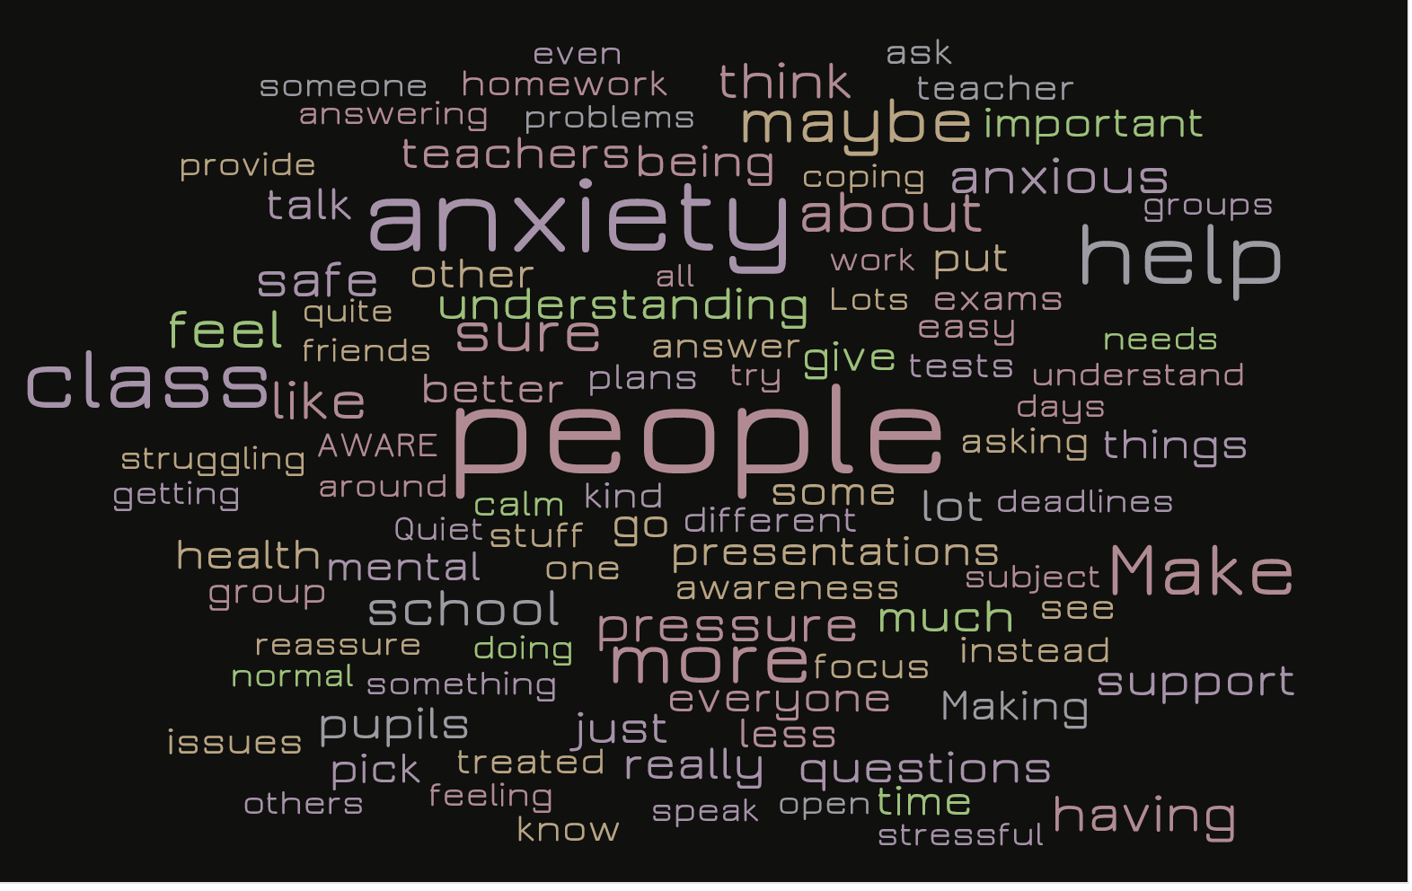
Health, Well-being and resilience
Pupils said…
Supporting anxiety…
Creating safe and nurturing environments…
Children’s Rights

Slide 19
Key messages from pupils on supporting anxiety and having safe and nurturing environments– and our responses
‘Be aware that pupils may feel anxious being put on the spot’ integrate a variety of questioning styles, use of show-me boards, quizzes etc (Quizlet, Quizziz – training recorded in CLPL virtual staffroom)
‘Quiet space is needed’
library space and various classrooms available over break and lunchtime
‘Give as much notice of tests, homework etc as possible’
use Teams for setting Assignments and sharing resources. Use the House style for channels.
‘Check-ins are useful’
staff-pupil mentoring, ethos and relationships, welcoming to class
‘Why am I feeling anxious? What can I do to help myself?’
Teach knowledge about what’s happening in the brain when someone is anxious, as well as coping strategies PSE, school counsellor, M. Alexander, mentoring, coaching, HWB rota

Slide 20
Key messages from pupils on children’s rights, reconnecting relationships, and building resilience
More knowledge and education about children’s rights Rights Respecting Schools, YPI, HWB rota, subject study, Pupil Council and pupil voice
Value of clubs and extra-curricular opportunities S1 Freshers’ Fair 24th Sept, more clubs and sport teams reopening, homework club,
Friendly, welcoming, interested ethos welcoming class, recognising the individual
Academic and Social Support study classes, Tree of Knowledge, homework club, Hub, open classrooms, teacher check-ins, use of Teams, mentoring
Clear expectations shared with class homework, dress code, punctuality, CfC
Clear and regular communication use of Teams, bulletin being shared, school newsletter, website and app, parents’ evening and Parent Council, Pupil Council

Slide 21
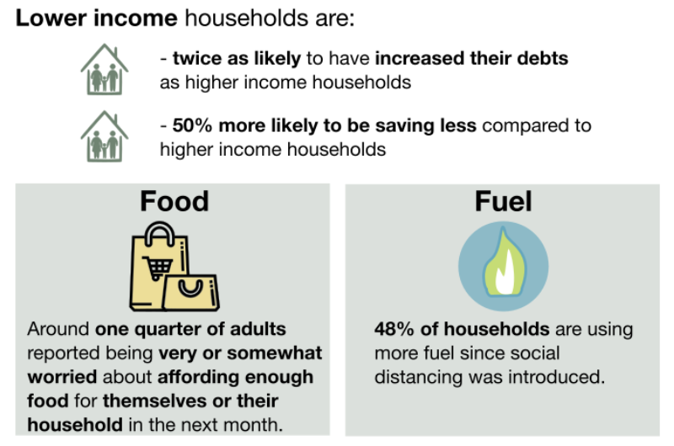

EQUITY AND INCLUSION
Current PEF list
Total of 95 students
SIMD 1-4 = 32
FME = 53
Other = 10
We recognise that recent events have led to some difficult circumstances for many families and want to encourage you to get in touch if you have relevant questions or concerns or you believe you may be eligible for this support and the school is not yet aware.
Some useful links:
https://www.edinburgh.gov.uk/xfp/form/261 - apply for free school meals and clothing grant
https://www.edinburgh.gov.uk/ema - apply for education maintenance allowance
other links can be found on our school website:
https://boroughmuirhighschool.org/pupil-support/ parents-information/
Notes:
1:1 meetings between pupils and PEF Coordinator
Targeted mentoring based on tracking reports
New website section supporting families, containing lots of links to external agency and school supports Parents Information | Boroughmuir High School
Continued focus on digital equity; ipads and wifi access.
Cost of the school day ScotGov. funding secured to cover HFTT, D & E, Numeracy costs.
EEI Report for 2021-22 created

