Slide 1


Welcome to Boroughmuir from Juliet Presly dht
P7 Parents’ Virtual Information Evening
Wednesday 17th June 2020
Our Vision
To ensure a confident, nurturing & inclusive learning community where ALL achieve their true potential & embrace life’s challenges.

Slide 2

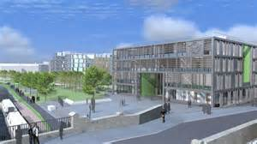


The Big Picture of Transition
260 P7s becoming S1
Other Non-Cluster Primary Schools

Slide 3
The Transition Process 2019/20
Ongoing: Health and Wellbeing visits
May (last year) P6 Maths Challenge
September: School of Tennis & Rugby at Meggetland
October: P7 Open Afternoon
November: Support for Learning Open Afternoon
Dec & Jan: P7 Christmas Choir & Science Show
April: Virtual Transition & Newsletter & Meetings
May: Virtual Tour and Welcome Videos
May/June: Enhanced Transition Team Set up
June: Virtual 3 Day Visit

Slide 4
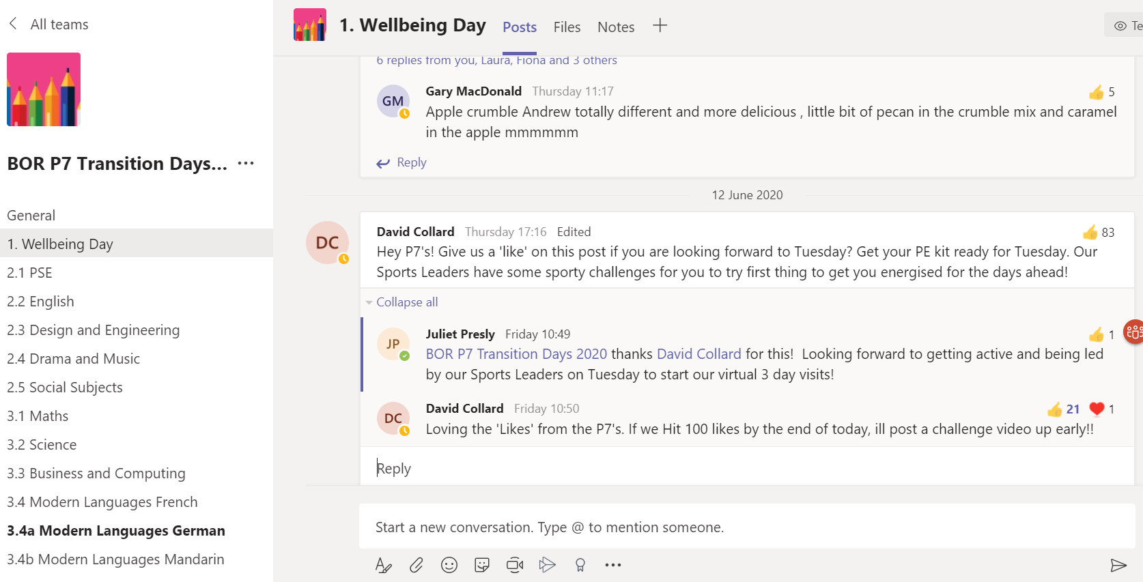
3 Day Visit – Replaced Virtually

Slide 5
The Transition Process
Visiting primary schools – DHT, Pupils, SfL & SfP
Listen to and work with our primary colleagues
Criteria for Making Our Register Classes
Mixed ability
Aim to keep siblings in same house
Gender balance
Balance of additional support needs
Several pupils from one school (where possible) in one class
Mandarin – one side of the year group

Slide 6
Creating Classes from our Information
1H1 | 1L1 | 1V1 | 1W1 | 1M1
Practical Sets 1-6 Modern Languages Classes x 4 Maths Classes set (after a few weeks)
1H2 | 1L2 | 1V2 | 1W2 | 1M2
Practical Sets 7-13 Modern Languages Classes x 5 Maths classes set (after a few weeks)

Slide 7
A Typical Day
Reg | 1 | 2 | Break | 3 | 4 | Lunch | 5 | 6
8.32-8.45 | 8.45-9.40 | 9.40-10.35 | 10.35-10.50 | 10.50-11.50 | 11.50-12.50 | 12.50-1.35 Clubs Hub Library | 1.35-2.30 | 2.30-3.30
Mon | Science 1.6 | History 1H2 |  | Maths Set | German |  | CDT 1.6 | English 1H2
Tues | Art 1.6 | Home Ec 1.6 |  | Modern Studies 1H2 | Drama 1H2 |  | PE 1H2 | PE 1H2
Fri | PSE 1H2 | English 1H2 |  | Music 1.6 | IT 1H2 |  | Finish at 12.50 on Fridays

Slide 8
Subjects Studied in S1 & Periods Per week
English (4)
Mathematics (4)
Modern Languages (3)
Science (3)
History (1) Geography (1)
Modern Studies (1)
RMPS (1)
Home Economics (1)
Health & Wellbeing (1)
Physical Education (2)
PSE (1)
Art & Design (1)
Craft & Design (1)
Drama (1)
Music (1)
ICT (1)
Business (1)

Slide 9

Modern Languages 1+2
All S1s this year will continue with French and German all year
2 periods of French and 1 German until Christmas then swap
2 different teachers to differentiate language
Opportunity in S2 to Specialise more with one main language
All pupils at Boroughmuir continue with a language until S4
We also have a class of 30 doing Mandarin

Slide 10

Extra-curricular Clubs and Activities
Science club Computer / programming club
Creative Writing
music: pupil choir / guitar ensemble / cello ensemble / wind band / Piping, chanting and drumming band
Amnesty International
Enigma Club Usually Early Sept
Meditation
Dance
Girls’ / boys’ rugby
Football / basketball / badminton / American football / ski race training / running / netball / hockey / dance
Scripture Union
Photography club

Slide 11
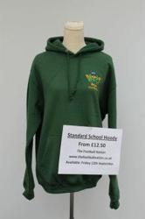

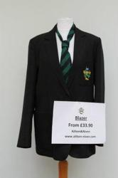
Dress Code
White shirt
Boroughmuir striped tie
School-badged hoodie
Black skirt / trousers
Black school shoes – no trainers or baseball boots
Boroughmuir blazer
Badged Sports t-shirt - navy and green PE kit
Ties available w/c 11th August £3
Nearly new uniform available too

Slide 12


Support for your child
The Scottish Government provides additional funding to schools to put in place strategies to assist with support for young people - Pupil Equity Funding (PEF).
We have a PEF Coordinator at Boroughmuir – Mrs Cockerill who is one of our Support for Learning Teachers. She coordinates strategies across the school to help close the attainment gap.
Should you think you need support or advice, or just want to have a chat about it – please arrange through the school office and Mrs Cockerill would be delighted to discuss anything with you.
Do you currently claim free school meals? Please ensure that you have applied for the new school year (i.e. August). Mrs Cockerill can help with this process.
If in doubt – please contact either Ms Presly, Mrs Cockerill or your child’s guidance teacher.

Slide 13
Some Useful Dates
S1 Event | ALL TBC
First Day at Boroughmuir as S1 Pupils | Week Commencing 11th August
S1 Welcome Evening – In partnership with Parent council & Numeracy Engagement Event for S1 Parents | If we can - Thursday 10th September 7pm-8pm Numeracy from 6.30pm
Bring Your Parents To School Day – a chance to experience a day in the life of your S1 child. | If we can -Thursday 1st October – 8.32am-3pm
S1 & S6 Sponsored Walk around Arthur’s Seat | If safe to do so - Friday 9t^{h} October – 10.30am -12.50pm
S1 Halloween Party | Late October 6.30-8pm
S1 Tracking Report – first snapshot of progress in S1 | Late October
S1 Parent Consultation Evening | Mid November 4.30-7pm
S1 Christmas Party | Thursday 10th December 6.30-8pm

Slide 14
Pupil Support TEAM (Guidance)
Your first point of contact & House System
Miss Grant – Hartington – 1H1 or 1H2
Miss Nisbet – Leamington 1L1 or 1L2
Mr Brandie – Viewforth 1V1 or 1V2
Mrs Wallace – Westhall 1W1 or 1W2
Mr McIlwaine – Montpelier – 1M1 or 1M2
The system is vertical, therefore the Guidance teacher remains with the pupils throughout their school career.

Slide 15
Aims and Role of Pupil Support
Our main aim is to get to know the pupils in our house well, and we do this through delivery of Personal and Social Education to register classes each week and we do this through the following areas:
Mental, Emotional, Social and Physical Wellbeing
Planning for Choices and Change
Relationships, Sexual Health and Parenting
Substance Misuse

Slide 16
Tracking and Monitoring Process
In Pupil Support we also track and monitor pupils progress. We do this through:
Checking homework diaries.
Weekly achievements and targets.
Weekly monitoring attendance and punctuality.
Discussing pupils tracking and full reports – S1 tracking reports – October and March / full report – May.
Discussing overall progress with parents / carers at the consultation evening in December.

Slide 17
Concerns
We respond to concerns that pupils, parents/carers or staff may have and work closely with our colleagues in Support for Learning.
We are happy to liaise with staff on a pupil or parent/carers behalf.
Pupil Support are the first point of contact with the school and can be accessed through the office.
We work in partnership with pupils, parents / carers, staff and all members of the community, in and out of school to promote positive relationships at all times.

Slide 18
Communication
All information relating to the school is on the website – www.boroughmuirhighschool.org
You can follow us on twitter @BoroughmuirHS
From August we will contact you through groupcall
Email our admin address with any other questions: admin@boroughmuir.edin.sch.uk

Slide 19

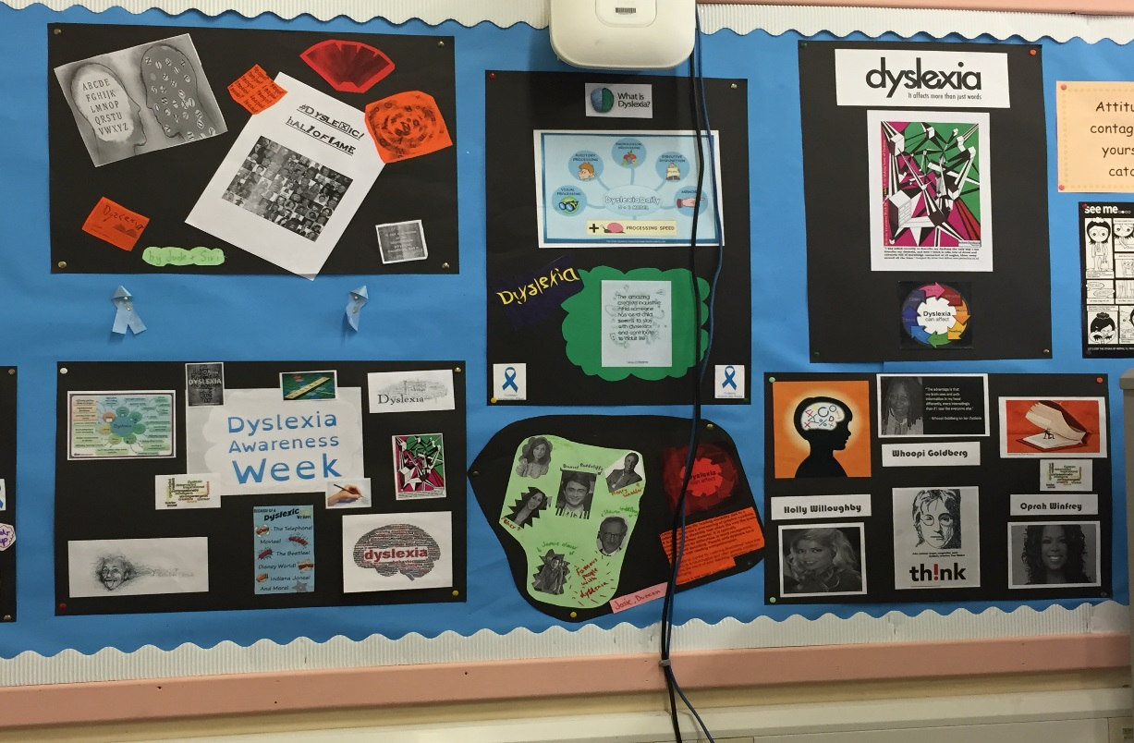
Support for Learning Staff
Support for Learning Leader
- Mrs Hall
Support for Learning Teachers
- Miss Adair & Mrs Cockerill
Pupil Support Assistants

Slide 20
SFL Support at Transition
We work closely with primary schools to ensure that literacy and numeracy support is continued for individual pupils.
Visit cluster primary schools to meet teachers and pupils
Attend primary school planning meetings during summer term
Talk informally to groups and provide leaflets
Participate in Enhanced Transition events
Plan individual support to meet learning needs using primary school data

Slide 21
Support for Learning at Boroughmuir
In Class Support
Differentiation in the classroom
SFL teachers, Pupil Support Assistants and Sixth Year students help in classes to support Literacy and Numeracy
Literacy Intervention
SFL teachers work with pupils on improving reading skills – SRA Reading Programme
SFL Interviews
Pupils are invited to informal settling in interviews
Pupils are invited to discuss their learning profile to ensure appropriate support strategies are in place
Organisation
Pupils may be invited to join the Organisation Skills Group during registration to help prepare for the school day

Slide 22
Supporting Pupils Overcome Barriers to Learning
Dyslexia Support Groups
S1 Peer support group meetings provide an opportunity to discuss literacy issues and successful strategies for dyslexics
Dyslexia Awareness Week
A focus week of events across the school to celebrate dyslexia
Resources
Digital texts are available for qualifying pupils.
Coloured jotters and overlays are available for pupils with visual stress
Library
SFL teachers work closely with the Librarian, experienced in recommending a range of Dyslexia friendly books for loan
Assessment Arrangements
Appropriate support for assessments may include extra time, word processing or use of a digital paper

Slide 23

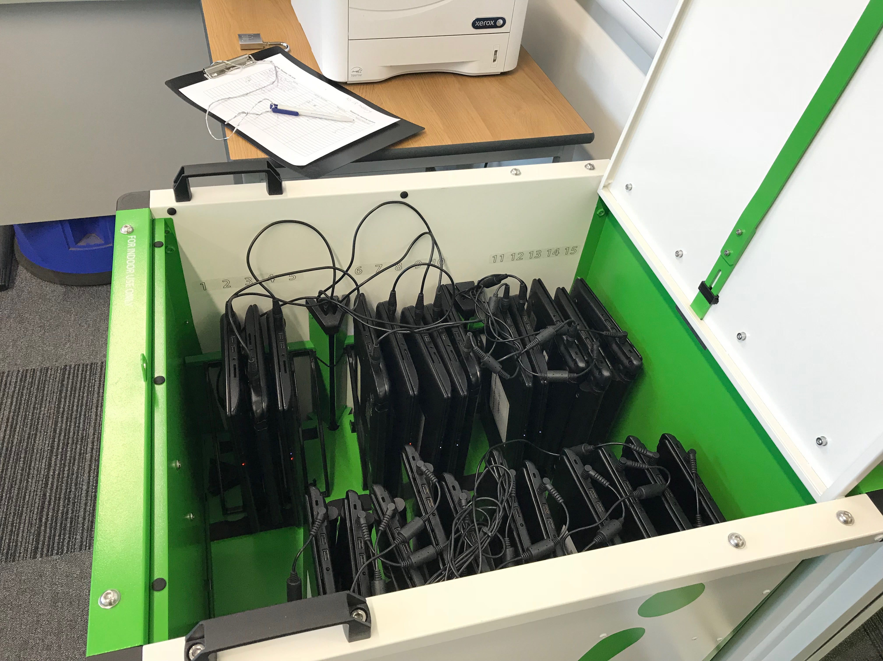
Using IT to Support Learning
Pupils who prefer to word process their written work may borrow a laptop from the SFL department.
Pupils receive training. This may include using IVONA (text to speech software), Office 365 and DocsPlus
Pupils may be encouraged to develop their touch typing skills. Doorway Online is recommended for practice at home.
Pupils may be given training on how to use a digital test paper.
You can bring your own device but it is your responsibility and you cannot access the school Wi-Fi network

Slide 24
A reminder : Two pathways
If your son/daughter is already learning an instrument through the Instrumental Music scheme (IMS) and wants to carry on at Boroughmuir their tuition will automatically continue at Boroughmuir.
All other new S1 pupils (including YMI and other Friday afternoon Music groups) will be given the opportunity to audition for an instrumental place on the IMS. They do not need to have had any prior experience of the instrument. This process will be complete by end of October.

Slide 25

S1 Auditions : Complete by October
Any pupils who have not been offered a place at this point in the year are also given a letter to take home letting them know that they have been put on the waiting list for their chosen instrument.

Slide 26

There are opportunities for ALL S1 to take part in other musical activities…

Slide 27
Questions from our P7 Parents
Classes & Timetable – when will we know?
When will Maths classes change?
How will teachers know about the additional support needs of my child?
What will lunches be like in August?
Will clubs happen before October?
What will blended learning look like?
What technology will be required?
How will school support pupils mental health on return in August?
How will I hear about my child’s progress in learning in S1?
How can parents help?
Thank you to our Parent Councils from Buckstone, Bruntsfield and South Morningside for your help. Any more questions to Ms Presly admin@boroughmuir.edin.sch.uk

