Slide 1
Welcome to Boroughmuir
P7 Parents’ Information Evening
Wednesday 20th June 2018

Slide 2
Welcome to Boroughmuir Mr D Dempster
Our Highlights 2017-18 Film by Mr Boyd
Transition from P7 Into S1 Ms J Presly & S1 Experts
Support for Pupils Mrs H Marshall
Support for Learning Mrs S Hall
Music Tuition Mrs A Clegg
Any Questions?

Slide 3
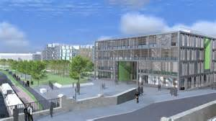
The Big Picture of Transition
260 + P7s becoming S1
Other Non-Cluster Primary Schools

Slide 4
The Transition Process 2017/18
Ongoing: Health and Wellbeing visits
May (last year) P6 Maths Challenge
October: P7 Open Afternoon
December: P7 Christmas Choir
April: Primary Visits by Support for Pupils
May: “FACE of Boroughmuir” Art Project
May : P7 Science Show
May: School of Rugby & Tennis
May/June: Enhanced Transition Group Visits
June: 3 Day Visit

Slide 5
The Transition Process
Visiting primary schools – DHT, Pupils, SfL & SfP
Listen to and work with our primary colleagues
Criteria for Making Our Register Classes
Mixed ability
Aim to keep siblings in same house (new house this year too)
Gender balance
Balance of additional support needs
Several pupils from one school (where possible) in one class
Mandarin – one side of the year group

Slide 6
Creating Classes from our Information
1H1 |  | 1L1 |  | 1V1 |  | 1W1 | 1M1
Practical Sets 1-7 Modern Languages Classes x 4 Maths Classes set (after a few weeks)
1H2 | 1L2 |  | 1V2 |  | 1W2 |  | 1M2 | 1B2
Practical Sets 8-14 Modern Languages Classes x 4 Maths classes set (after a few weeks)

Slide 7
Modern Languages 1+2
All S1s this year will continue with French and German all year
2 periods of French and 1 German until Christmas then swap
2 different teachers to differentiate language
Opportunity in S2 to Specialise more with one main language
All pupils at Boroughmuir continue with a language until S4
We also have a class of 30 doing Mandarin

Slide 8
What does Transition into S1 Look Like & Sound like?
Danny
Sage
Akshat
Redd

Slide 9
A Typical Day
Reg | 1 | 2 | Break | 3 | 4 | Lunch | 5 | 6
8.32-8.45 | 8.45-9.40 | 9.40-10.35 | 10.35-10.50 | 10.50-11.50 | 11.50-12.50 | 12.50-1.35 Clubs Hub Library | 1.35-2.30 | 2.30-3.30
Mon | Science 1.6 | History 1H2 |  | Maths Set | German |  | CDT 1.6 | English 1H2
Tues | Art 1.6 | Home Ec 1.6 |  | Modern Studies 1H2 | Drama 1H2 |  | PE 1H2 | PE 1H2
Fri | PSE 1H2 | English 1H2 |  | Music 1.6 | IT 1H2 |  | Finish at 12.50 on Fridays

Slide 10
Subjects Studied in S1 & Periods Per week
English (4)
Mathematics (4)
Modern Languages (3)
Science (3)
History (1) Geography (1)
Modern Studies (1)
RMPS (1)
Home Economics (1)
Health & Wellbeing (1)
Physical Education (2)
PSE (1)
Art & Design (1)
Craft & Design (1)
Drama (1)
Music (1)
ICT (1)
Business (1)

Slide 11
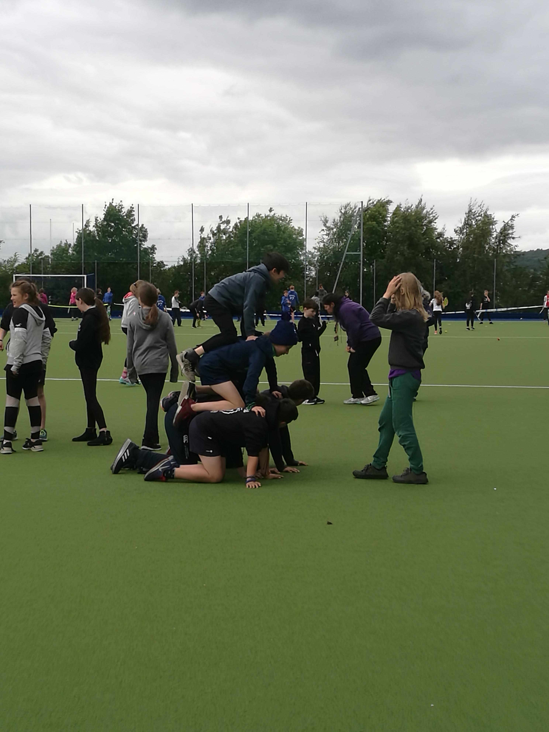
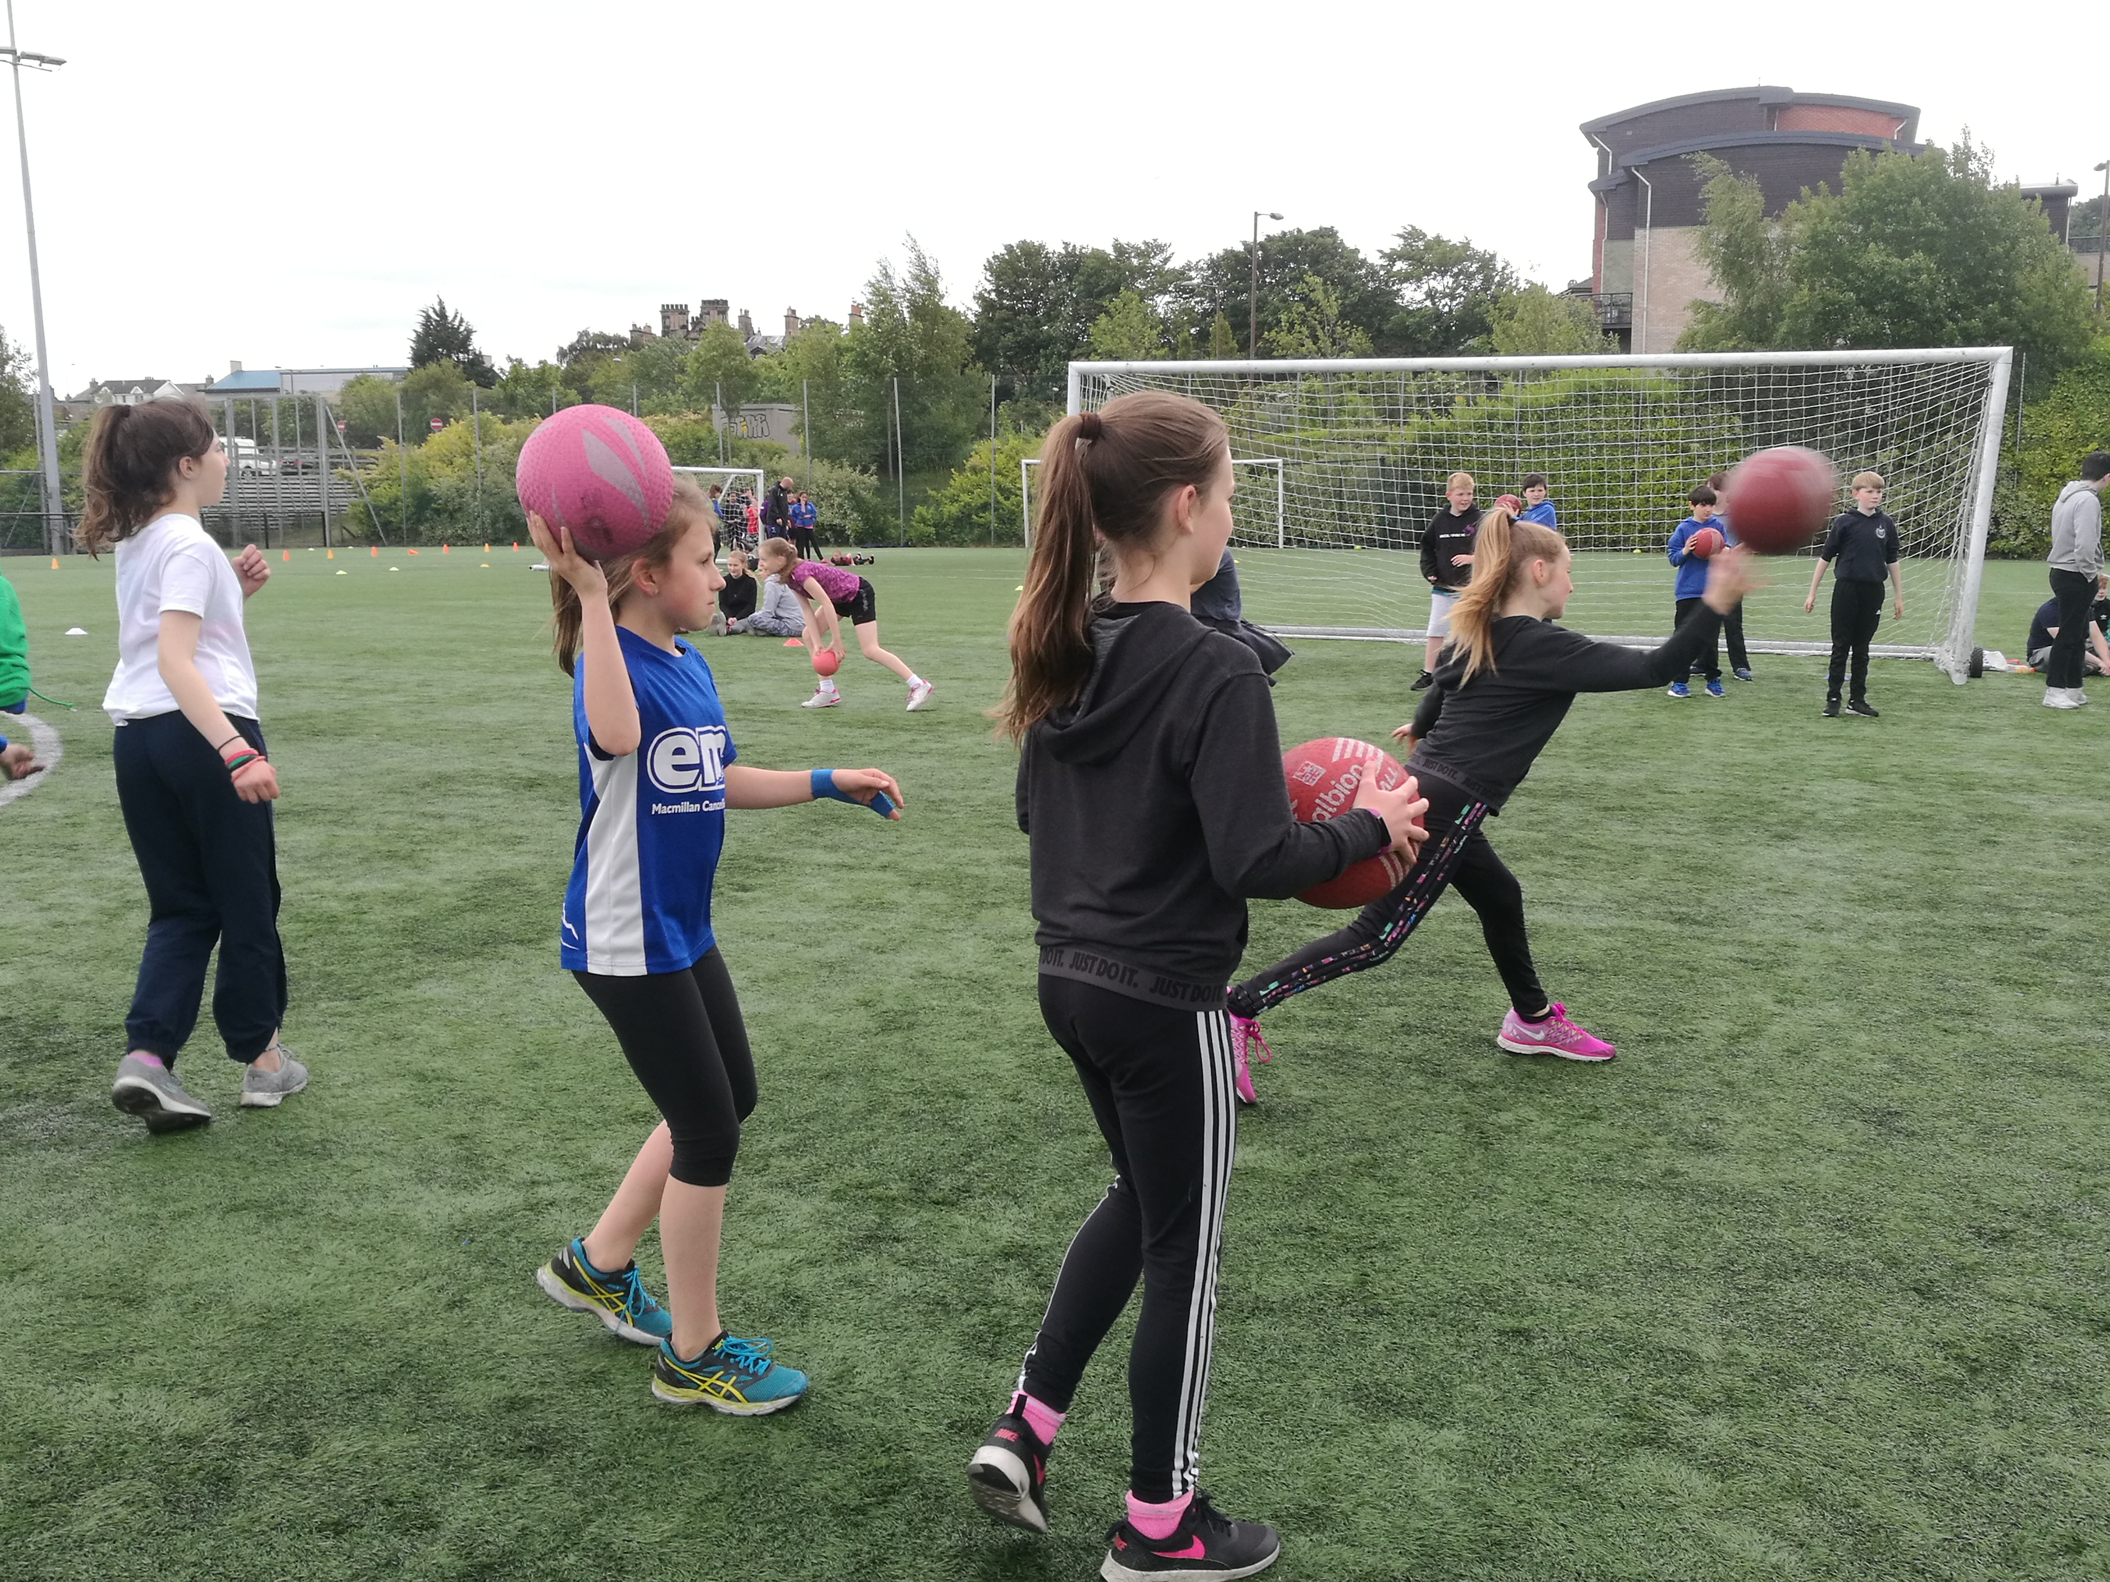
3 Day Visit – Day 1 - Meggetland
We met our new classes and played some rugby
And danced…

Slide 12
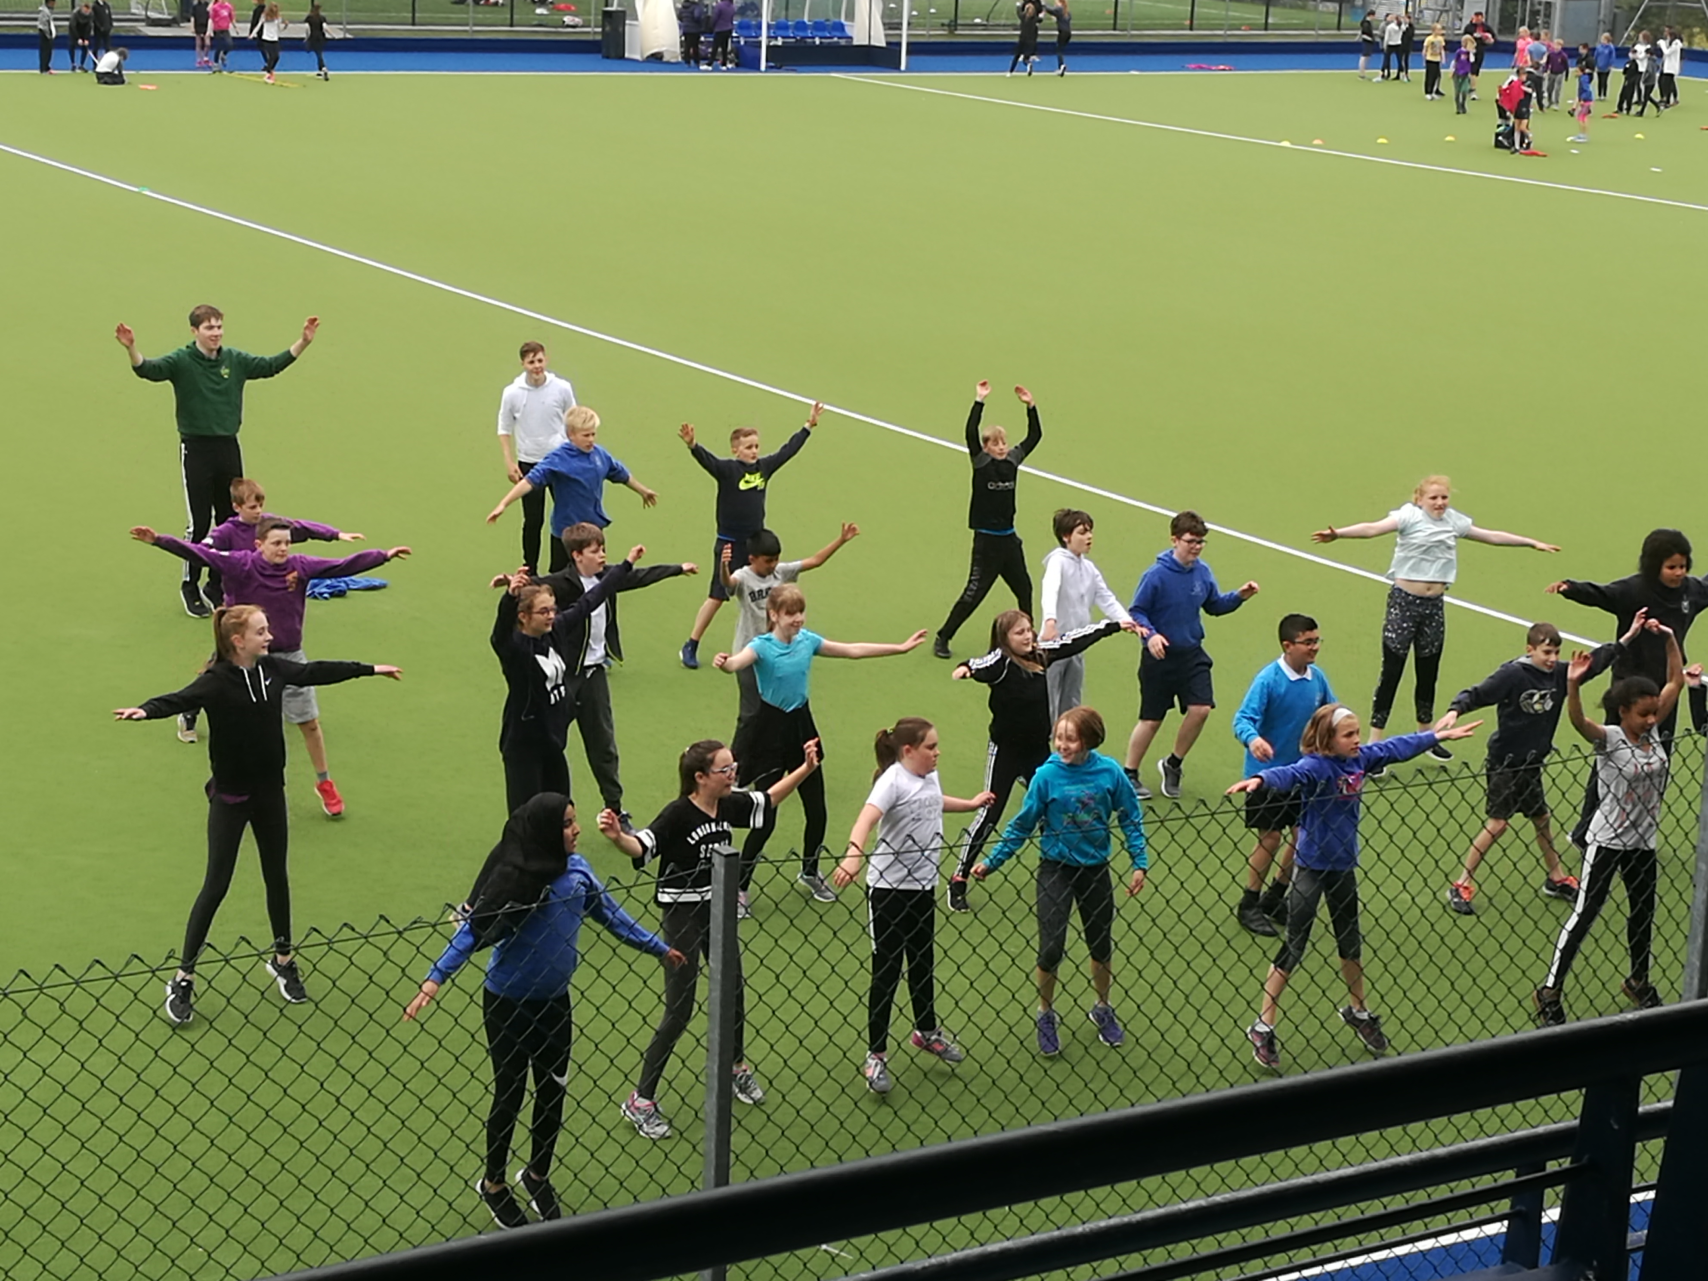
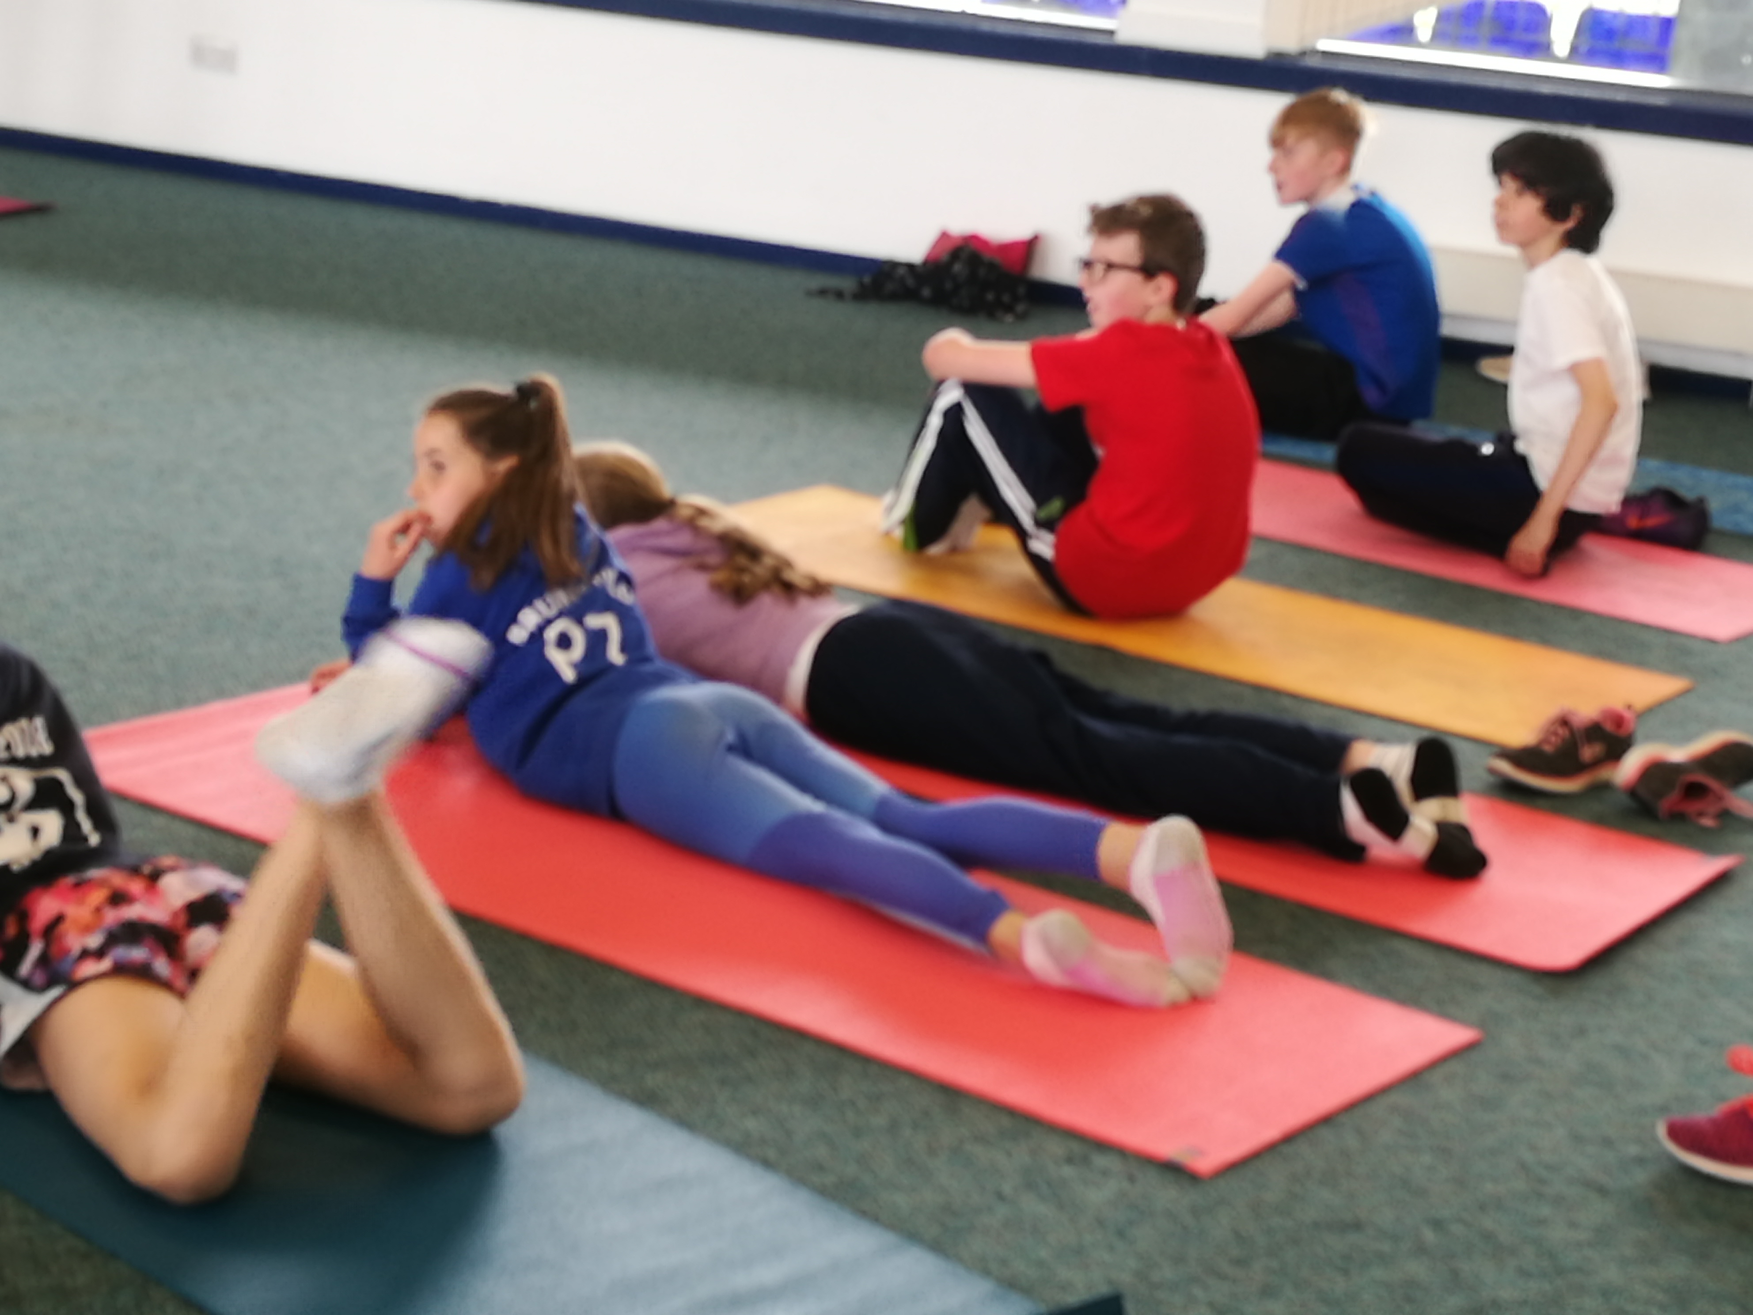
And…
We played football…
And we danced some more…and stretched

Slide 13
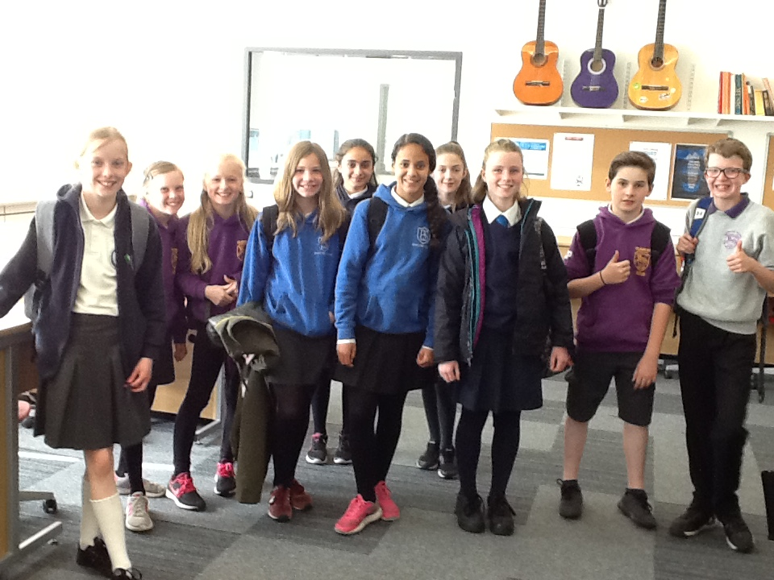
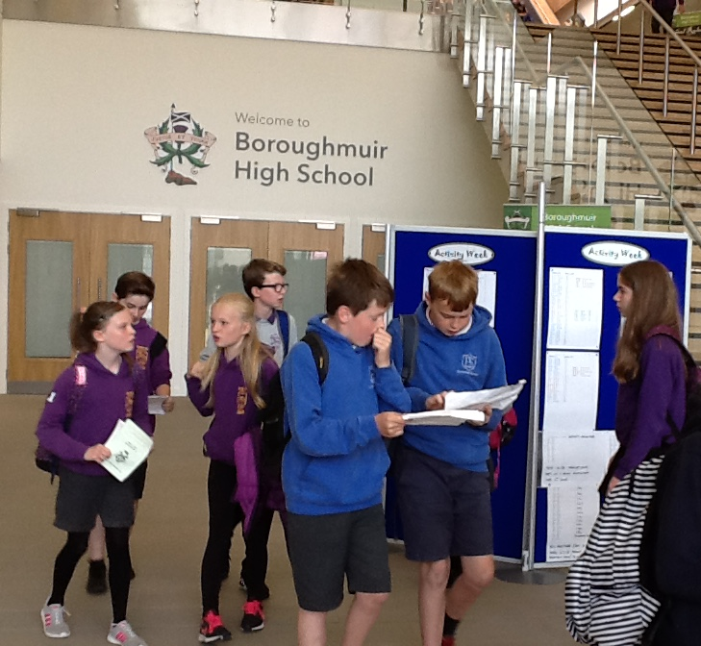
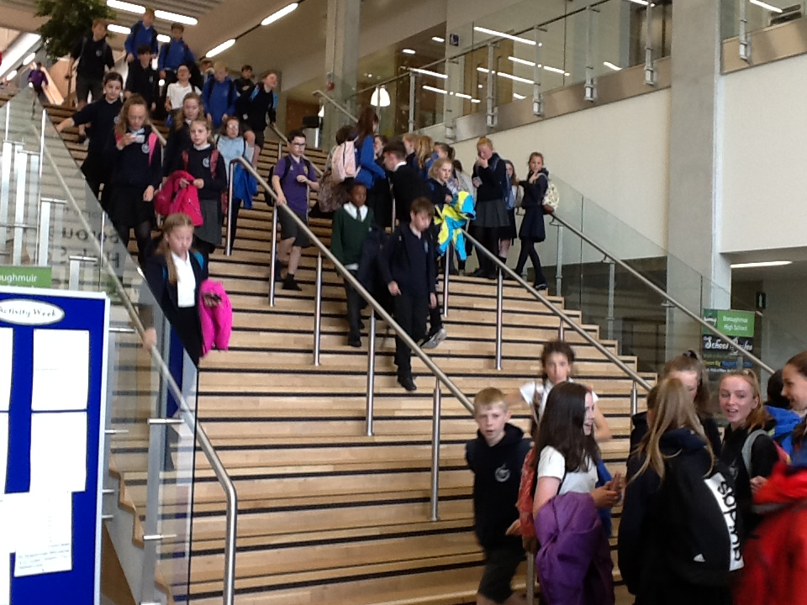
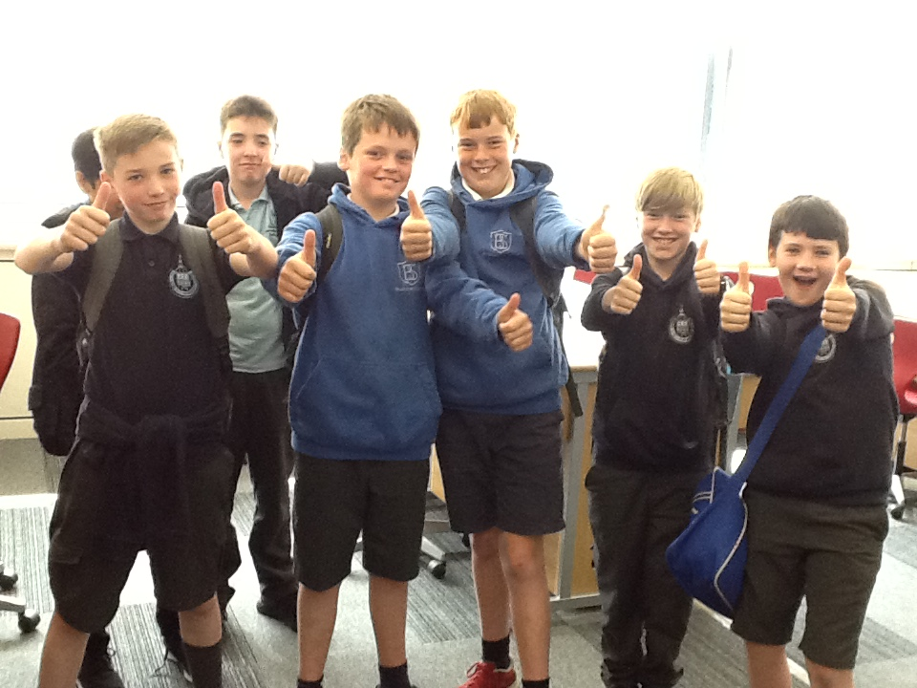
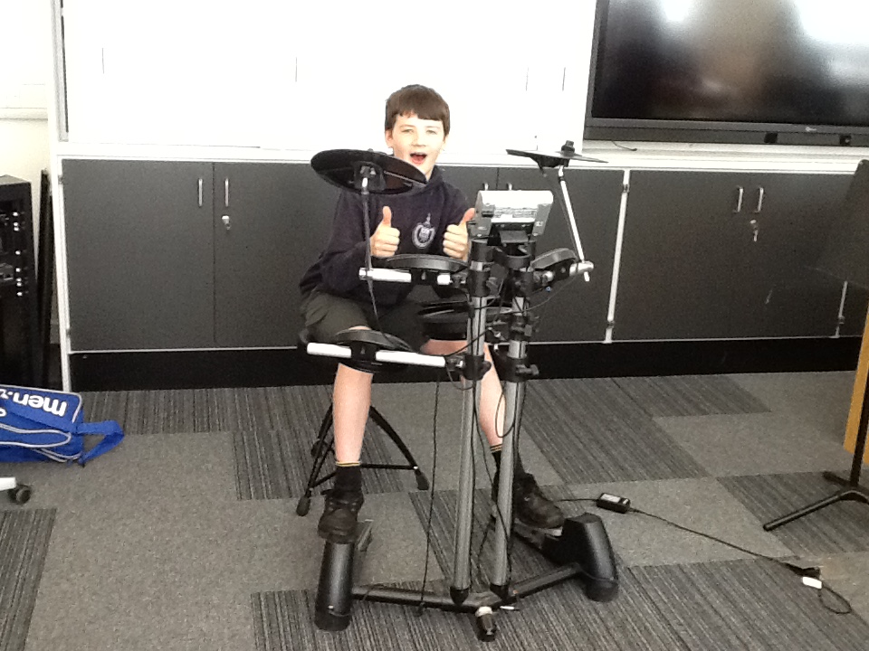
3 Day Visit – Days 2 & 3
First thing is a tour of the school after our assembly.
Then met with Guidance Teachers in PSE
A range of lunchtime clubs were on offer today:
Something Sporty
Something Digital
Something Musical

Slide 14
Extra-curricular Clubs and Activities
Science club Computer / programming club
Creative Writing
music: pupil choir / guitar ensemble / cello ensemble / wind band / Piping, chanting and drumming band
Amnesty International
Enigma Club Friday 7th Sept
Meditation
Dance
Girls’ / boys’ rugby
Football / basketball / badminton / American football / ski race training / running / netball / hockey / dance
Scripture Union
Photography club

Slide 15
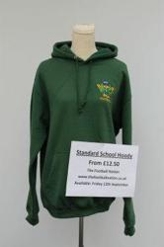
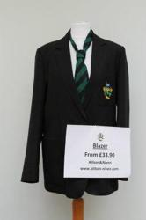
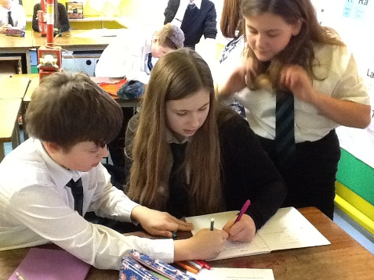
Dress Code
White shirt
Boroughmuir striped tie
School-badged hoodie
Black skirt / trousers
Black school shoes – no trainers or baseball boots
Boroughmuir blazer
Badged Sports t-shirt
Ties available tonight & Information leaflets

Slide 16
Some Useful Dates
S1 Event | Date & Time
First Day at Boroughmuir as S1 Pupils | Wednesday 15th August 8.32am
S1 Welcome Evening – In partnership with Parent council & Numeracy Engagement Event for S1 Parents | Thursday 20th September 7-8pm Numeracy from 6.30pm
Bring Your Parents To School Day – a chance to experience a day in the life of your S1 child. | Thursday 4th October – 8.32am-3pm
S1 & S6 Sponsored Walk around Arthur’s Seat | Friday 12th October – 10.30am -12.50pm
S1 Halloween Party | Thursday 25th October 6.30-8pm
S1 Tracking Report – first snapshot of progress in S1 | Week/beginning 29th October
S1 Parent Consultation Evening | Wednesday 14th November 4.30-7pm
S1 Christmas Party | Thursday 6th December 6.30-8pm

Slide 17
Pupil Support TEAM (Guidance) Your first point of contact & House System
Miss Grant – Hartington – 1H1 or 1H2
Mrs Marshall – Leamington 1L1 or 1L2
Mr Brandie – Viewforth 1V1 or 1V2
Mrs Wallace – Westhall 1W1 or 1W2
Mr McIlwhaine – Montpelier – 1M1 or 1M2
If your child is in 1B2 – Mrs McGinley will be their Register teacher and PSE teacher – they will also have a guidance teacher too.
The system is vertical, therefore the Guidance teacher remains with the pupils throughout their school career.

Slide 18
Aim
Our main aim is to get to know the pupils in our house well, and we do this through delivery of Personal and Social Education to register classes each week and we do this through the following areas:
Mental, Emotional, Social and Physical Wellbeing
Planning for Choices and Change
Relationships, Sexual Health and Parenting
Substance Misuse

Slide 19
Tracking and Monitoring Process
In Pupil Support we also track and monitor pupils progress. We do this through:
Checking homework diaries.
Weekly achievements and targets.
Weekly monitoring attendance and punctuality.
Discussing pupils tracking and full reports – S1 tracking reports – October and March / full report – May.
Discussing overall progress with parents / carers at the consultation evening in December.

Slide 20
Concerns
We respond to concerns that pupils, parents/carers or staff may have and work closely with our colleagues in Support for Learning.
We are happy to liaise with staff on a pupil or parent/carers behalf.
Pupil Support are the first point of contact with the school and can be accessed through the office.
We work in partnership with pupils, parents / carers, staff and all members of the community, in and out of school to promote positive relationships at all times.

Slide 21
Information
All information relating to the school is on the website – boroughmuirhighschool.org
You can follow us on twitter @BoroughmuirHS
Your young person has been issued with an information booklet, please read it and encourage them to read it too! If you have any concerns, please do not hesitate to ask.

Slide 22
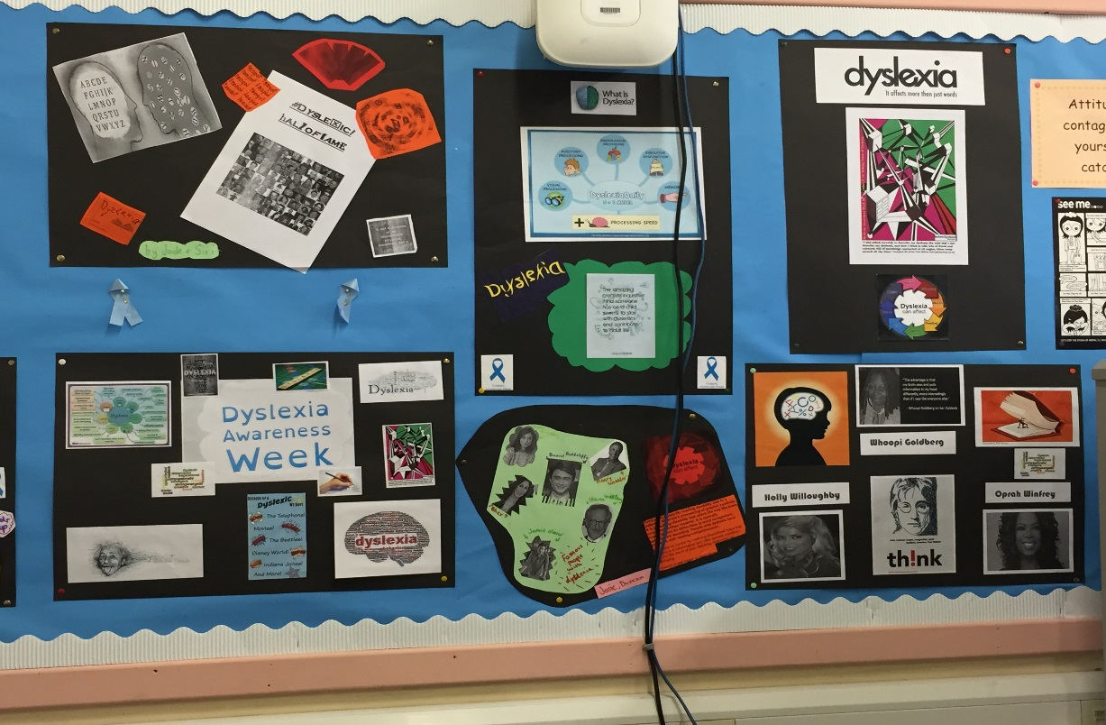
Support for Learning Staff
Support for Learning Leader
- Mrs Haresnape
Support for Learning Teacher
- Mrs Hall
Pupil Support Assistants

Slide 23
SFL Support at Transition We work closely with primary schools to ensure that literacy and numeracy support is continued for individual pupils.
Visit cluster primary schools to meet teachers and pupils
Attend primary school planning meetings during summer term
Talk informally to groups and provide leaflets
Participate in Enhanced Transition events
Plan individual support to meet learning needs using primary school data

Slide 24
Support for Learning at Boroughmuir
In Class Support
Differentiation in the classroom
SFL teachers, Pupil Support Assistants and Sixth Year students help in classes to support Literacy and Numeracy
Literacy Intervention
SFL teachers work with pupils on improving reading skills
PSAs work 1 to 1 on structured literacy programme
SFL Interviews
Pupils are invited to informal settling in interviews
Pupils are invited to discuss their learning profile to ensure to appropriate support strategies are in place
Organisation
Pupils may be invited to join the Organisation Skills Group during registration to help prepare for the school day
Homework Club
Before school and lunch time for help with homework and plan homework tasks.

Slide 25
Supporting Pupils Overcome Barriers to Learning
Dyslexia Support Groups
S1 Peer support group meetings provide an opportunity to discuss literacy issues and successful strategies for dyslexics
Dyslexia Awareness Week
A focus week of events across the school to celebrate dyslexia
Resources
Digital texts are available for qualifying pupils.
Coloured jotters and overlays are available for pupils with visual stress
Library
SFL teachers work closely with the Librarian, experienced in recommending a range of Dyslexia friendly books for loan
Assessment Arrangements
Appropriate support for assessments may include extra time, word processing or use of a digital paper

Slide 26
Using IT to Support Learning
Pupils who prefer to word process their written work may borrow a Toshiba notebook from the library
Pupils receive training. This may include using IVONA text to speech software
Pupils may be encouraged to develop their touch typing skills. Doorway Online is recommended for practice at home.
Pupils may be given training on how to use a digital test paper.

Slide 27
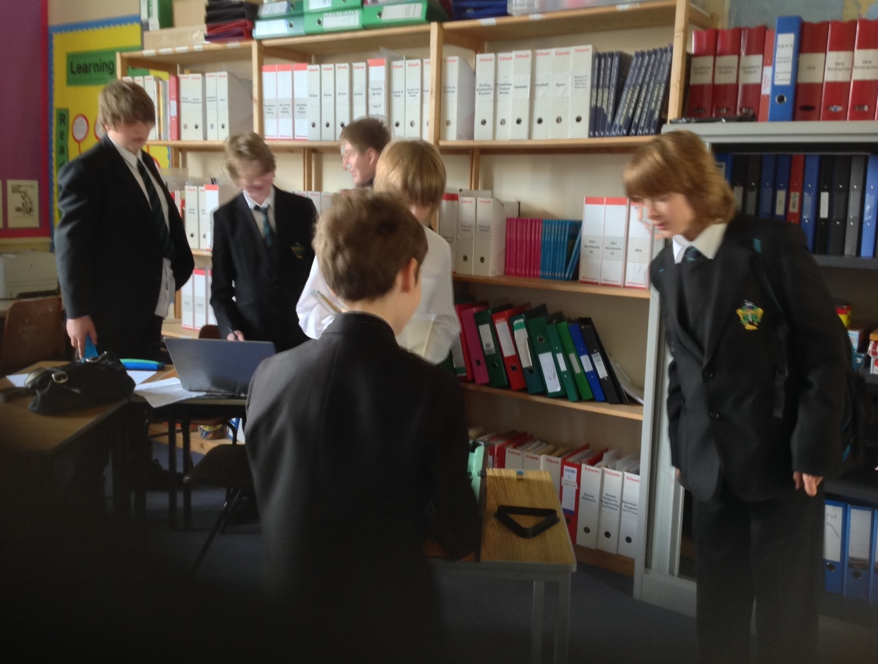
Support during social times
Room 303
Is open to all pupils at break and lunch times providing a supervised, safe and stimulating area for a chat, or to play board games.
The Breakfast Club
This is open before school to help with homework. Pupils can use PC for word processing and research
Homework Club
This a chance to get help with homework and learn how to plan homework tasks

Slide 28
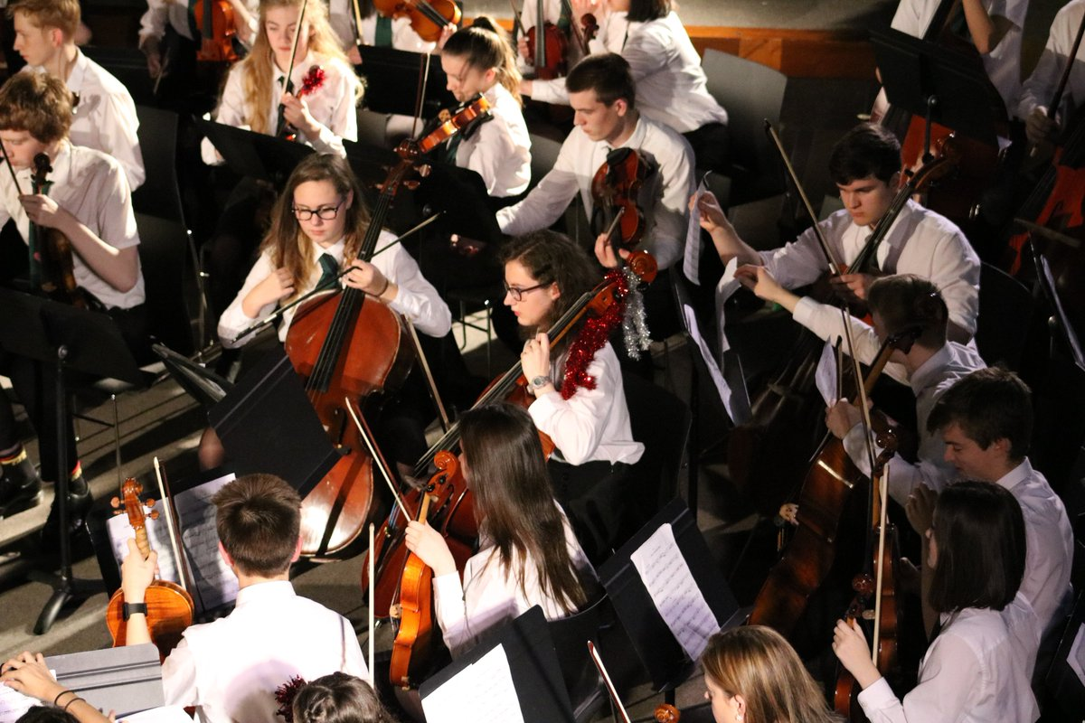
Instrumental Music in Boroughmuir
Notes:
V lucky to have vibrant music dept 14 staff in total, 11 of which instrumental staff
Number instrumental ensembles

Slide 29
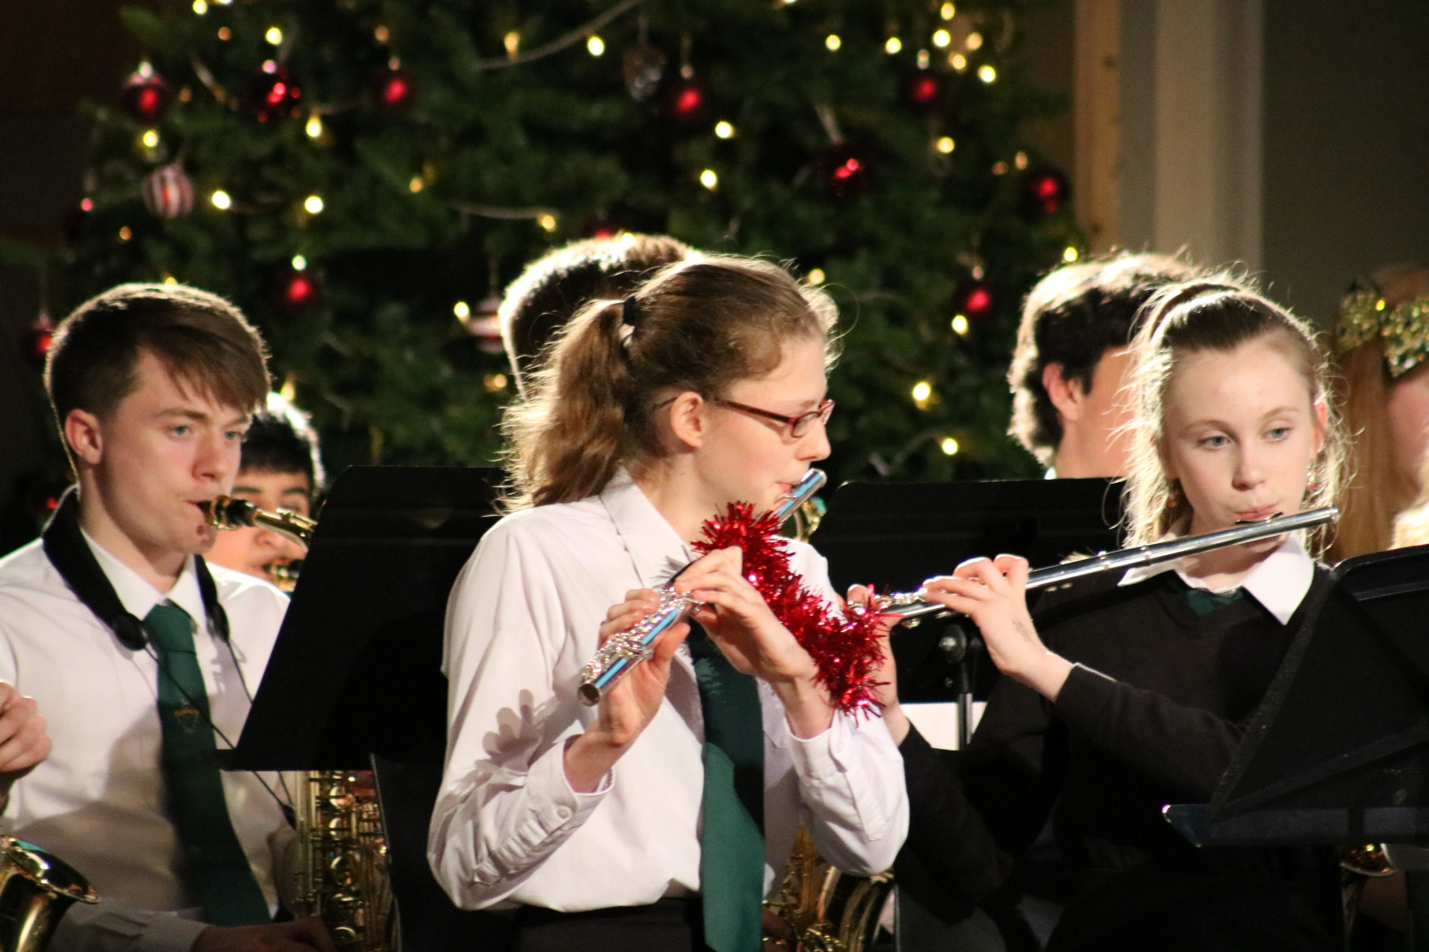

Slide 30
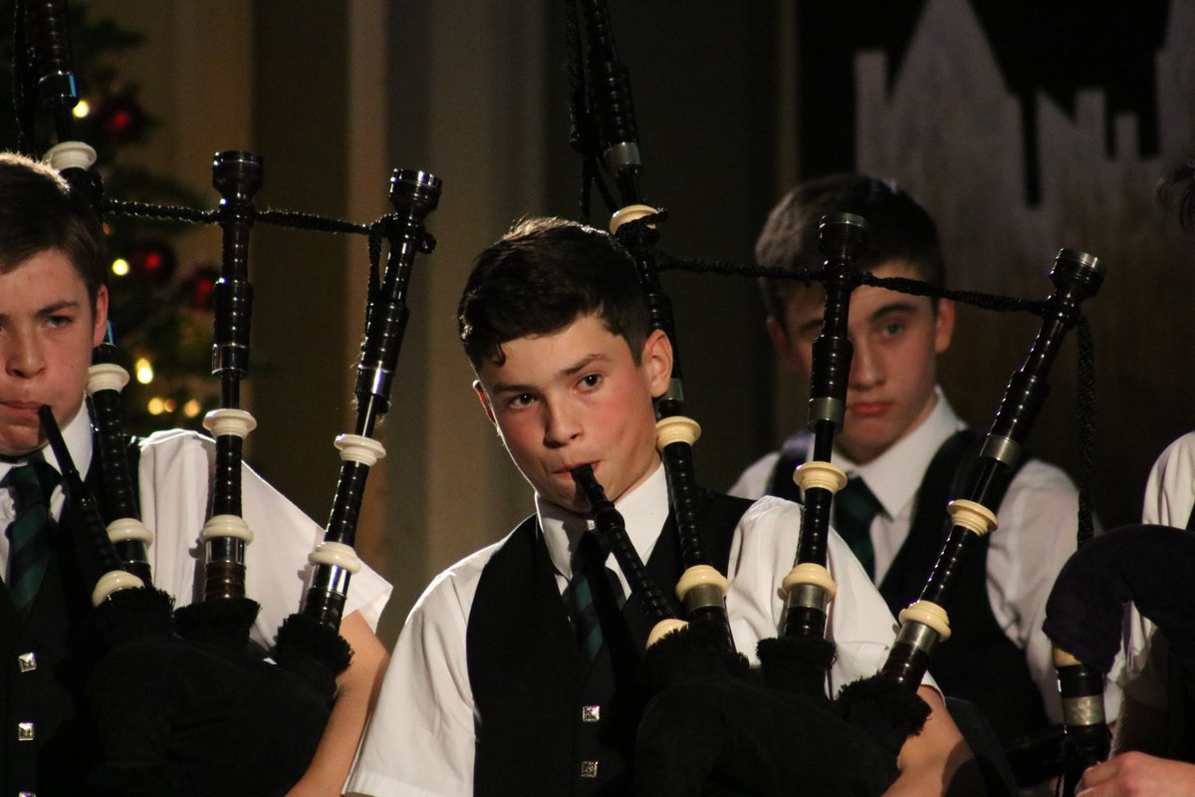

Slide 31
A reminder : Two pathways
If your son/daughter is already learning an instrument through the Instrumental Music scheme (IMS) and wants to carry on at Boroughmuir their tuition has automatically continue at Boroughmuir.
All other new S1 pupils (including YMI and other Friday afternoon Music groups) will be given the opportunity to audition for an instrumental place on the IMS. They do not need to have had any prior experience of the instrument. This process will be complete by 28/9/18.

Slide 32
S1 Auditions : Complete by 28/9/18
If your son/daughter has been successful in being awarded a place on our Instrumental tuition scheme they will have been given a progress diary and letter to take home detailing how the scheme works.
Any pupils who have not been offered a place at this point in the year are also given a letter to take home letting them know that they have been put on the waiting list for their chosen instrument.

Slide 33
There are opportunities for ALL S1 to take part in other musical activities…

Slide 35
We look forward to seeing some of our new S1 perform in the Christmas Concert!

Slide 36
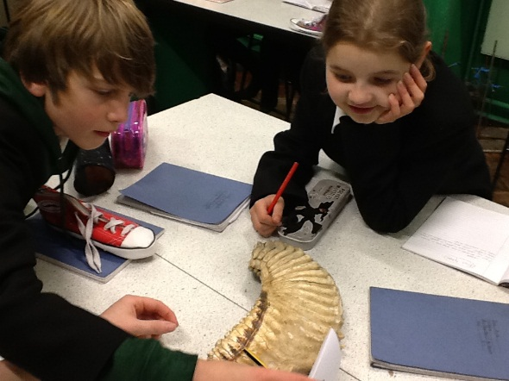
Ties on sale £3
Uniform information and leaflets to collect
We will be around for a wee while.

