Slide 2
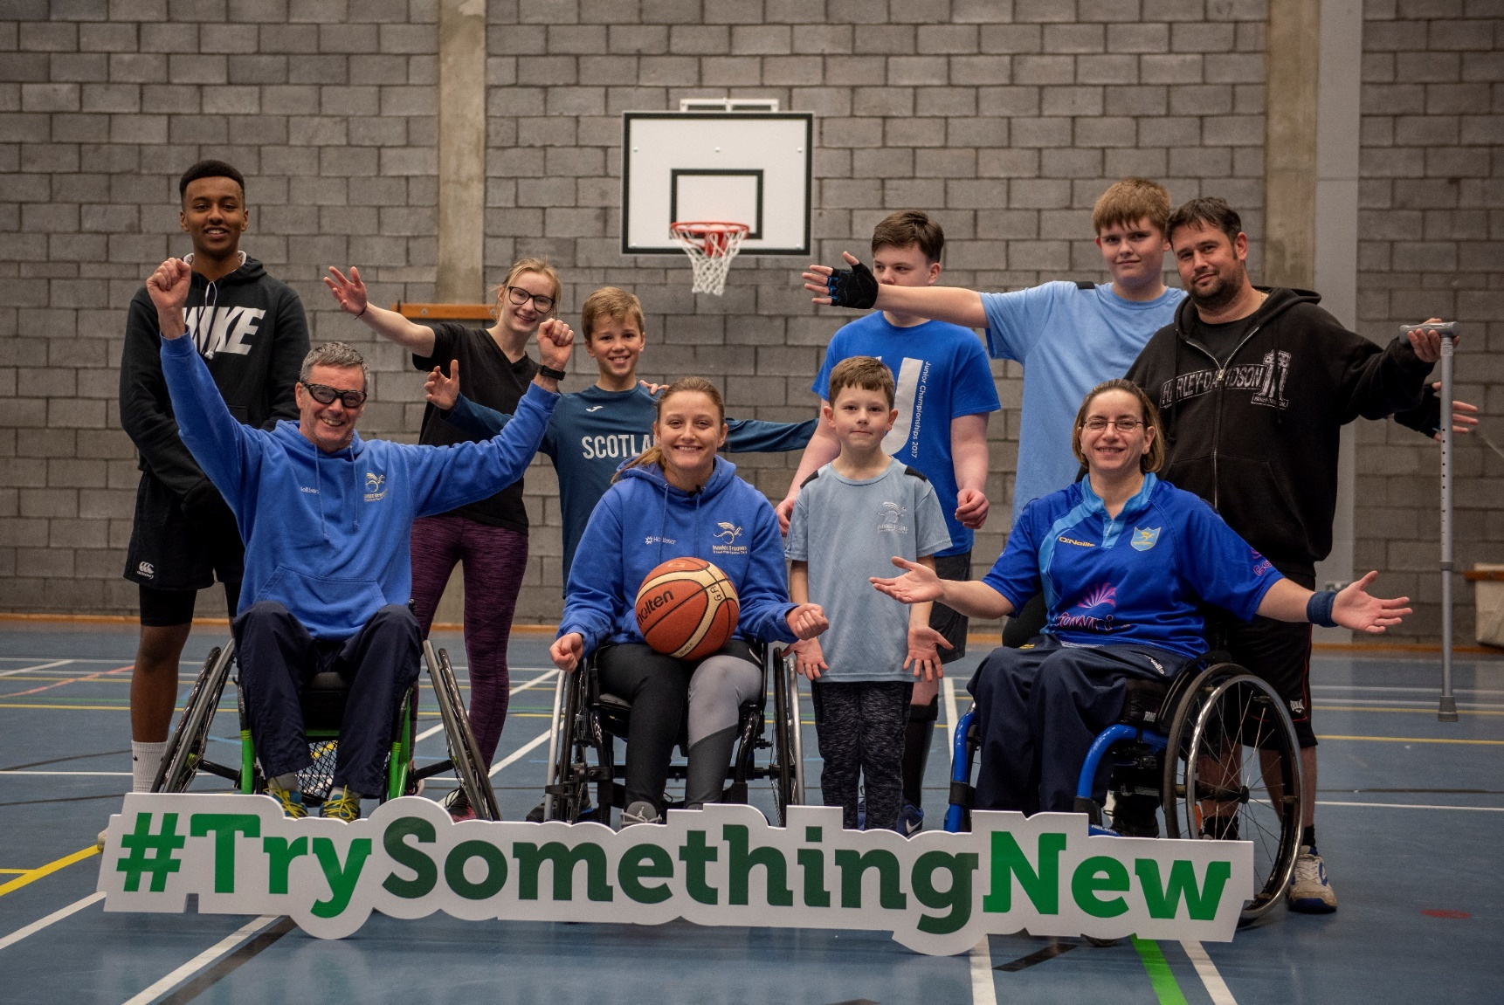
ILF Scotland Transition Fund

Slide 3
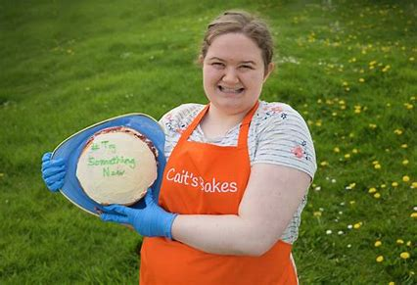
What is the Transition Fund?
The ILF Scotland Transition Fund provides money, for up to one year, to support young disabled people aged 16-25, who are at a transitional stage in their lives.
The Fund helps young disabled people access opportunities that enable them to participate in their communities.

Slide 4
Who can apply?
You can apply for the ILF Scotland Transition Fund if you:
Are between the age of 15 and 21 years old;
Have lived in Scotland for the last 6 months;
Have an impairment or disability (as defined in the Equality Act 2010);
Have less than £26,250 of personal savings.
Although the Fund is not exclusive to people who receive little or no formal social work support, they will be prioritised.

Slide 5
Impairment or disability (as defined in the Equality Act 2010).
You might be eligible for the Transition Fund if:
you have a learning difficulty, dyslexia, dyspraxia or autism.
You have a physical or mental impairment
The impairment has a considerable and long-term adverse effect on your ability to carry out normal day-to-day activities

Slide 6
An impairment doesn’t have to be a diagnosed medical condition:
You may be suffering from stress or you might have mental impairments - like difficulty concentrating - as well as physical impairments such as extreme tiredness and difficulty sleeping
An impairment doesn’t have to stop you doing anything, but may make day-to-day tasks more difficult. It might cause you pain, things may take much longer than they should or you might be unable to do an activity more than once
https://www.citizensadvice.org.uk/law-and-courts/discrimination/protected-characteristics/what-counts-as-disability

Slide 7
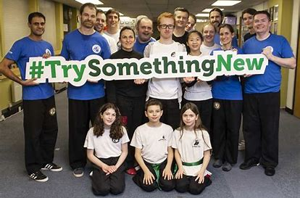
#TrySomethingNew
You can use the money for things like:
art or music lessons or sports coaching
a device or piece of technology to help you in your transition
travel training,
to join a class and/or club,
driving lessons,
training courses.

Slide 8
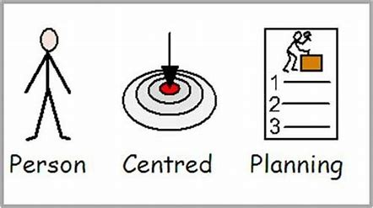
Young Person’s Planning Grant
Not sure what to apply for but want to be part of your community and spend time with other people?
ILF Scotland can provide person centred planning grants to help young people find the support they need
to plan their future and
make and application
to the Transition Fund.

Slide 9
Limits on using the money
Money from the ILF Transition Fund cannot be solely used for these things:
Anything that should be provided by another organisation (Social Work, SAAS, NHS etc)
Personal care
Medical care
Cleaning and domestic duties
Essential safeguarding/adult support and protection.

Slide 10
Transition Fund is a resource for young people 1. Make it a real option at key planning points in their lives 2. Embed it into the transition agenda 3. Consider it alongside other resources

Slide 11
Contact us
Facebook/IndependenLivingFundScotland
@ILFScotland
#TrySomethingNew
Enquiries@ILF.scot

