Slide 1
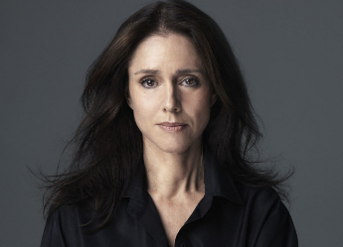
Julie TAYMOR
USA 1952 - Present
Julie Taymor is a successful theatre and film director, designer and producer.
Young Julie Taymor was fond of international folklore and mythology, and also developed a passion for theatre. She spent her formative years living in several countries.
During the 1970s, Taymor lived in Japan, studying the art of puppetry and Japanese theatre.
She spent five years in Indonesia, working as director of international theatre with Asian, European, and American actors.
Back in the USA, she worked on and off Broadway - she achieved her first success with staging a fairy tale, "The King Stag", and then toured 66 cities across the world, including Los Angeles, Venice, Tokyo, and Moscow.
In 1997, Taymor directed a massive Walt Disney Company's production of "The Lion King" on Broadway, for which she also co-designed over 100 costumes and masks of animals, and earned two Tony Awards.

Slide 2
The Lion King – Disney Animated Film
The Lion King is originally a globally popular Disney animated film released in 1994 set in Africa.
It tells the story of Simba, a young lion who is to succeed his father, Mufasa, as king; however, after Simba's uncle Scar murders Mufasa, Simba is manipulated into thinking he was responsible and flees into exile in shame and despair. Simba is given some valuable perspective from his childhood friend, Nala, and his shaman, Rafiki, before returning to challenge Scar to end his tyranny.
It was influenced by Shakespeare's Hamlet.

Slide 3
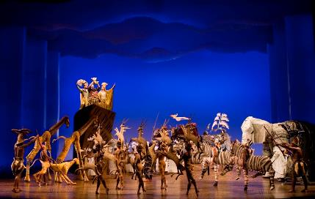
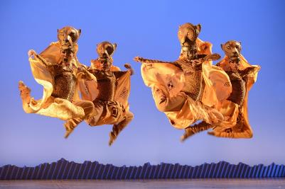
The Lion King – Stage Musical 1997
The Lion King (1997) is Julie Taymor’s major achievement and it allowed her to use all her talents and experiences in working in the theatre.
Julie Taymor was:
Director
Costume Design
Mask/Puppet Co-Design
Additional Lyricist
Being one of the world’s most innovative directors, Taymor brought a vast array of disciplines to THE LION KING, including extensive experience staging epic theatre and opera productions, exploring classic myths through ritualised puppetry, mask, and movement.

Slide 4
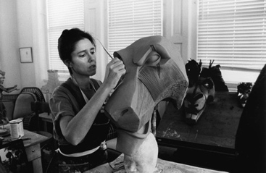
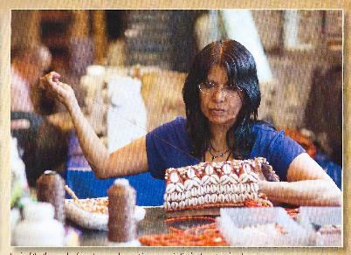
Julie Taymor - Style
Strong background in puppet theatre.
Masks made to look like wood to keep strong African influence, but cast in carbon graphite – strong and lightweight.
Costumes designed from traditional sources with bright colours and elaborate patterns to show the spirit of Africa. Beads were matted to give it the sun kissed look of the African Savannah.
Natural materials (or appearance of natural materials) used in the costumes to represent the Earth and Savannah itself.
Taymor absorbed influences from African tribal designs in the pattern and cloth she used. She also took inspiration from Balinese and Indonesian patterns and designs
Taymor wanted to keep the humanity involved – animals with human characteristics

Slide 5
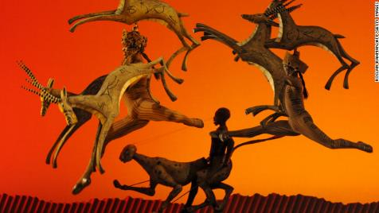
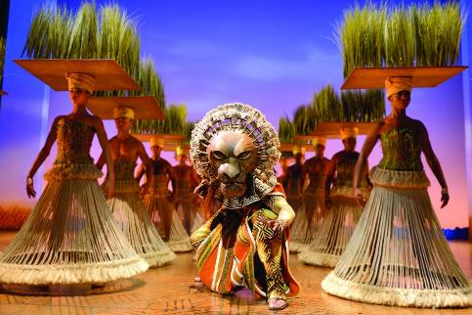
Designing The Lion King for the Stage
It is impossible to replicate an animated film on stage – so Taymor had to be creative and inventive in creating animals and landscape
Key element is the ‘imagination of the audience’
“if you give a little…and let the audience fill in the blanks…they see more” Julie Taymor
Costumes become the scenery or ‘stage architecture’
The Lion King is not set in a particular era – it could be today, it could be 100 years ago – it is timeless.

Slide 6
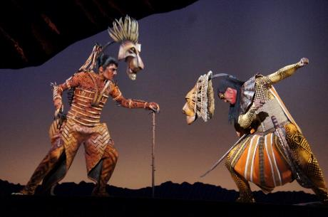
Taymor’s costume designs for The Lion King
All the characters are animals so costumes can’t be ‘real’- you have to suggest the animal through movement and image
The puppets, masks & costumes are key to suggesting the character as well as the animal
Costumes must allow and enhance movement and dance, while being comfortable to wear.
Both actor and mask / puppet are clearly visible to create a ‘double event’ and evoke ‘pure theatre’

Slide 7
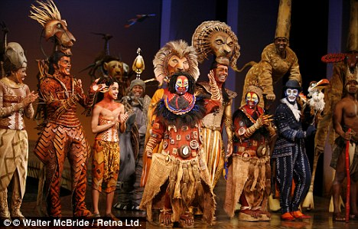
The Lion King costumes- ‘Look’ & Style
The ‘Look’ is hot, sunbaked African plains
Matt, natural colours and materials are used
No sparkly sequins or traditional stage glamour
Natural materials- hand sewn beads, grasses and feathers
Traditional African designs printed from scratch
Based mainly on Africa but with a multi-cultural influence
All the animals/costumes are represented in an original way rather than conforming to a single concept or ‘house style’

Slide 8
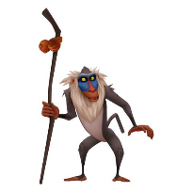
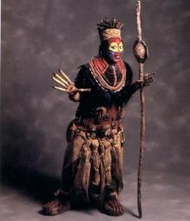
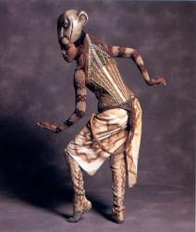
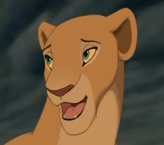
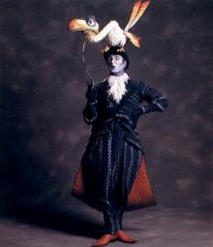
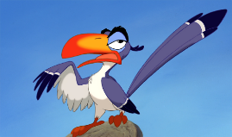
Principal Characters – Animated Film & stage version
Rafiki
Nala
Zazu

Slide 9
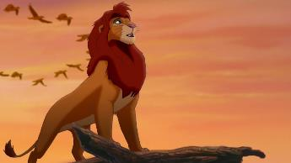
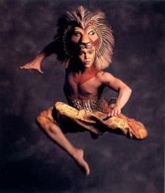
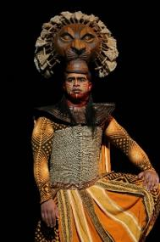
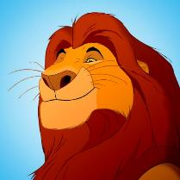
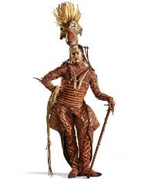
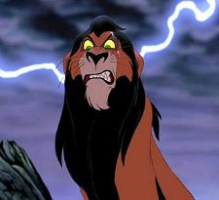
Simba Mufasa Scar

Slide 10
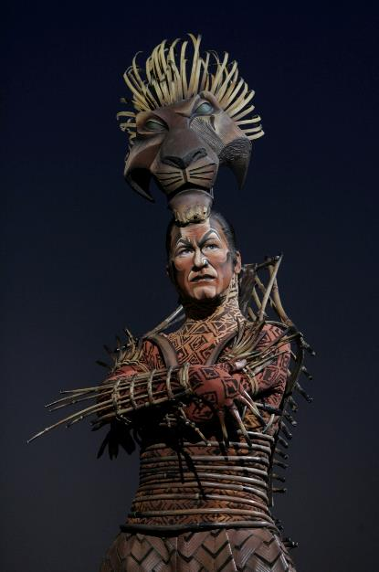
Scar - character
Scar is the main antagonist and younger brother of Mufasa.
Believes he should be on the throne and will stop at nothing to become King of Pride Rock.
He is a dangerous and damaged character, both physically and mentally.
A dark and bitter character – smaller and weaker than Mufasa but sly and evil

Slide 11
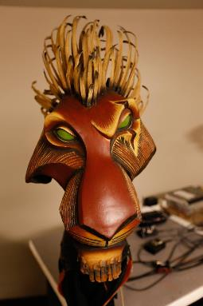
Scar Costume - Mask
Scar’s mask, like Mufasa’s, is mechanically set on his head like a ‘crown’ but can be moved forward on a rail to create dramatic effect and an aggressive, threatening, animal ‘roar’.
Unlike Mufasa’s wholesome, complete shape, Scar’s mask is twisted and asymetrical, with one eyebrow arched, cut away cheekbones and a damaged mane - all suggesting damaged fragility.
A deep scar on the mask is echoed in stage make-up
“Because he is so mis-shapen psychologically I sculpted him with one eyebrow up, and one down, completely twisting his face” - Julie Taymor

Slide 12
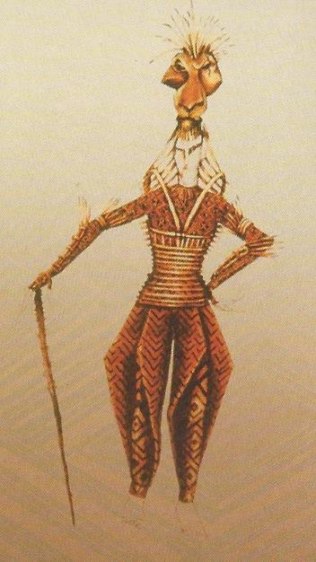
Scar – costume
“Scar is a more active force in the drama and has a wider range of emotions than Mufasa” – Julie Taymor
Jodhpur trousers reflect the English aristocratic gentry – but as a ‘cad’ not a gentleman
His ‘bamboo stick’ costume is a bony, skeletal, fragile construction reflective of the nobility of a Japanese Samurai warrior
The human qualities of the lions come out in the African styled beadwork, corsets, armour and cloth, the costumes use silk cloth to negate the human shape, breaking the shoulder line, enhancing the powerful joints and thighs.

Slide 13
Mufasa - character
Simba’s father and king of the Pridelands
Mufasa is a good leader & teacher cut down his prime – his wholesome spirituality and influence is symbolised by the sun.
The essence of Mufasa is symmetry – he is a very balanced and straight forward personality.
“I designed his mane to form a circle round his head. He is like a sun god – the centre of the universe.” Julie Taymor

Slide 14
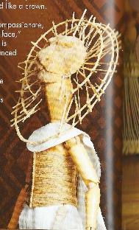
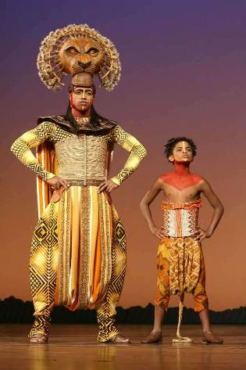
Mufasa - Costume
Mufasa was one of the first costumes designed by Taymor, starting with the distinctive mask – portrayed as an animal but to sit on the head as a crown.
His costume, swords, hair and make-up are all based on traditional Maasai warrior dress with the swords doubling as front legs when on the prowl.
The sun rays started in the mask, made from burnt peacock feathers, are continued in the costume to give rays of strength and leadership
Like Scar’s mask it can move mechanically forward to suggest aggression and the ‘roar’, when the ‘animal’ is more present than the ‘person’

Slide 15
Simba Character
Simba is the protagonist, son of Mufasa and eventually King of Pride Rock.
Simba changes greatly from baby, to child, to runaway in exile, to king. The development from aimless child to responsible leader is shown in elements of the costume design
Portrayed as 3 different types of puppet (hand, rod, shadow) a child actor and an adult actor.

Slide 16
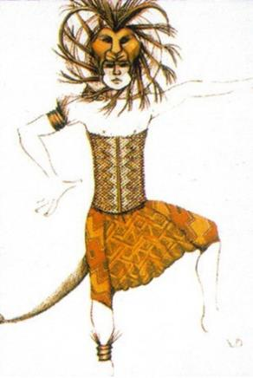
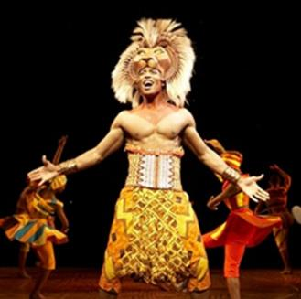
Simba - Costume Design
The Simba mask-headdress is made of carbon graphite, a lightweight but durable material cast from a silicone mold, paint and polyester fibers. The clean white mane feathers suggests purity and youth
Simba’s corset was handmade and includes beadwork of a Maasai warrior with different Balinese elements to show that he is brave, strong and graceful.
Simba’s costume uses brighter and more vibrant colours representing his youth and is contrast to his father Mufasa’s costume.

Slide 17
Zazu - Character Design
Zazu is a bird – a hornbill. He acts as a ‘majordomo’ (a butler / advisor) to the King and is continually trying to organise, advise and interfere in all matters. His actions add humour to the story.
Zazu is a combination of a stage actor and a bird puppet. Taymor calls this a ‘double event’ and it adds interest, humour and depth to the character.
The ‘double-event’ allows the puppet and actor to interact with each other creating a sense of confusion and ‘slapstick’
.

Slide 18
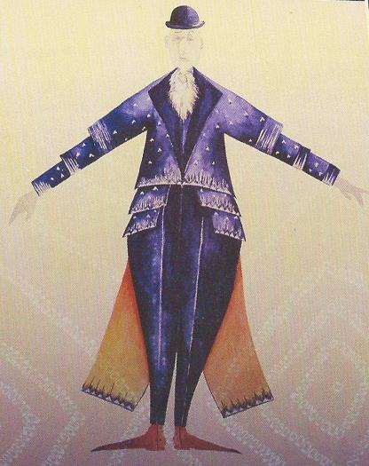
Zazu - Costume
Styled on Western formal dress (coat and tails) but printed in geometric patterned fabric based on African Kuba cloth. This creates a fusion of the African and Englishness of the character
The bowler hat emphasises the majordomo role and is also a perch for the bird
The tails and jacket of the costume are separate but the trousers and vest are made all in one, which allow the actor the ability to move easily.
The coat tails represent bird tail feathers and the neck cravatte the bird’s ruffle
The actor’s costume provides an environment for the character of Zazu to exist, representing the blue sky.

Slide 19
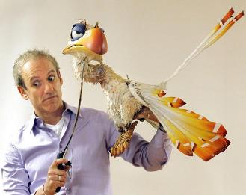
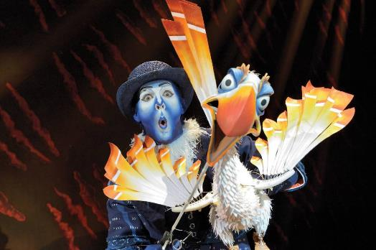
Zazu - Puppet
Zazu puppet is the most technical mask / puppet in the production to build and operate. This allows it the greatest range of emotions
Body made from carbon graphite, feathers from hand-painted parachute silk.
Eyes, neck, beak and wings controlled by actor to enhance and emphasise actor’s features creating greater emotion and gesture.

Slide 20
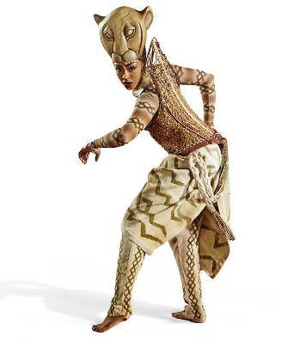
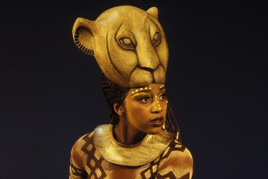
Nala – Character and mask
Nala is Simba’s best friend and playmate from childhood who becomes a strong female character – feisty & brave – who ‘speaks up for the people’ under Scar’s brutal dictatorship.
Her mask is made from lightweight carbon graphite but looks carved traditionally from wood. Being a female lion, it is simpler and more elegant that the male lions.
Like Simba’s the mask is jawless, does not move and and sits on the head like a crown, emphasising youth rather than experience

Slide 21
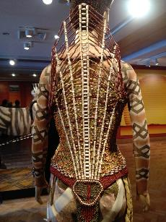
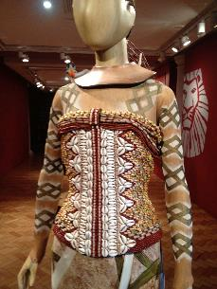
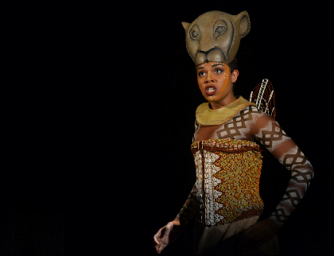
Nala – Costume Design
Nala’s costume contains elements of both Africa and Asia to illustrate the many aspects of her character.
Her costume’s corset is beaded to represent a lion’s white ‘soft’ underbelly, while the beading on her back resembles a Maasai warrior’s ‘harp’ structure indicating strength and bravery.
Her collar and movements come from Bali which add grace and fluidity to her characteristics

Slide 22
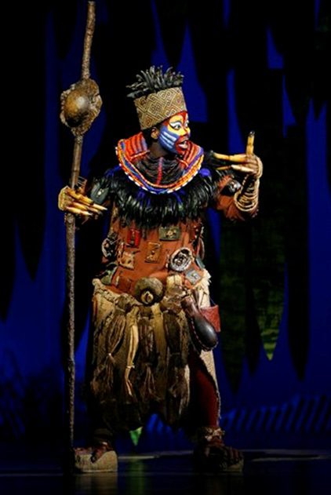
Rafiki - Character
Rafiki is the first character to appear in the stage show and is the most developed from the animated film. She sings the key song “The Circle of Life”
Taymor wanted to create a strong female character (which the film lacked) and this has been achieved through the costume design - keeping the film character of a monkey but adding elements of a traditional Sangoma – a South African spiritual healer and guide that can foresee the future.
Rafiki is spiritual, soulful and mysterious, and guides Simba along the correct path back to become leader of the Pridelands

Slide 23
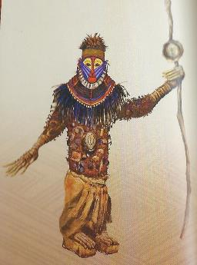
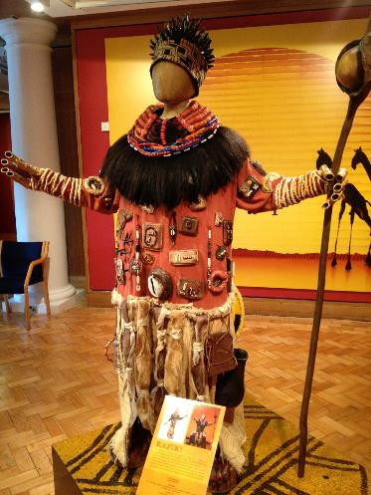
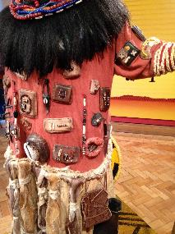
Rafiki - Costume
The costume combines the two aspects – sangoma and monkey
The mandrill characteristics are painted on her face with elongated arms and fingers emphasising a monkey
The body of the costume is decorated with beading, ornaments and trinkets made from natural materials and sewn on to display the sangoma elements of the character

Slide 24
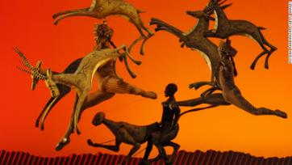
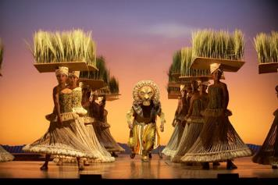
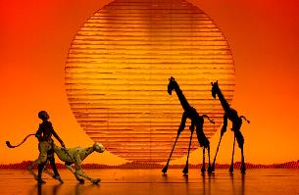
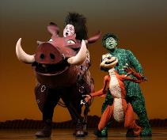
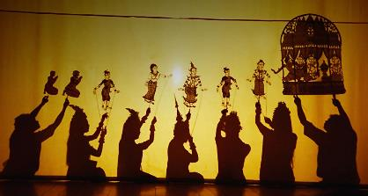
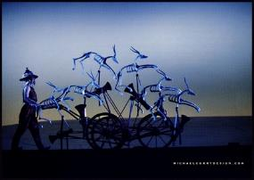
Other Costume designs from The Lion King…
As well as the main characters Taymor’s invention led to the creation of giraffes, elephants, gazelles, birds, cheetahs and many other animals as well as actors playing the grasslands. The experience and imagination of puppetry in all its forms creates a magical and dazzling experience for the audience which brings sensations and ideas to The Lion King well beyond the animated film version - creating ‘total theatre’.

